Slide 1


Chapter 4
Collecting Data
Section 4.2
Experiments

Slide 2
Experiments
Explain the concept of confounding and how it limits the ability to make cause-and-effect conclusions.
Distinguish between an observational study and an experiment, and identify the explanatory and response variables in each type of study.
Identify the experimental units and treatments in an experiment.
Describe the placebo effect and the purpose of blinding in an experiment.

Slide 3
Experiments
Describe how to randomly assign treatments in an experiment using slips of paper, technology, or a table of random digits.
Explain the purpose of comparison, random assignment, control, and replication in an experiment.
Describe a completely randomized design for an experiment.
Describe a randomized block design and a matched pairs design for an experiment and explain the purpose of blocking in an experiment.

Slide 4
Observational Studies Versus Experiments
Sample surveys are one kind of observational study.
Observational studies that examine existing data for a sample of individuals are called retrospective.
Observational studies that track individuals into the future are called prospective.

Slide 5
Observational Studies Versus Experiments
Is taking a vitamin D supplement good for you? Hundreds of observational studies have looked at the relationship between vitamin D concentration in a person’s blood and various health outcomes.
An observational study observes individuals and measures variables of interest but does not attempt to influence the responses.
A response variable measures an outcome of a study.
An explanatory variable may help explain or predict changes in a response variable.
Unfortunately, it is very difficult to show that taking vitamin D causes a lower risk of diabetes using an observational study.

Slide 6
Observational Studies Versus Experiments
Is taking a vitamin D supplement good for you? Hundreds of observational studies have looked at the relationship between vitamin D concentration in a person’s blood and various health outcomes.
Tatiana Popova/Shutterstock.com

Slide 7
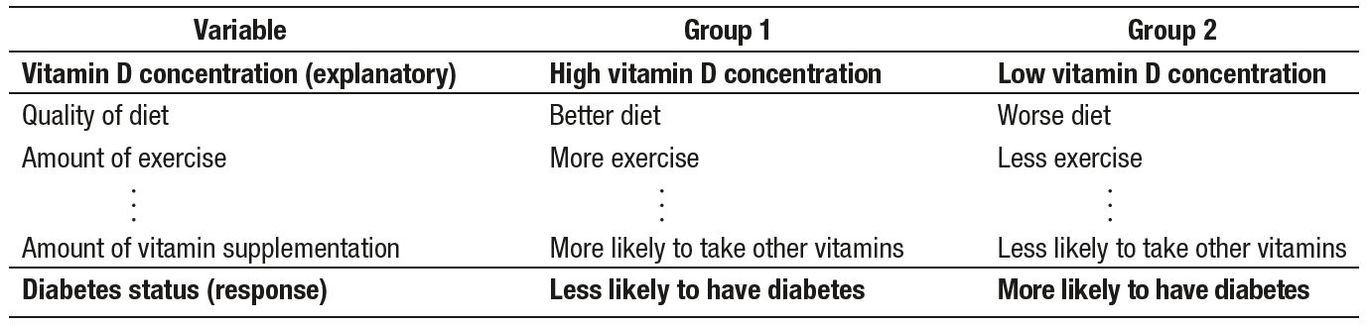
Observational Studies Versus Experiments
Is taking a vitamin D supplement good for you? Hundreds of observational
studies have looked at the relationship between vitamin D concentration in a person’s blood and various health outcomes.
Confounding occurs when two variables are associated in such a way that their effects on a response variable cannot be distinguished from each other.

Slide 8
Observational Studies Versus Experiments
To determine if taking vitamin D actually causes a reduction in diabetes risk, researchers in Norway performed an experiment. The researchers randomly assigned 500 people with pre-diabetes to either take a high dose of vitamin D or to take a placebo—a pill that looked exactly like the vitamin D supplement but contained no active ingredient. After 5 years, about 40% of the people in each group were diagnosed with diabetes.
Tatiana Popova/Shutterstock.com

Slide 9
Observational Studies Versus Experiments
To determine if taking vitamin D actually causes a reduction in diabetes risk, researchers in Norway performed an experiment. The researchers randomly assigned 500 people with pre-diabetes to either take a high dose of vitamin D or to take a placebo—a pill that looked exactly like the vitamin D supplement but contained no active ingredient. After 5 years, about 40% of the people in each group were diagnosed with diabetes.
An experiment deliberately imposes some treatment on individuals to measure their responses.
A placebo is a treatment that has no active ingredient, but is otherwise like other treatments.

Slide 10
The Language of Experiments
An experiment is a statistical study in which we actually do something (a treatment) to people, animals, or objects (the experimental units or subjects) to observe the response.
A specific condition applied to the individuals in an experiment is called a treatment. If an experiment has several explanatory variables, a treatment is a combination of specific values of these variables.
An experimental unit is the object to which a treatment is randomly assigned. When the experimental units are human beings, they are often called subjects.

Slide 11
The Language of Experiments
Malaria causes hundreds of thousands of deaths each year, with many of the victims being children. Will regularly screening children for the malaria parasite and treating those who test positive reduce the proportion of children who develop the disease? Researchers worked with children in 101 schools in Kenya, randomly assigning half of the schools to receive regular screenings and follow-up treatments and the remaining schools to receive no regular screening. Children at all 101 schools were tested for malaria at the end of the study.
Identify the treatments and the experimental units in this experiment.
Alexander Joe/Getty Images

Slide 12
The Language of Experiments
Malaria causes hundreds of thousands of deaths each year, with many of the victims being children. Will regularly screening children for the malaria parasite and treating those who test positive reduce the proportion of children who develop the disease? Researchers worked with children in 101 schools in Kenya, randomly assigning half of the schools to receive regular screenings and follow-up treatments and the remaining schools to receive no regular screening. Children at all 101 schools were tested for malaria at the end of the study.
Identify the treatments and the experimental units in this experiment.
Experimental units:
The 101 schools in Kenya
Treatments:
Regular screenings and follow-up treatments
No regular screening

Slide 13
The Language of Experiments
Researchers from Rutgers University put the five-second rule to the
test. They used four different types of food: watermelon, bread, bread
with butter, and gummy candy. They dropped the food onto four different surfaces: stainless steel, ceramic tile, wood, and carpet. And they waited for four different lengths of time: less than 1 second, 5 seconds, 30
seconds, and 300 seconds. Finally, they used bacteria prepared two different ways: in a tryptic soy broth or peptone buffer. Once the bacteria were ready, the researchers spread them out on the different surfaces and
started dropping food.
List the factors in this experiment and the number of levels for each factor..
In an experiment, a factor is a variable that is manipulated and may cause a change in the response variable. The different values of a factor are called levels.
Zaia Snively

Slide 14
The Language of Experiments
Researchers from Rutgers University put the five-second rule to the
test. They used four different types of food: watermelon, bread, bread
with butter, and gummy candy. They dropped the food onto four different surfaces: stainless steel, ceramic tile, wood, and carpet. And they waited for four different lengths of time: less than 1 second, 5 seconds, 30
seconds, and 300 seconds. Finally, they used bacteria prepared two different ways: in a tryptic soy broth or peptone buffer. Once the bacteria were ready, the researchers spread them out on the different surfaces and
started dropping food.
List the factors in this experiment and the number of levels for each factor..
Type of food (4 levels)
Type of surface (4 levels)
Amount of time (4 levels)
Method of bacterial prep (2 levels)
Zaia Snively

Slide 15
Designing Experiments: Comparison
Good designs are essential for effective experiments, just as they are for sampling. To see why, let’s start with an example of a bad experimental design.
Experimental Units
Treatment
Measure Response
In this design, there are many other variables (besides the treatment) that are potentially confounded with taking caffeine.
The remedy for potential confounding is to do a comparative experiment with two or more groups.

Slide 16
Designing Experiments: Comparison
In an experiment, a control group is used to provide a baseline for comparing the effects of other treatments. Depending on the purpose of the experiment, a control group may be given an inactive treatment (placebo), an active treatment, or no treatment at all.
Eric O’Connell/Getty Images

Slide 17
Designing Experiments: Comparison
In an experiment, a control group is used to provide a baseline for comparing the effects of other treatments. Depending on the purpose of the experiment, a control group may be given an inactive treatment (placebo), an active treatment, or no treatment at all.
In all other aspects, the treatment groups should be treated exactly the same so that the only difference is the treatments.
This way, if there is convincing evidence of a difference in the average response, we can safely conclude it was caused by the treatments.

Slide 18
Designing Experiments:
Blinding and the Placebo Effect
The placebo effect describes the fact that some subjects in an experiment will respond favorably to any treatment, even an inactive treatment.
In a double-blind experiment, neither the subjects nor those who interact with them and measure the response variable know which treatment a subject received.
In a single-blind experiment, either the subjects don’t know which treatment they are receiving or the people who interact with them and measure the response variable don’t know which subjects are receiving which treatment.

Slide 19
Designing Experiments: Random Assignment
To create roughly equivalent groups at the beginning of an experiment, we use random assignment to determine which experimental units get which treatment.
In an experiment, random assignment means that experimental units are assigned to treatments using a chance process.

Slide 20
Designing Experiments: Random Assignment
A total of 20 students have agreed to participate in an experiment comparing the effects of caffeinated cola and caffeine-free cola on pulse rates. Describe how you would randomly assign 10 students to each of the two treatments:
(a) Using 20 identical slips of paper
(b) Using technology
(c) Using Table D.
Zaia Snively

Slide 21
Designing Experiments: Random Assignment
A total of 20 students have agreed to participate in an experiment comparing the effects of caffeinated cola and caffeine-free cola on pulse rates. Describe how you would randomly assign 10 students to each of the two treatments:
(a) Using 20 identical slips of paper
(b) Using technology
(c) Using Table D.
(a) On 10 slips of paper, write the letter “A”; on the remaining 10 slips, write the letter “B.” Shuffle the slips of paper and hand out one slip of paper to each volunteer. Students who get an “A” slip receive the cola with caffeine and students who get a “B” slip receive the cola without caffeine.

Slide 22
Designing Experiments: Random Assignment
A total of 20 students have agreed to participate in an experiment comparing the effects of caffeinated cola and caffeine-free cola on pulse rates. Describe how you would randomly assign 10 students to each of the two treatments:
(a) Using 20 identical slips of paper
(b) Using technology
(c) Using Table D.
(b) Label each student with a different integer from 1 to 20. Then randomly generate 10 different integers from 1 to 20. The students with these labels receive the cola with caffeine. The remaining 10 students receive the cola without caffeine.

Slide 23
Designing Experiments: Random Assignment
A total of 20 students have agreed to participate in an experiment comparing the effects of caffeinated cola and caffeine-free cola on pulse rates. Describe how you would randomly assign 10 students to each of the two treatments:
(a) Using 20 identical slips of paper
(b) Using technology
(c) Using Table D.
(c) Label each student with a different integer from 01 to 20. Go to a line of Table D and read two-digit groups moving from left to right. The first 10 different labels between 01 and 20 identify the 10 students who receive cola with caffeine. The remaining 10 students receive the caffeine-free cola. Ignore groups of digits from 21 to 00.

Slide 24
Designing Experiments: Control
In an experiment, control means keeping other variables constant for all experimental units.
After randomly assigning treatments and controlling other variables, treatment groups should be about the same, except for the treatments. Then a difference in the average response must be due either to the treatments themselves or to the random assignment.
We can’t say that any difference in average response between treatment groups must be caused by the treatments because there would likely be some difference just because the random assignment is unlikely to produce two groups that are exactly equivalent.

Slide 25

Designing Experiments: Replication
In an experiment, replication means using enough experimental units to
distinguish a difference in the effects of the treatments from chance variation due to the random assignment.
CAUTION:
In statistics, replication means “use enough subjects.” In other fields, the term replication has a different meaning.

Slide 26
Experiments: Putting It All Together
Principles of Experimental Design
The basic principles for designing experiments are as follows:
Comparison. Use a design that compares two or more treatments.
Random assignment. Use chance to assign experimental units to treatments. Doing so helps create roughly equivalent groups of experimental units by balancing the effects of other variables among the treatment groups.
Control. Keep other variables the same for all groups, especially variables that are likely to affect the response variable. Control helps avoid confounding and reduces variability in the response variable.
Replication. Use enough experimental units in each group so that any differences in the effects of the treatments can be distinguished from chance differences between the groups.

Slide 27
Completely Randomized Designs
In a completely randomized design, the experimental units are assigned to the treatments completely by chance.
Group 1
Treatment 1
Compare response variable
Experimental units
Random assignment
Group 2
Treatment 2

Slide 28
Randomized Block Designs
A block is a group of experimental units that are known before the experiment to be similar in some way that is expected to affect the response to the treatments.
In a randomized block design, the random assignment of experimental units to treatments is carried out separately within each block.
Using a randomized block design allows us to account for the variation in the response that is due to the blocking variable. This makes it easier to determine if one treatment is really more effective than the other.
When blocks are formed wisely, it is easier to find convincing evidence that one treatment is more effective than another.

Slide 29
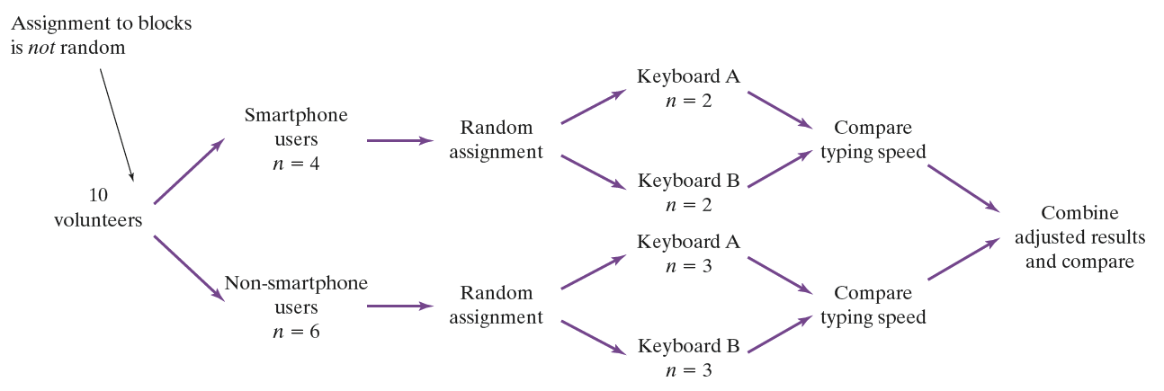
Randomized Block Designs

Slide 30
Randomized Block Designs
A matched pairs design is a common experimental design for comparing two treatments that uses blocks of size 2. In some matched pairs designs, two very similar experimental units are paired and the two treatments are randomly assigned within each pair. In others, each experimental unit receives both treatments in a random order.
The idea is to create blocks by matching pairs of similar experimental units. Just as with other forms of blocking, matching helps account for the variation due to the variable(s) used to form the pairs.

Slide 31
Section Summary
Explain the concept of confounding and how it limits the ability to make cause-and-effect conclusions.
Distinguish between an observational study and an experiment, and identify the explanatory and response variables in each type of study.
Identify the experimental units and treatments in an experiment.
Describe the placebo effect and the purpose of blinding in an experiment.

Slide 32
Section Summary
Describe how to randomly assign treatments in an experiment using slips of paper, technology, or a table of random digits.
Explain the purpose of comparison, random assignment, control, and replication in an experiment.
Describe a completely randomized design for an experiment.
Describe a randomized block design and a matched pairs design for an experiment and explain the purpose of blocking in an experiment.

