Slide 1


Chapter 4
Collecting Data
Section 4.3
Using Studies Wisely

Slide 2
Using Studies Wisely
Explain the concept of sampling variability when making an inference about a population and how sample size affects sampling variability.
Explain the meaning of statistically significant in the context of an experiment and use simulation to determine if the results of an experiment are statistically significant.
Identify when it is appropriate to make an inference about a population and when it is appropriate to make an inference about cause and effect.
Evaluate if a statistical study has been carried out in an ethical manner.*

Slide 3
Inference for Sampling
When the members of a sample are selected at random from a population, we can use the sample results to make inferences about the population.
Even when making an inference from a random sample, it would be surprising if the estimate from the sample was exactly equal to the truth about the population.
Sampling variability refers to the fact that different random samples of the same size from the same population produce different estimates.

Slide 4
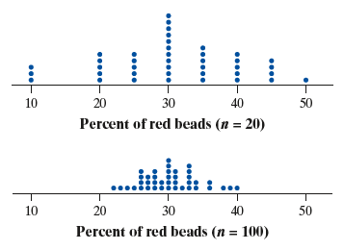
Inference for Sampling
Sampling Variability and Sample Size
Larger random samples tend to produce estimates that are closer to the true population value than smaller random samples. In other words, estimates from larger samples are more precise.

Slide 5
Inference for Sampling
How much do National Football League (NFL) players weigh, on average? In a random sample of 50 NFL players, the average weight is 244.4 pounds.
Do you think that 244.4 pounds is the true average weight of all NFL players? Explain your answer.
No. Different samples of size 50 would produce different average weights. So it would be surprising if this estimate is equal to the true average weight of all NFL players.
Diamond Images/Getty Images

Slide 6
Inference for Sampling
How much do National Football League (NFL) players weigh, on average? In a random sample of 50 NFL players, the average weight is 244.4 pounds.
Do you think that 244.4 pounds is the true average weight of all NFL players? Explain your answer.
Which would be more likely to give an estimate close to the true average weight of all NFL players: a random sample of 50 players or a random sample of 100 players? Explain your answer.
(b) A random sample of 100 players, because estimates tend to be closer to the truth when the sample size is larger.
Diamond Images/Getty Images

Slide 7
Inference for Experiments
Well-designed experiments allow for inferences about cause and effect.
In an experiment, there are two ways to explain why the average response for one group is different than the average response for another group:
The treatment does not have a different effect for the groups, and the difference in the response happened because of chance variation in the random assignment.
The treatment causes a difference in the average response of the groups.
When the observed results of a study are too unusual to be explained by chance alone, the results are called statistically significant.

Slide 8
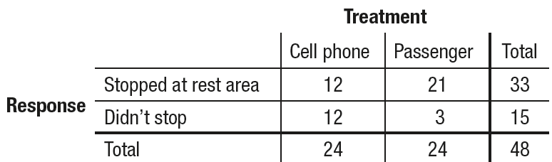
Inference for Experiments
Is talking on a cell phone while driving more distracting than talking to a passenger? David Strayer and his colleagues at the University of Utah designed an experiment to help answer this question. They used 48 undergraduate students as subjects. The researchers randomly assigned half of the subjects to drive in a simulator while talking on a cell phone, and the other half to drive in the simulator while talking to a passenger. One response variable was whether or not the driver stopped at a rest area that was specified by researchers before the simulation started. The table shows the results.
Sean Locke Photography/
Shutterstock.com

Slide 9
Inference for Experiments
(a) Calculate the difference (Passenger –
Cell phone) in the proportion of
students who stopped at the rest
area in the two groups.
Sean Locke Photography/
Shutterstock.com
Difference in proportions = 21/24 – 12/24
= 0.875 – 0.500
= 0.375

Slide 10
Inference for Experiments
One hundred trials of a simulation were performed to see what differences in proportions would occur due only to chance variation in
the random assignment, assuming that the type of distraction did not affect whether a subject stopped at the rest area. That is, 33 “stoppers” and 15 “non-stoppers” were randomly assigned to two groups
of 24.
(b) There are three dots at 0.29. Explain
what these dots mean in this context.
Sean Locke Photography/
Shutterstock.com
(b) When we assumed that the type of distraction doesn’t matter, there were three simulated random assignments where the difference in the proportion of students who stopped at the rest area was 0.29.

Slide 11
Inference for Experiments
One hundred trials of a simulation were performed to see what differences in proportions would occur due only to chance variation in
the random assignment, assuming that the type of distraction did not affect whether a subject stopped at the rest area. That is, 33 “stoppers” and 15 “non-stoppers” were randomly assigned to two groups
of 24.
(c) Use the results of the simulation to
determine if the difference in proportions
from part (a) is statistically significant.
Explain your reasoning.
Sean Locke Photography/
Shutterstock.com
(c) Because a difference of 0.375 or greater never occurred in the simulation, the difference is statistically significant. It is extremely unlikely to get a difference this big simply due to chance variation in the random assignment..

Slide 12
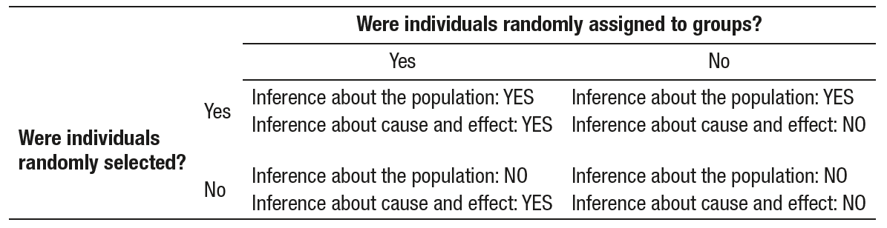
The Scope of Inference: Putting it All Together
The Scope of Inference
Random selection of individuals allows inference about the population from which the individuals were chosen.
Random assignment of individuals to groups allows inference about cause and effect.

Slide 13
The Challenges of Establishing Causation
There are several criteria for establishing causation when we can’t do an experiment:
The association is strong.
The association is consistent.
Larger values of the explanatory variable are associated with stronger responses.
The alleged cause precedes the effect in time.
The alleged cause is plausible.
archives/Getty Images

Slide 14
Data Ethics*
*This is an important topic, but it is not required for the AP® Statistics exam.
Basic Data Ethics
All planned studies must be reviewed in advance by an institutional review board charged with protecting the safety and well-being of the subjects.
All individuals who are subjects in a study must give their informed consent before data are collected.
All individual data must be kept confidential. Only statistical summaries for groups of subjects may be made public.

Slide 15
Section Summary
Explain the concept of sampling variability when making an inference about a population and how sample size affects sampling variability.
Explain the meaning of statistically significant in the context of an experiment and use simulation to determine if the results of an experiment are statistically significant.
Identify when it is appropriate to make an inference about a population and when it is appropriate to make an inference about cause and effect.
Evaluate if a statistical study has been carried out in an ethical manner.*

