Slide 1


Chapter 6
Random Variables and Probability Distributions
Section 6.2
Transforming and Combining Random Variables

Slide 2
Transforming and Combining Random Variables
DESCRIBE the effect of adding or subtracting a constant or multiplying or dividing by a constant on the probability distribution of a random variable.
CALCULATE the mean and standard deviation of the sum or difference of random variables.
FIND probabilities involving the sum or difference of independent Normal random variables.

Slide 3
Transforming a Random Variable
In Chapter 2, we studied the effects of linear transformations on the shape, center, and variability of a distribution of data. Recall:

Slide 4
Transforming a Random Variable
In Chapter 2, we studied the effects of linear transformations on the shape, center, and variability of a distribution of data. Recall:
Adding (or subtracting) a constant a to each observation:
  Adds (subtracts) a to measures of center and location.
  Does not change the measures of variability.
  Does not change the shape or measures of variability.

Slide 5
Transforming a Random Variable
In Chapter 2, we studied the effects of linear transformations on the shape, center, and variability of a distribution of data. Recall:
Adding (or subtracting) a constant a to each observation:
  Adds (subtracts) a to measures of center and location.
  Does not change the measures of variability.
  Does not change the shape or measures of variability.
Multiplying (or dividing) each observation by a positive constant b:
  Multiplies (divides) measures of center and location by b.
  Multiplies (divides) measures of spread by b.
  Does not change the shape of the distribution.

Slide 6
Effect of Adding or Subtracting a Constant
Pete’s Jeep Tours offers a popular day trip in a tourist area.

Slide 7
Effect of Adding or Subtracting a Constant
Pete’s Jeep Tours offers a popular day trip in a tourist area.
Let C = the total amount of money that Pete collects on a randomly selected trip.

Slide 8
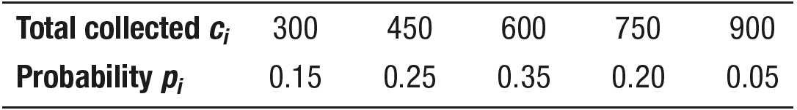
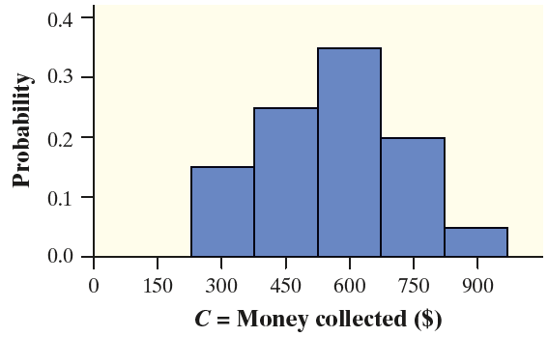
Effect of Adding or Subtracting a Constant
Pete’s Jeep Tours offers a popular day trip in a tourist area.
Let C = the total amount of money that Pete collects on a randomly selected trip.

Slide 9
Effect of Adding or Subtracting a Constant
It costs Pete $100 to buy permits, gas, and a ferry pass for each day trip.

Slide 10
Effect of Adding or Subtracting a Constant
It costs Pete $100 to buy permits, gas, and a ferry pass for each day trip.
Let V = the amount of profit that Pete collects on a randomly selected trip.

Slide 11
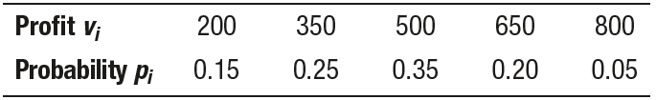
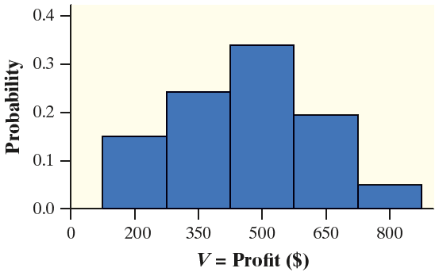
Effect of Adding or Subtracting a Constant
It costs Pete $100 to buy permits, gas, and a ferry pass for each day trip.
Let V = the amount of profit that Pete collects on a randomly selected trip.

Slide 12
Effect of Adding or Subtracting a Constant
V = C – 100

Slide 13
Effect of Adding or Subtracting a Constant
V = C – 100
How does the distribution of V compare to the distribution of C?

Slide 14
Effect of Adding or Subtracting a Constant
V = C – 100
How does the distribution of V compare to the distribution of C?
  µ_{V} = $462.50, which is $100 less than µ_{C} = $562.50

Slide 15
Effect of Adding or Subtracting a Constant
V = C – 100
How does the distribution of V compare to the distribution of C?
  µ_{V} = $462.50, which is $100 less than µ_{C} = $562.50
  σ_{V} = $163.46, which is the same as σ_{C} = $163.46

Slide 16
Effect of Adding or Subtracting a Constant
V = C – 100
How does the distribution of V compare to the distribution of C?
  µ_{V} = $462.50, which is $100 less than µ_{C} = $562.50
  σ_{V} = $163.46, which is the same as σ_{C} = $163.46
  The shape of V is the same as the shape of C

Slide 17
Effect of Adding or Subtracting a Constant
The Effect of Adding or Subtracting a Constant
on a Probability Distribution
Adding the same positive number a to (subtracting a from) each value of a
random variable:

Slide 18
Effect of Adding or Subtracting a Constant
The Effect of Adding or Subtracting a Constant
on a Probability Distribution
Adding the same positive number a to (subtracting a from) each value of a
random variable:
Adds a to (subtracts a from) measures of center and location (mean, median, quartiles, percentiles).

Slide 19
Effect of Adding or Subtracting a Constant
The Effect of Adding or Subtracting a Constant
on a Probability Distribution
Adding the same positive number a to (subtracting a from) each value of a
random variable:
Adds a to (subtracts a from) measures of center and location (mean, median, quartiles, percentiles).
Does not change measures of variability (range, IQR, standard deviation).

Slide 20
Effect of Adding or Subtracting a Constant
The Effect of Adding or Subtracting a Constant
on a Probability Distribution
Adding the same positive number a to (subtracting a from) each value of a
random variable:
Adds a to (subtracts a from) measures of center and location (mean, median, quartiles, percentiles).
Does not change measures of variability (range, IQR, standard deviation).
Does not change the shape of the probability distribution.

Slide 21
Effect of Adding or Subtracting a Constant
The Effect of Adding or Subtracting a Constant
on a Probability Distribution
Adding the same positive number a to (subtracting a from) each value of a
random variable:
Adds a to (subtracts a from) measures of center and location (mean, median, quartiles, percentiles).
Does not change measures of variability (range, IQR, standard deviation).
Does not change the shape of the probability distribution.
Note that adding or subtracting a constant affects the distribution of a quantitative variable and the probability distribution of a random variable in exactly the same way.

Slide 22
Effect of Adding or Subtracting a Constant
Problem: In a large introductory statistics class, the score X of a randomly selected student on a test worth 50 points can be modeled by a Normal distribution with mean 35 and standard
deviation 5. Due to a difficult question on the
test, the professor decides to add 5 points to
each student’s score. Let Y be the scaled test
score of the randomly selected student.
Describe the shape, center, and variability
of the probability distribution of Y.
monkeybusinessimages/Getty Images

Slide 23
Effect of Adding or Subtracting a Constant
Problem: In a large introductory statistics class, the score X of a randomly selected student on a test worth 50 points can be modeled by a Normal distribution with mean 35 and standard
deviation 5. Due to a difficult question on the
test, the professor decides to add 5 points to
each student’s score. Let Y be the scaled test
score of the randomly selected student.
Describe the shape, center, and variability
of the probability distribution of Y.
monkeybusinessimages/Getty Images
Shape: Approximately Normal
Center: µ_{Y} = µ_{X} + 5 = 35 + 5 = 40
Variability: σ_{Y} = σ_{X} = 5

Slide 24
Effect of Multiplying or Dividing by a Constant
The Effect of Multiplying or Dividing by a Constant
on a Probability Distribution
Multiplying (or dividing) each value of a random variable by the same
positive number b:

Slide 25
Effect of Multiplying or Dividing by a Constant
The Effect of Multiplying or Dividing by a Constant
on a Probability Distribution
Multiplying (or dividing) each value of a random variable by the same
positive number b:
Multiplies (divides) measures of center and location (mean, median, quartiles, percentiles) by b.

Slide 26
Effect of Multiplying or Dividing by a Constant
The Effect of Multiplying or Dividing by a Constant
on a Probability Distribution
Multiplying (or dividing) each value of a random variable by the same
positive number b:
Multiplies (divides) measures of center and location (mean, median, quartiles, percentiles) by b.
Multiplies (divides) measures of variability (range, IQR, standard deviation) by b.

Slide 27
Effect of Multiplying or Dividing by a Constant
The Effect of Multiplying or Dividing by a Constant
on a Probability Distribution
Multiplying (or dividing) each value of a random variable by the same
positive number b:
Multiplies (divides) measures of center and location (mean, median, quartiles, percentiles) by b.
Multiplies (divides) measures of variability (range, IQR, standard deviation) by b.
Does not change the shape of the distribution.

Slide 28
Effect of Multiplying or Dividing by a Constant
The Effect of Multiplying or Dividing by a Constant
on a Probability Distribution
Multiplying (or dividing) each value of a random variable by the same
positive number b:
Multiplies (divides) measures of center and location (mean, median, quartiles, percentiles) by b.
Multiplies (divides) measures of variability (range, IQR, standard deviation) by b.
Does not change the shape of the distribution.
Multiplying or dividing by a constant has the same effect on the
probability distribution of a random variable as it does on a distribution of quantitative data.

Slide 29
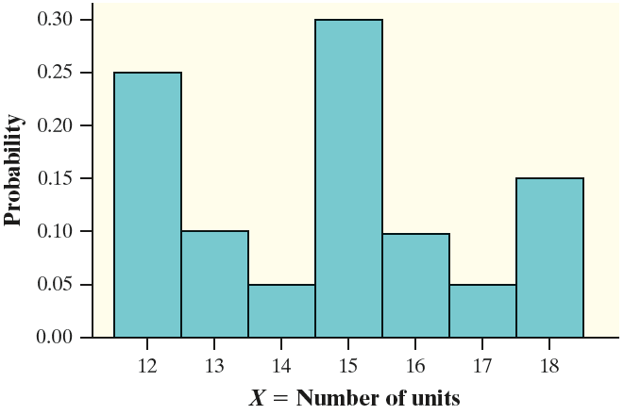
Effect of Multiplying or Dividing by a Constant
Problem: El Dorado Community College considers a student to be full-time if he or she is taking between 12 and 18 units. The number of units X that a randomly selected El Dorado Community College full-time student is taking in the fall semester has the following distribution.
At right is a histogram of the probability
distribution. The mean is µ_{X} = 14.65 and
the standard deviation is σ_{X} = 2.056. At
El Dorado Community College, the
tuition for full-time students is $50 per
unit. That is, if T = tuition charge for a
randomly selected full-time student,
T = 50X.

Slide 30
Effect of Multiplying or Dividing by a Constant
Problem:
What shape does the
probability distribution
of T have?
Find the mean of T.
Calculate the standard
deviation of T.
(a) Shape: The same shape as the probability distribution of X, roughly symmetric with three peaks.
(b) Center: µ_{T} = 50µ_{X} = 50(14.65) = $732.50
(c) Variability: σ_{T} = 50σ_{X} = 50(2.056) = $102.80

Slide 31
Linear Transformations of Random Variables
The Effect of a Linear Transformation
on a Random Variable
If Y = a+ bX is a linear transformation of the random variable X,

Slide 32
Linear Transformations of Random Variables
The Effect of a Linear Transformation
on a Random Variable
If Y = a+ bX is a linear transformation of the random variable X,
The probability distribution of Y has the same shape as the probability distribution of X if b > 0

Slide 33
Linear Transformations of Random Variables
The Effect of a Linear Transformation
on a Random Variable
If Y = a+ bX is a linear transformation of the random variable X,
The probability distribution of Y has the same shape as the probability distribution of X if b > 0
μ_{Y} = a+ bμ_{X}

Slide 34
Linear Transformations of Random Variables
The Effect of a Linear Transformation
on a Random Variable
If Y = a+ bX is a linear transformation of the random variable X,
The probability distribution of Y has the same shape as the probability distribution of X if b > 0
μ_{Y} = a+ bμ_{X}
σ_{Y} = |b|σ_{X} (because b could be a negative number)

Slide 35
Linear Transformations of Random Variables
The Effect of a Linear Transformation
on a Random Variable
If Y = a+ bX is a linear transformation of the random variable X,
The probability distribution of Y has the same shape as the probability distribution of X if b > 0
μ_{Y} = a+ bμ_{X}
σ_{Y} = |b|σ_{X} (because b could be a negative number)
Note that these results apply to both discrete and continuous random variables.

Slide 36

Combining Random Variables
Let X = the number of passengers on a randomly selected trip at Pete’s Jeep Tours.

Slide 37
Combining Random Variables
Let X = the number of passengers on a randomly selected trip at Pete’s Jeep Tours.
Pete’s sister Erin runs jeep tours in another part of the country.

Slide 38

Combining Random Variables
Let X = the number of passengers on a randomly selected trip at Pete’s Jeep Tours.
Pete’s sister Erin runs jeep tours in another part of the country.
Let Y = the number of passengers on a randomly selected trip at Erin’s Adventures.

Slide 39
Combining Random Variables
Let X = the number of passengers on a randomly selected trip at Pete’s Jeep Tours.
Pete’s sister Erin runs jeep tours in another part of the country.
Let Y = the number of passengers on a randomly selected trip at Erin’s Adventures.
What is the sum S = X + Y of the number of passengers Pete and Erin will have on their tours on a randomly selected day?
What is the difference D = X – Y in the number of passengers Pete and Erin will have on a randomly selected day?

Slide 40
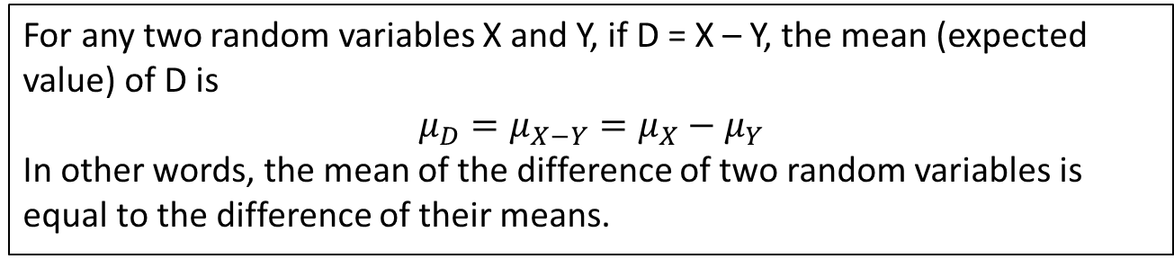
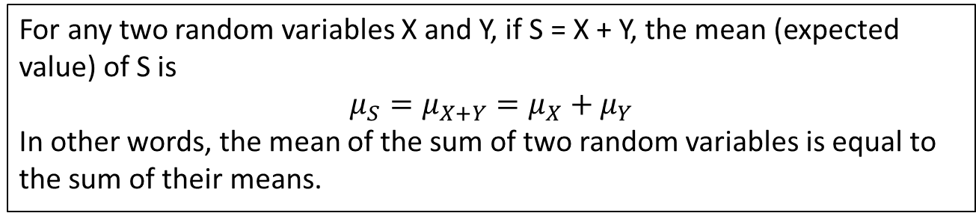
Combining Random Variables
Mean (Expected Value) of a Sum of Random Variables
For any two random variables X and Y, if S = X + Y, the mean (expected
value) of S is
$$μ_{S}=μ_{X+Y}=μ_{X}+μ_{Y}$$
In other words, the mean of the sum of two random variables is equal to the sum of their means.
Mean (Expected Value) of a Difference of Random Variables
For any two random variables X and Y, if D = X – Y, the mean (expected
value) of D is
$$μ_{D}=μ_{X−Y}=μ_{X}−μ_{Y}$$
In other words, the mean of the difference of two random variables is equal to the difference of their means.

Slide 41
Combining Random Variables
Problem: Pete charges $150 per passenger and Erin charges $175
per passenger for a jeep tour. Let C = the amount of money that Pete
collects and E = the amount of money that Erin collects on a randomly
selected day. From our earlier work, we know that µ_{C} = 562.50
and it is easy to show that µ_{E} = 542.50. Define S = C + E. Calculate
and interpret the mean of S.
moodboard/Superstock

Slide 42
Combining Random Variables
Problem: Pete charges $150 per passenger and Erin charges $175
per passenger for a jeep tour. Let C = the amount of money that Pete
collects and E = the amount of money that Erin collects on a randomly
selected day. From our earlier work, we know that µ_{C} = 562.50
and it is easy to show that µ_{E} = 542.50. Define S = C + E. Calculate
and interpret the mean of S.
µ_{S} = µ_{C} + µ_{E}
= 562.50 + 542.50
= $1105.00
Pete and Erin expect to collect a total of $1105 per day, on average, over many randomly selected days.
moodboard/Superstock

Slide 43
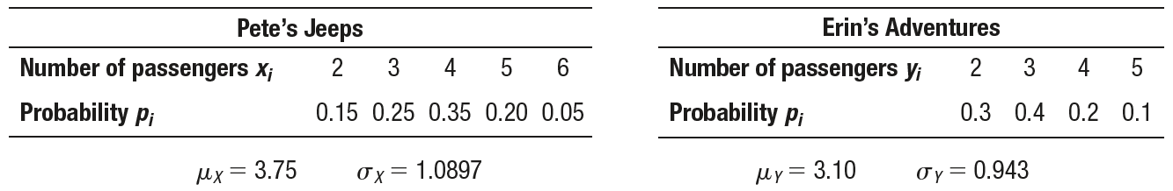
Standard Deviation of the Sum or Difference of Two Random Variables

Slide 44
Standard Deviation of the Sum or Difference of Two Random Variables
S = total number of passengers who go on Pete’s and Erin’s tours on a randomly chosen day
S = X + Y

Slide 45
Standard Deviation of the Sum or Difference of Two Random Variables
S = total number of passengers who go on Pete’s and Erin’s tours on a randomly chosen day
S = X + Y
If knowing the value of X does not help us predict the value of Y, then X and Y are independent random variables.

Slide 46
Standard Deviation of the Sum or Difference of Two Random Variables
It’s reasonable to treat the random variables X = number of passengers on
Pete’s trip and Y = number of passengers on Erin’s trip on a randomly chosen day as independent, because the siblings operate their trips in different parts of the country.

Slide 47
Standard Deviation of the Sum or Difference of Two Random Variables
It’s reasonable to treat the random variables X = number of passengers on
Pete’s trip and Y = number of passengers on Erin’s trip on a randomly chosen day as independent, because the siblings operate their trips in different parts of the country.
Recall that for independent events, P(A and B) = P(A)·P(B)

Slide 48
Standard Deviation of the Sum or Difference of Two Random Variables
It’s reasonable to treat the random variables X = number of passengers on
Pete’s trip and Y = number of passengers on Erin’s trip on a randomly chosen day as independent, because the siblings operate their trips in different parts of the country.
Recall that for independent events, P(A and B) = P(A)·P(B)
There are two ways to get a total of S = 5 passengers on a randomly selected day: X = 3, Y = 2 or X = 2, Y = 3.
So P(S = 5) = P(X = 2 and Y = 3) + P(X = 3 and Y = 2)
= (0.15)(0.4) + (0.25)(0.3)
= 0.06 + 0.075
= 0.135

Slide 49

Standard Deviation of the Sum or Difference of Two Random Variables
It’s reasonable to treat the random variables X = number of passengers on
Pete’s trip and Y = number of passengers on Erin’s trip on a randomly chosen day as independent, because the siblings operate their trips in different parts of the country.
Recall that for independent events, P(A and B) = P(A)·P(B)
There are two ways to get a total of S = 5 passengers on a randomly selected day: X = 3, Y = 2 or X = 2, Y = 3.
So P(S = 5) = P(X = 2 and Y = 3) + P(X = 3 and Y = 2)
= (0.15)(0.4) + (0.25)(0.3)
= 0.06 + 0.075
= 0.135

Slide 50


Standard Deviation of the Sum or Difference of Two Random Variables
$$σ_{X}^{2}=1.1875$$
$$σ_{X}=1.0897$$
$$σ_{Y}^{2}=0.89$$
$$σ_{Y}=0.943$$

Slide 51
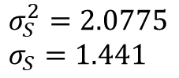
Standard Deviation of the Sum or Difference of Two Random Variables
$$σ_{X}^{2}=1.1875$$
$$σ_{X}=1.0897$$
$$σ_{Y}^{2}=0.89$$
$$σ_{Y}=0.943$$
$$σ_{S}^{2}=2.0775$$
$$σ_{S}=1.441$$

Slide 52
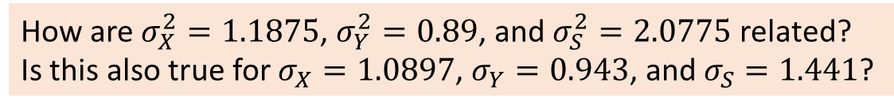
Standard Deviation of the Sum or Difference of Two Random Variables
$$σ_{X}^{2}=1.1875$$
$$σ_{X}=1.0897$$
$$σ_{Y}^{2}=0.89$$
$$σ_{Y}=0.943$$
$$σ_{S}^{2}=2.0775$$
$$σ_{S}=1.441$$
How are $σ_{X}^{2}=1.1875$, $σ_{Y}^{2}=0.89$, and $σ_{S}^{2}=2.0775$ related?
Is this also true for $σ_{X}=1.0897$, $σ_{Y}=0.943$, and $σ_{S}=1.441$?

Slide 53
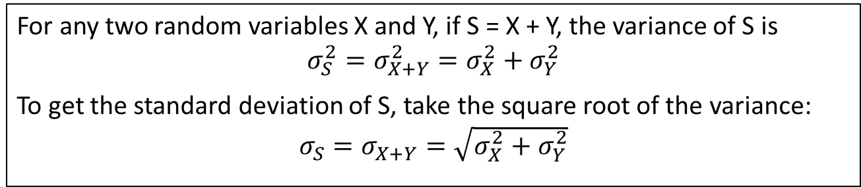
Standard Deviation of the Sum or Difference of Two Random Variables
Mean (Expected Value) of a Sum of Random Variables
For any two random variables X and Y, if S = X + Y, the variance of S is
$$σ_{S}^{2}=σ_{X+Y}^{2}=σ_{X}^{2}+σ_{Y}^{2}$$
To get the standard deviation of S, take the square root of the variance:
$σ_{S}=σ_{X+Y}=\sqrt{σ_{X}^{2}+σ_{Y}^{2}}$

Slide 54

Standard Deviation of the Sum or Difference of Two Random Variables
Mean (Expected Value) of a Sum of Random Variables
For any two random variables X and Y, if S = X + Y, the variance of S is
$$σ_{S}^{2}=σ_{X+Y}^{2}=σ_{X}^{2}+σ_{Y}^{2}$$
To get the standard deviation of S, take the square root of the variance:
$σ_{S}=σ_{X+Y}=\sqrt{σ_{X}^{2}+σ_{Y}^{2}}$
CAUTION:
When we add two independent random variables, their variances add. Standard deviations do not add.

Slide 55
Standard Deviation of the Sum or Difference of Two Random Variables
$$σ_{X}^{2}=1.1875$$
$$σ_{X}=1.0897$$
$$σ_{Y}^{2}=0.89$$
$$σ_{Y}=0.943$$

Slide 56


Standard Deviation of the Sum or Difference of Two Random Variables
$$σ_{X}^{2}=1.1875$$
$$σ_{X}=1.0897$$
$$σ_{Y}^{2}=0.89$$
$$σ_{Y}=0.943$$
Let D = X – Y
$$σ_{D}^{2}=2.0775$$
$$σ_{D}=1.441$$

Slide 57
Standard Deviation of the Sum or Difference of Two Random Variables
$$σ_{X}^{2}=1.1875$$
$$σ_{X}=1.0897$$
$$σ_{Y}^{2}=0.89$$
$$σ_{Y}=0.943$$
Let D = X – Y
No, this is NOT a typo!
$$σ_{D}^{2}=2.0775$$
$$σ_{D}=1.441$$

Slide 58
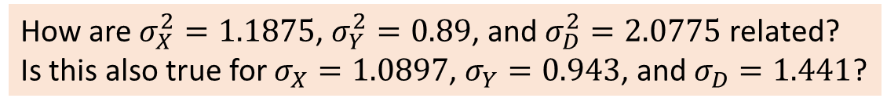
Standard Deviation of the Sum or Difference of Two Random Variables
$$σ_{X}^{2}=1.1875$$
$$σ_{X}=1.0897$$
$$σ_{Y}^{2}=0.89$$
$$σ_{Y}=0.943$$
Let D = X – Y
No, this is NOT a typo!
$$σ_{D}^{2}=2.0775$$
$$σ_{D}=1.441$$
How are $σ_{X}^{2}=1.1875$, $σ_{Y}^{2}=0.89$, and $σ_{D}^{2}=2.0775$ related?
Is this also true for $σ_{X}=1.0897$, $σ_{Y}=0.943$, and $σ_{D}=1.441$?

Slide 59
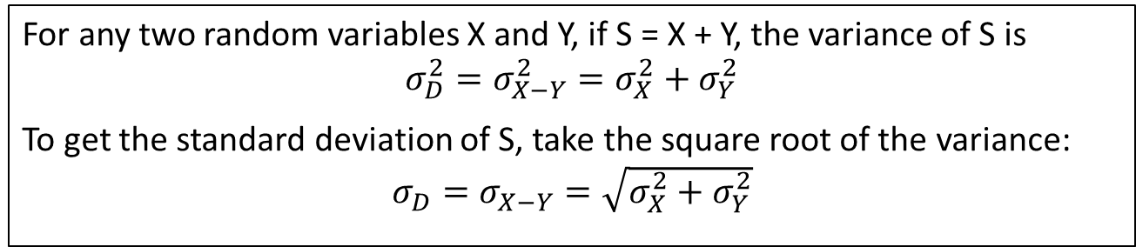
Standard Deviation of the Sum or Difference of Two Random Variables
Mean (Expected Value) of a Difference of Random Variables
For any two random variables X and Y, if S = X + Y, the variance of S is
$$σ_{D}^{2}=σ_{X−Y}^{2}=σ_{X}^{2}+σ_{Y}^{2}$$
To get the standard deviation of S, take the square root of the variance:
$σ_{D}=σ_{X−Y}=\sqrt{σ_{X}^{2}+σ_{Y}^{2}}$

Slide 60
Standard Deviation of the Sum or Difference of Two Random Variables
Mean (Expected Value) of a Difference of Random Variables
For any two random variables X and Y, if S = X + Y, the variance of S is
$$σ_{D}^{2}=σ_{X−Y}^{2}=σ_{X}^{2}+σ_{Y}^{2}$$
To get the standard deviation of S, take the square root of the variance:
$σ_{D}=σ_{X−Y}=\sqrt{σ_{X}^{2}+σ_{Y}^{2}}$
CAUTION:
When we subtract two independent random variables, their variances add.

Slide 61
Standard Deviation of the Sum or Difference of Two Random Variables
Problem: Pete charges $150 per passenger and Erin charges $175 per passenger for a jeep tour. Let C = the amount of money that Pete collects and E = the amount of money that Erin collects on a randomly selected day. From our earlier work, it is easy to show that σ_{C} = $163.46 and
σ_{E} = $165.03. You may assume that these two random variables are independent. Define D = C – E. Earlier, we found that µ_{D} = $20.
Calculate and interpret the standard deviation of D.

Slide 62
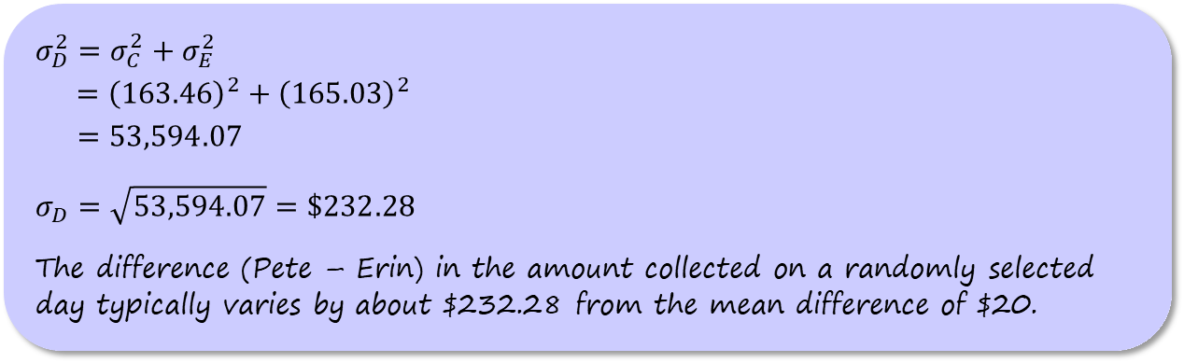
Standard Deviation of the Sum or Difference of Two Random Variables
Problem: Pete charges $150 per passenger and Erin charges $175 per passenger for a jeep tour. Let C = the amount of money that Pete collects and E = the amount of money that Erin collects on a randomly selected day. From our earlier work, it is easy to show that σ_{C} = $163.46 and
σ_{E} = $165.03. You may assume that these two random variables are independent. Define D = C – E. Earlier, we found that µ_{D} = $20.
Calculate and interpret the standard deviation of D.
$$σ_{D}^{2}=σ_{C}^{2}+σ_{E}^{2}$$
$={\left(163.46\right)}^{2}+{\left(165.03\right)}^{2}$
$=53,594.07$
$$σ_{D}=\sqrt{53,594.07}=\$232.28$$
The difference (Pete – Erin) in the amount collected on a randomly selected day typically varies by about $232.28 from the mean difference of $20.

Slide 63
Combining Normal Random Variables
So far, we have concentrated on developing rules for means and variances of random variables.

Slide 64
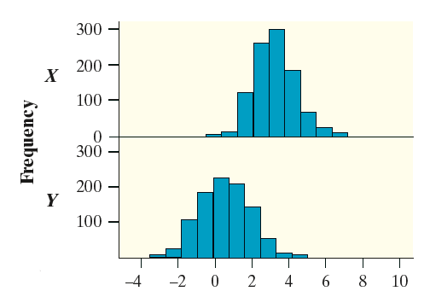
Combining Normal Random Variables
So far, we have concentrated on developing rules for means and variances of random variables.
What happens if we combine two independent Normal random variables?

Slide 65
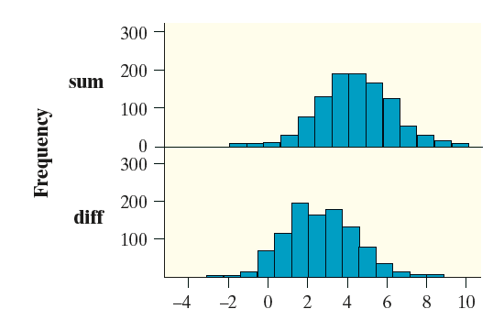
Combining Normal Random Variables
So far, we have concentrated on developing rules for means and variances of random variables.
What happens if we combine two independent Normal random variables?
Any sum or difference of independent Normal
random variables is also Normally distributed.

Slide 66
Combining Normal Random Variables
So far, we have concentrated on developing rules for means and variances of random variables.
What happens if we combine two independent Normal random variables?
Any sum or difference of independent Normal
random variables is also Normally distributed.
The mean and standard deviation of the resulting Normal distribution can be found using the appropriate rules for means and standard deviations.

Slide 67
Combining Normal Random Variables
Problem: The diameter C of the top of a randomly selected large drink cup at a fast-food restaurant follows a Normal distribution with a mean of 3.96 inches and a standard deviation of 0.01 inch. The diameter L of a randomly selected large lid at this restaurant follows a Normal distribution with mean 3.98 inches and standard deviation 0.02 inch. Assume that L and C are independent random variables. Let the random variable D = L – C be the difference between
the lid’s diameter and the cup’s diameter.
Describe the distribution of D.

Slide 68
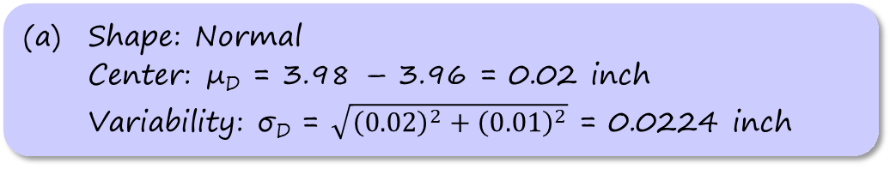
Combining Normal Random Variables
Problem: The diameter C of the top of a randomly selected large drink cup at a fast-food restaurant follows a Normal distribution with a mean of 3.96 inches and a standard deviation of 0.01 inch. The diameter L of a randomly selected large lid at this restaurant follows a Normal distribution with mean 3.98 inches and standard deviation 0.02 inch. Assume that L and C are independent random variables. Let the random variable D = L – C be the difference between
the lid’s diameter and the cup’s diameter.
Describe the distribution of D.
(a) Shape: Normal
Center: µ_{D} = 3.98 – 3.96 = 0.02 inch
Variability: σ_{D} = $\sqrt{{\left(0.02\right)}^{2}+{\left(0.01\right)}^{2}}$ = 0.0224 inch

Slide 69
Combining Normal Random Variables
Problem: The diameter C of the top of a randomly selected large drink cup at a fast-food restaurant follows a Normal distribution with a mean of 3.96 inches and a standard deviation of 0.01 inch. The diameter L of a randomly selected large lid at this restaurant follows a Normal distribution with mean 3.98 inches and standard deviation 0.02 inch. Assume that L and C are independent random variables. Let the random variable D = L – C be the difference between
the lid’s diameter and the cup’s diameter.
Describe the distribution of D.
For a lid to fit on a cup, the value of L has to be bigger than the value of C, but not by more than 0.06 inch. Find the probability that a randomly selected lid will fit on a randomly selected cup. Interpret this value.

Slide 70
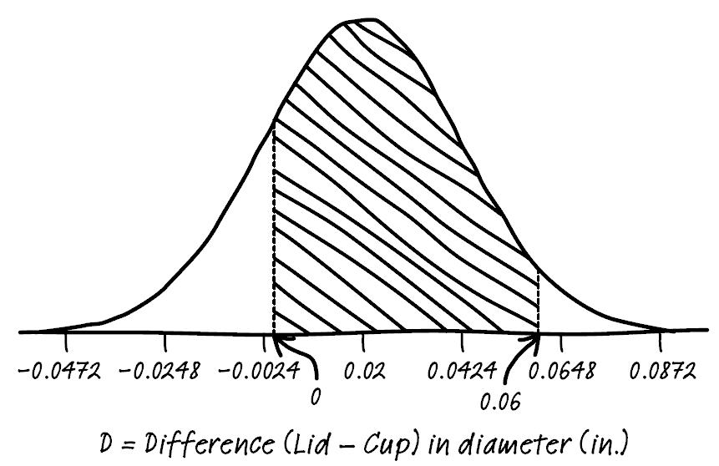
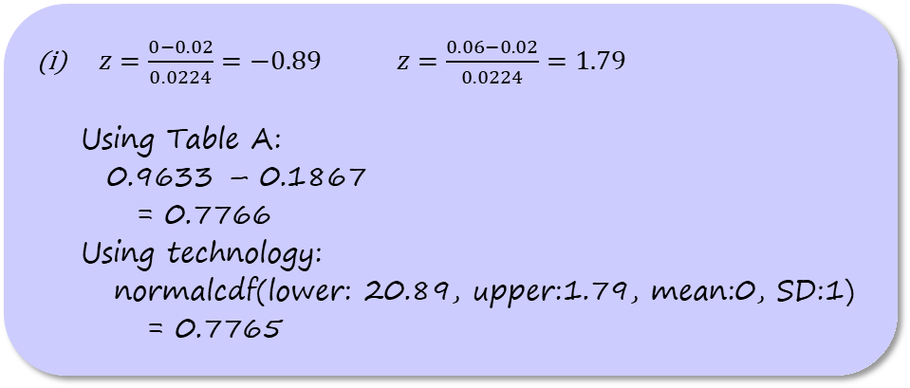
Combining Normal Random Variables
Problem:
(b) For a lid to fit on a cup, the value of L has to be bigger than the value of C, but not by more than 0.06 inch. Find the probability that a randomly selected lid will fit on a randomly selected cup. Interpret this value.
$z=\frac{0−0.02}{0.0224}=−0.89$ $z=\frac{0.06−0.02}{0.0224}=1.79$
  Using Table A:
  0.9633 – 0.1867
  = 0.7766
  Using technology:
  normalcdf(lower: 20.89, upper:1.79, mean:0, SD:1)
  = 0.7765

Slide 71
Combining Normal Random Variables
Problem:
(b) For a lid to fit on a cup, the value of L has to be bigger than the value of C, but not by more than 0.06 inch. Find the probability that a randomly selected lid will fit on a randomly selected cup. Interpret this value.
normalcdf(lower:0, upper:0.06, mean:0.02, SD:0.0224)
= 0.7770

Slide 72
Combining Normal Random Variables
Problem:
(b) For a lid to fit on a cup, the value of L has to be bigger than the value of C, but not by more than 0.06 inch. Find the probability that a randomly selected lid will fit on a randomly selected cup. Interpret this value.
There’s about a 77.7% chance that a randomly selected lid will fit on a randomly selected cup.

Slide 73
Section Summary
DESCRIBE the effect of adding or subtracting a constant or multiplying or dividing by a constant on the probability distribution of a random variable.
CALCULATE the mean and standard deviation of the sum or difference of random variables.
FIND probabilities involving the sum or difference of independent Normal random variables.

