Slide 1


Chapter 7
Sampling Distributions
Section 7.1
What Is a Sampling Distribution?

Slide 2
What Is a Sampling Distribution?
DISTINGUISH between a parameter and a statistic.
CREATE a sampling distribution using all possible samples from a small population.
USE the sampling distribution of a statistic to EVALUATE a claim about a parameter.
DISTINGUISH among the distribution of a population, the distribution of a sample, and the sampling distribution of a statistic.
DETERMINE if a statistic is an unbiased estimator of a population parameter.
DESCRIBE the relationship between sample size and the variability of a statistic.

Slide 3
Parameters and Statistics
A statistic is a number that describes some characteristic of a sample.
A parameter is a number that describes some characteristic of the population.

Slide 4
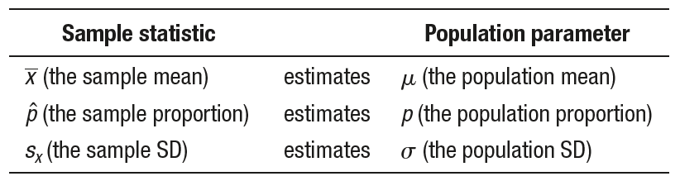
Parameters and Statistics
A statistic is a number that describes some characteristic of a sample.
A parameter is a number that describes some characteristic of the population.

Slide 5
Parameters and Statistics
A statistic is a number that describes some characteristic of a sample.
A parameter is a number that describes some characteristic of the population.
NOTE: A sample statistic is sometimes called a point estimator of the corresponding population parameter because the estimate is a single point on the number line.

Slide 6
Parameters and Statistics
Problem: Identify the population, the parameter, the sample, and the
statistic in each of the following settings.
(a) The Gallup Poll asked 515 randomly selected U.S. adults if they believe in ghosts. Of the respondents, 160 said “Yes.”
(b) During the winter months, the temperatures outside the Starneses’ cabin in Colorado can stay well below freezing for weeks at a time. To prevent the pipes from freezing, Mrs. Starnes sets the thermostat at 50°F. She wants to know how low the temperature actually gets in the cabin. A digital thermometer records the indoor temperature at 20 randomly chosen times during a given day. The minimum reading is 38°F.

Slide 7
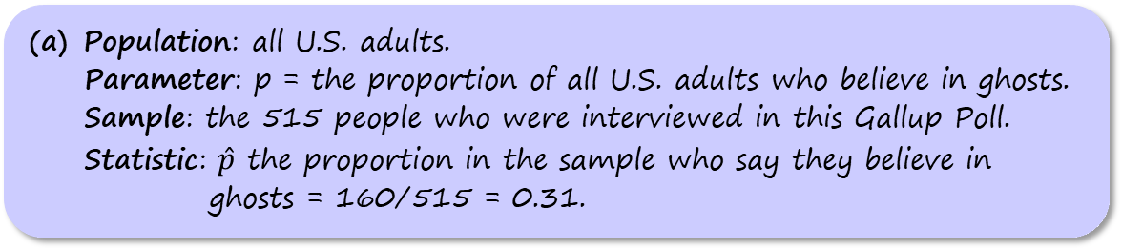
Parameters and Statistics
Problem: Identify the population, the parameter, the sample, and the
statistic in each of the following settings.
(a) The Gallup Poll asked 515 randomly selected U.S. adults if they believe in ghosts. Of the respondents, 160 said “Yes.”
(b) During the winter months, the temperatures outside the Starneses’ cabin in Colorado can stay well below freezing for weeks at a time. To prevent the pipes from freezing, Mrs. Starnes sets the thermostat at 50°F. She wants to know how low the temperature actually gets in the cabin. A digital thermometer records the indoor temperature at 20 randomly chosen times during a given day. The minimum reading is 38°F.
Population: all U.S. adults.
Parameter: p = the proportion of all U.S. adults who believe in ghosts.
Sample: the 515 people who were interviewed in this Gallup Poll.
Statistic: $\hat{p}$ the proportion in the sample who say they believe in ghosts = 160/515 = 0.31.

Slide 8
Parameters and Statistics
Problem: Identify the population, the parameter, the sample, and the
statistic in each of the following settings.
(a) The Gallup Poll asked 515 randomly selected U.S. adults if they believe in ghosts. Of the respondents, 160 said “Yes.”
(b) During the winter months, the temperatures outside the Starneses’ cabin in Colorado can stay well below freezing for weeks at a time. To prevent the pipes from freezing, Mrs. Starnes sets the thermostat at 50°F. She wants to know how low the temperature actually gets in the cabin. A digital thermometer records the indoor temperature at 20 randomly chosen times during a given day. The minimum reading is 38°F.
(b) Population: all times during the day in question.
Parameter: the true minimum temperature in the cabin at all times that day.
Sample: the 20 randomly selected times.
Statistic: the sample minimum temperature, 38°F.

Slide 9
Parameters and Statistics
AP® Exam Tip
Many students lose credit on the AP® Statistics exam when defining parameters because their description refers to the sample instead of the population or because the description isn’t clear about which group of individuals the parameter is describing. When defining a parameter, we suggest including the word all or the word true in your description to make it clear that you aren’t referring to a sample statistic.

Slide 10
Parameters and Statistics
AP® Exam Tip
Many students lose credit on the AP® Statistics exam when defining parameters because their description refers to the sample instead of the population or because the description isn’t clear about which group of individuals the parameter is describing. When defining a parameter, we suggest including the word all or the word true in your description to make it clear that you aren’t referring to a sample statistic.
Remember s and p:
statistics come from samples and
parameters come from populations

Slide 11
Parameters and Statistics
AP® Exam Tip
Many students lose credit on the AP® Statistics exam when defining parameters because their description refers to the sample instead of the population or because the description isn’t clear about which group of individuals the parameter is describing. When defining a parameter, we suggest including the word all or the word true in your description to make it clear that you aren’t referring to a sample statistic.
Remember s and p:
statistics come from samples and
parameters come from populations

Slide 12
Parameters and Statistics
AP® Exam Tip
Many students lose credit on the AP® Statistics exam when defining parameters because their description refers to the sample instead of the population or because the description isn’t clear about which group of individuals the parameter is describing. When defining a parameter, we suggest including the word all or the word true in your description to make it clear that you aren’t referring to a sample statistic.
Remember s and p:
statistics come from samples and
parameters come from populations

Slide 13
The Idea of a Sampling Distribution
Sampling variability refers to the fact that different random samples of the same size from the same population produce different values for a statistic.

Slide 14
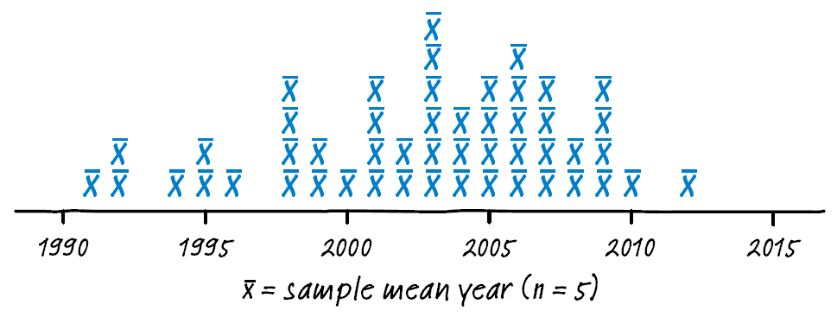
The Idea of a Sampling Distribution
Sampling variability refers to the fact that different random samples of the same size from the same population produce different values for a statistic.
The sampling distribution of a statistic is the distribution of values taken by the statistic in all possible samples of the same size from the same population.

Slide 15
The Idea of a Sampling Distribution
Problem: John and Carol have four grown sons. Their heights (in inches) are 71, 75, 72, and 68.
(a) List all 6 possible samples of size 2.
(b) Calculate the mean of each sample and display the sampling distribution of the sample mean using a dotplot.
(c) Calculate the range of each sample and display the sampling distribution of the sample range using a dotplot.

Slide 16
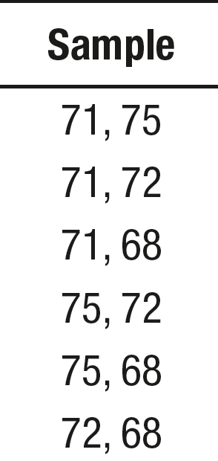
The Idea of a Sampling Distribution
Problem: John and Carol have four grown sons. Their heights (in inches) are 71, 75, 72, and 68.
(a) List all 6 possible samples of size 2.
(b) Calculate the mean of each sample and display the sampling distribution of the sample mean using a dotplot.
(c) Calculate the range of each sample and display the sampling distribution of the sample range using a dotplot.
(a)

Slide 17
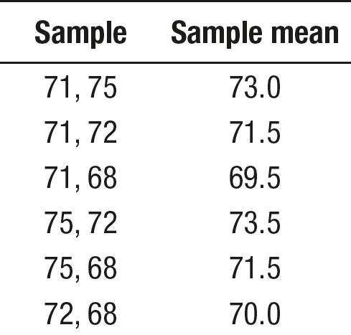
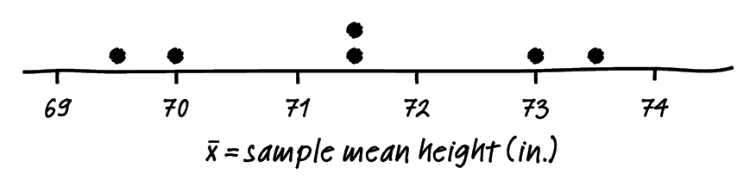
The Idea of a Sampling Distribution
Problem: John and Carol have four grown sons. Their heights (in inches) are 71, 75, 72, and 68.
(a) List all 6 possible samples of size 2.
(b) Calculate the mean of each sample and display the sampling distribution of the sample mean using a dotplot.
(c) Calculate the range of each sample and display the sampling distribution of the sample range using a dotplot.
(b)

Slide 18
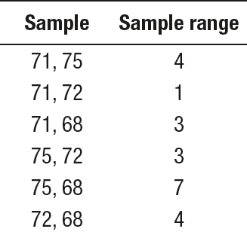
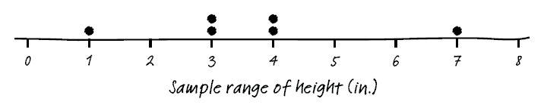
The Idea of a Sampling Distribution
Problem: John and Carol have four grown sons. Their heights (in inches) are 71, 75, 72, and 68.
(a) List all 6 possible samples of size 2.
(b) Calculate the mean of each sample and display the sampling distribution of the sample mean using a dotplot.
(c) Calculate the range of each sample and display the sampling distribution of the sample range using a dotplot.
(c)

Slide 19
The Idea of a Sampling Distribution
Problem: To determine how much homework time students will get
in class, Mrs. Lin has a student select an SRS of 20 chips from a large
bag. The number of red chips in the SRS determines the number of
minutes in class students get to work on homework. Mrs. Lin claims
that there are 200 chips in the bag and that 100 of them are red.
When Jenna selected a random sample of 20 chips from the bag
(without looking), she got 7 red chips. Does this provide convincing
evidence that less than half of the chips in the bag are red?
(a) What is the evidence that less than half of the chips in the bag are red?
woodygraphs/Getty Images

Slide 20
The Idea of a Sampling Distribution
Problem: To determine how much homework time students will get
in class, Mrs. Lin has a student select an SRS of 20 chips from a large
bag. The number of red chips in the SRS determines the number of
minutes in class students get to work on homework. Mrs. Lin claims
that there are 200 chips in the bag and that 100 of them are red.
When Jenna selected a random sample of 20 chips from the bag
(without looking), she got 7 red chips. Does this provide convincing
evidence that less than half of the chips in the bag are red?
(a) What is the evidence that less than half of the chips in the bag are red?
woodygraphs/Getty Images
(a) Jenna’s sample proportion was $\hat{p}$ = 7/20 = 0.35, which is less than 0.50.

Slide 21
The Idea of a Sampling Distribution
Problem: To determine how much homework time students will get
in class, Mrs. Lin has a student select an SRS of 20 chips from a large
bag. The number of red chips in the SRS determines the number of
minutes in class students get to work on homework. Mrs. Lin claims
that there are 200 chips in the bag and that 100 of them are red.
When Jenna selected a random sample of 20 chips from the bag
(without looking), she got 7 red chips. Does this provide convincing
evidence that less than half of the chips in the bag are red?
(b) Provide two explanations for the evidence described in part (a).
woodygraphs/Getty Images

Slide 22
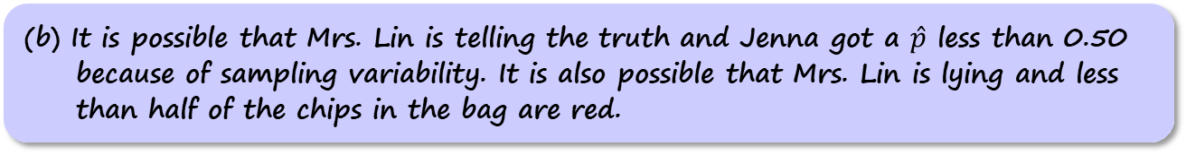
The Idea of a Sampling Distribution
Problem: To determine how much homework time students will get
in class, Mrs. Lin has a student select an SRS of 20 chips from a large
bag. The number of red chips in the SRS determines the number of
minutes in class students get to work on homework. Mrs. Lin claims
that there are 200 chips in the bag and that 100 of them are red.
When Jenna selected a random sample of 20 chips from the bag
(without looking), she got 7 red chips. Does this provide convincing
evidence that less than half of the chips in the bag are red?
(b) Provide two explanations for the evidence described in part (a).
woodygraphs/Getty Images
(b) It is possible that Mrs. Lin is telling the truth and Jenna got a $\hat{p}$ less than 0.50 because of sampling variability. It is also possible that Mrs. Lin is lying and less than half of the chips in the bag are red.

Slide 23
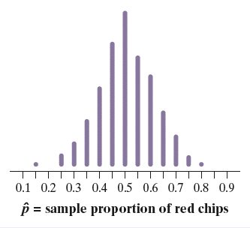
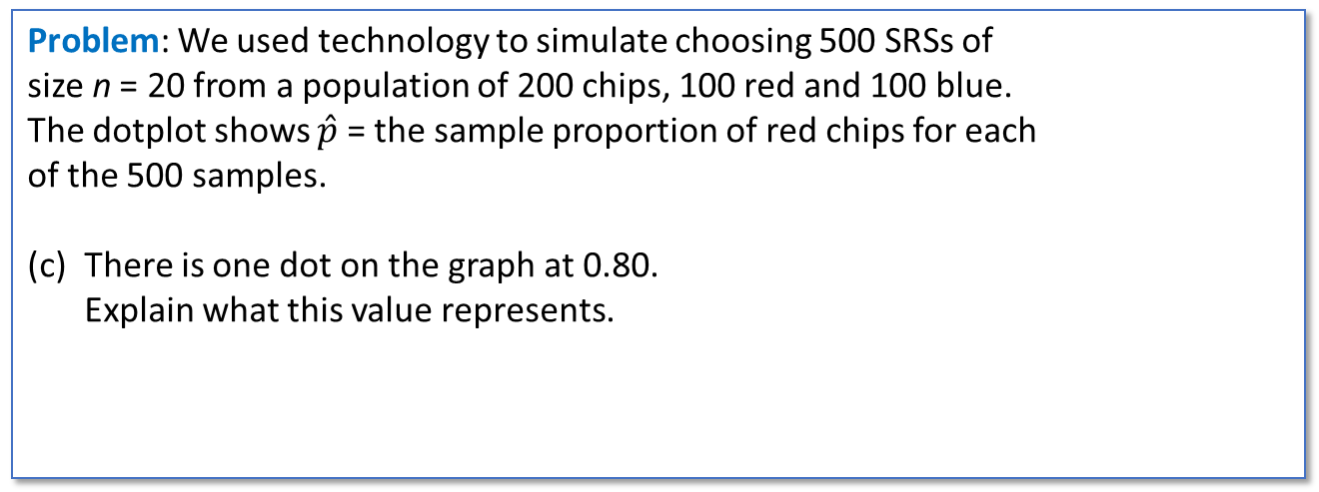
The Idea of a Sampling Distribution
Problem: We used technology to simulate choosing 500 SRSs of
size n = 20 from a population of 200 chips, 100 red and 100 blue.
The dotplot shows $\hat{p}$ = the sample proportion of red chips for each
of the 500 samples.
(c) There is one dot on the graph at 0.80.
Explain what this value represents.
woodygraphs/Getty Images

Slide 24
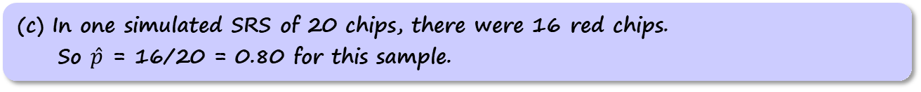
The Idea of a Sampling Distribution
Problem: We used technology to simulate choosing 500 SRSs of
size n = 20 from a population of 200 chips, 100 red and 100 blue.
The dotplot shows $\hat{p}$ = the sample proportion of red chips for each
of the 500 samples.
(c) There is one dot on the graph at 0.80.
Explain what this value represents.
woodygraphs/Getty Images
(c) In one simulated SRS of 20 chips, there were 16 red chips.
So $\hat{p}$ = 16/20 = 0.80 for this sample.

Slide 25
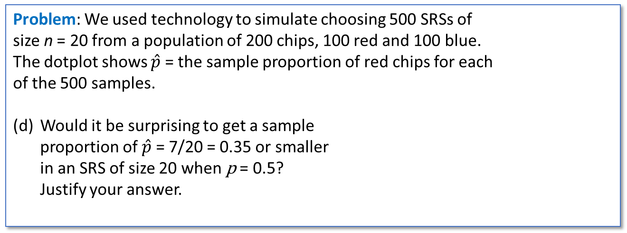
The Idea of a Sampling Distribution
Problem: We used technology to simulate choosing 500 SRSs of
size n = 20 from a population of 200 chips, 100 red and 100 blue.
The dotplot shows $\hat{p}$ = the sample proportion of red chips for each
of the 500 samples.
(d) Would it be surprising to get a sample
proportion of $\hat{p}$ = 7/20 = 0.35 or smaller
in an SRS of size 20 when p = 0.5?
Justify your answer.
woodygraphs/Getty Images

Slide 26
The Idea of a Sampling Distribution
Problem: We used technology to simulate choosing 500 SRSs of
size n = 20 from a population of 200 chips, 100 red and 100 blue.
The dotplot shows $\hat{p}$ = the sample proportion of red chips for each
of the 500 samples.
(d) Would it be surprising to get a sample
proportion of $\hat{p}$ = 7/20 = 0.35 or smaller
in an SRS of size 20 when p = 0.5?
Justify your answer.
woodygraphs/Getty Images
(d) No; there were many simulated samples that had $\hat{p}$ values less than or equal to 0.35.

Slide 27
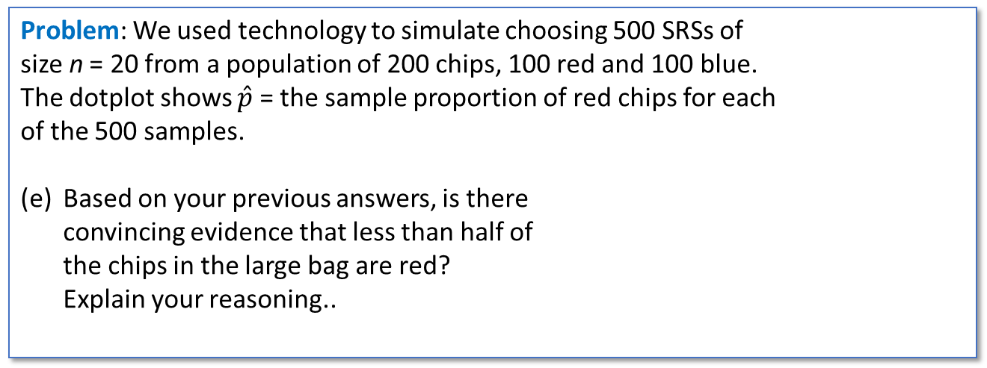
The Idea of a Sampling Distribution
Problem: We used technology to simulate choosing 500 SRSs of
size n = 20 from a population of 200 chips, 100 red and 100 blue.
The dotplot shows $\hat{p}$ = the sample proportion of red chips for each
of the 500 samples.
(e) Based on your previous answers, is there
convincing evidence that less than half of
the chips in the large bag are red?
Explain your reasoning..
woodygraphs/Getty Images

Slide 28
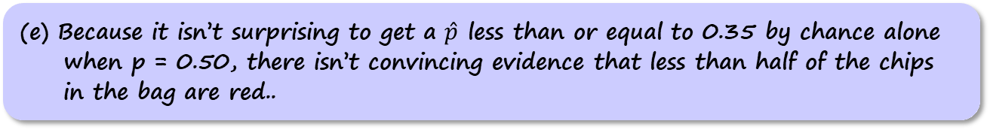
The Idea of a Sampling Distribution
Problem: We used technology to simulate choosing 500 SRSs of
size n = 20 from a population of 200 chips, 100 red and 100 blue.
The dotplot shows $\hat{p}$ = the sample proportion of red chips for each
of the 500 samples.
(e) Based on your previous answers, is there
convincing evidence that less than half of
the chips in the large bag are red?
Explain your reasoning..
woodygraphs/Getty Images
(e) Because it isn’t surprising to get a $\hat{p}$ less than or equal to 0.35 by chance alone when p = 0.50, there isn’t convincing evidence that less than half of the chips in the bag are red..

Slide 29

The Idea of a Sampling Distribution
Problem: We used technology to simulate choosing 500 SRSs of
size n = 20 from a population of 200 chips, 100 red and 100 blue.
The dotplot shows $\hat{p}$ = the sample proportion of red chips for each
of the 500 samples.
woodygraphs/Getty Images
NOTE: When we simulate a sampling distribution using assumed values for the parameters, like in the chips example, the resulting distribution is sometimes called a randomization distribution.

Slide 30
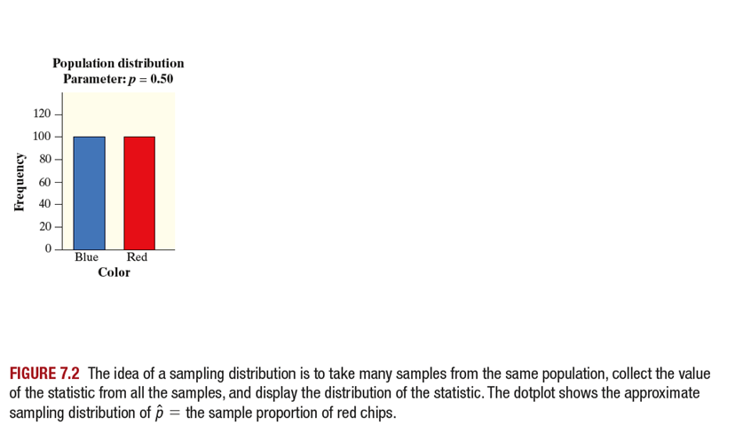
The Idea of a Sampling Distribution

Slide 31
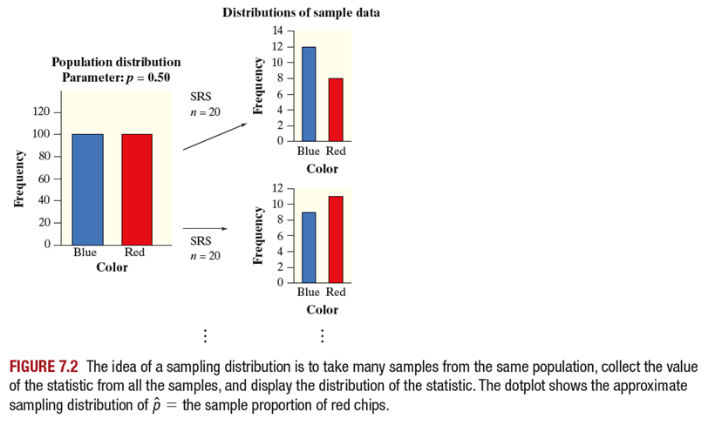
The Idea of a Sampling Distribution

Slide 32
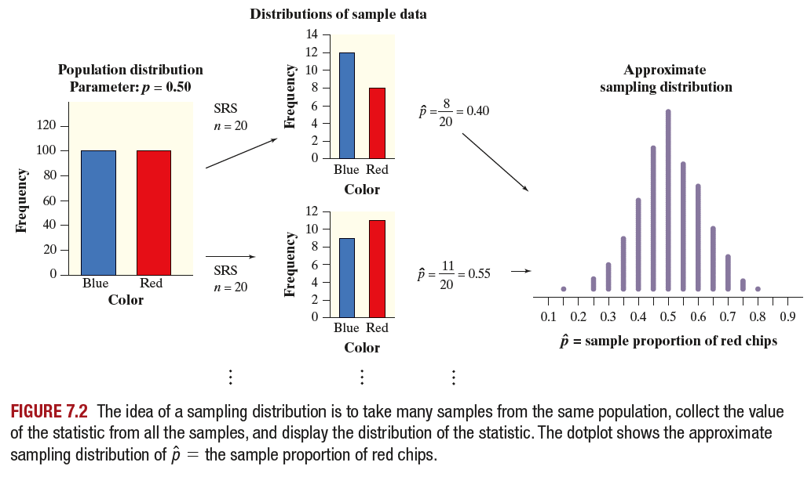
The Idea of a Sampling Distribution

Slide 33
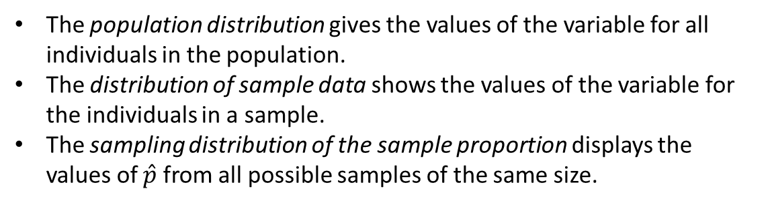
The Idea of a Sampling Distribution
The population distribution gives the values of the variable for all individuals in the population.
The distribution of sample data shows the values of the variable for the individuals in a sample.
The sampling distribution of the sample proportion displays the values of $\hat{p}$ from all possible samples of the same size.

Slide 34
The Idea of a Sampling Distribution
The population distribution gives the values of the variable for all individuals in the population.
The distribution of sample data shows the values of the variable for the individuals in a sample.
The sampling distribution of the sample proportion displays the values of $\hat{p}$ from all possible samples of the same size.

Slide 35
The Idea of a Sampling Distribution
The population distribution gives the values of the variable for all individuals in the population.
The distribution of sample data shows the values of the variable for the individuals in a sample.
The sampling distribution of the sample proportion displays the values of $\hat{p}$ from all possible samples of the same size.

Slide 36
The Idea of a Sampling Distribution
The population distribution gives the values of the variable for all individuals in the population.
The distribution of sample data shows the values of the variable for the individuals in a sample.
The sampling distribution of the sample proportion displays the values of $\hat{p}$ from all possible samples of the same size.

Slide 37
The Idea of a Sampling Distribution
AP® Exam Tip
Terminology matters. Never just say “the distribution.” Always say “the distribution of [blank],” being careful to distinguish the distribution of the population, the distribution of sample data, and the sampling distribution of a statistic. Likewise, don’t use ambiguous terms like
“sample distribution,” which could refer to the distribution of sample data or to the sampling distribution of a statistic. You will lose credit on free response questions for misusing statistical terms.

Slide 38
Describing Sampling Distributions
A statistic used to estimate a parameter is an unbiased estimator if the mean of its sampling distribution is equal to the value of the parameter being estimated.

Slide 39
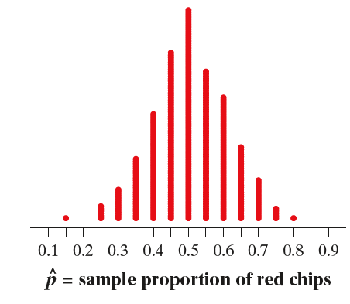
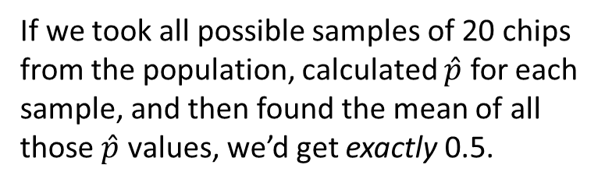
Describing Sampling Distributions
A statistic used to estimate a parameter is an unbiased estimator if the mean of its sampling distribution is equal to the value of the parameter being estimated.
If we took all possible samples of 20 chips from the population, calculated $\hat{p}$ for each sample, and then found the mean of all those $\hat{p}$ values, we’d get exactly 0.5.

Slide 40
Describing Sampling Distributions
Problem: In the “Sampling heights” example, we created the sampling distribution of the sample range for samples of size n = 2 from the population of John and Carol’s four sons with heights of 71, 75, 72, and 68 inches tall. Is the sample range an unbiased estimator of the population range? Explain your answer.

Slide 41
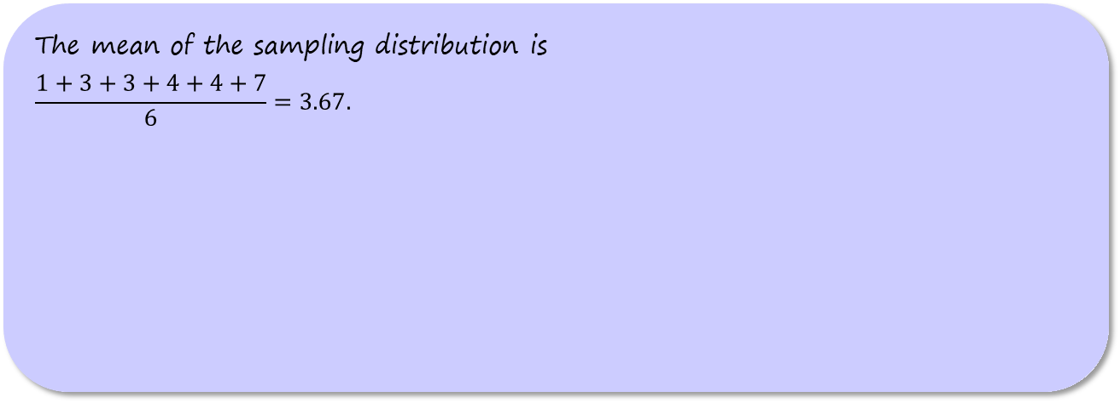
Describing Sampling Distributions
Problem: In the “Sampling heights” example, we created the sampling distribution of the sample range for samples of size n = 2 from the population of John and Carol’s four sons with heights of 71, 75, 72, and 68 inches tall. Is the sample range an unbiased estimator of the population range? Explain your answer.
The mean of the sampling distribution is
$$\frac{1+3+3+4+4+7}{6}=3.67.$$

Slide 42
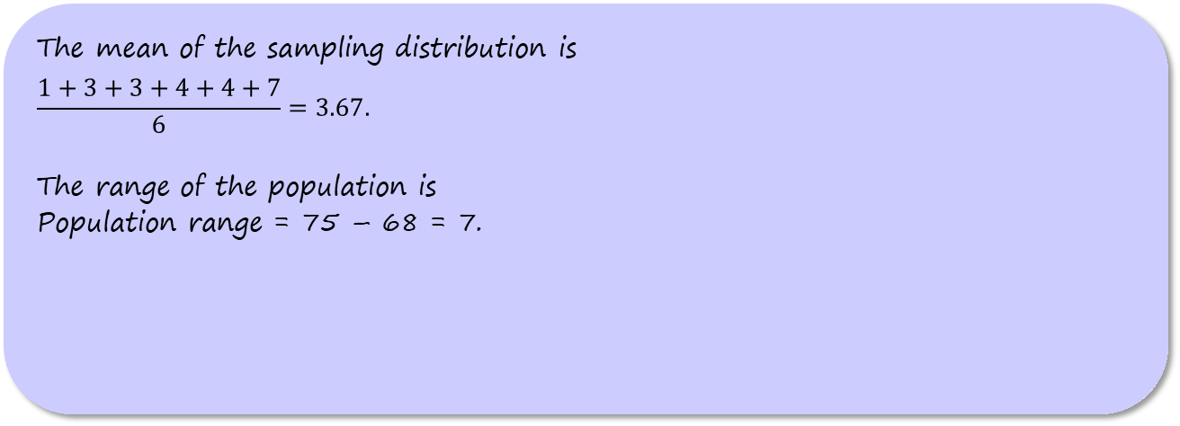
Describing Sampling Distributions
Problem: In the “Sampling heights” example, we created the sampling distribution of the sample range for samples of size n = 2 from the population of John and Carol’s four sons with heights of 71, 75, 72, and 68 inches tall. Is the sample range an unbiased estimator of the population range? Explain your answer.
The mean of the sampling distribution is
$$\frac{1+3+3+4+4+7}{6}=3.67.$$
The range of the population is
Population range = 75 – 68 = 7.

Slide 43
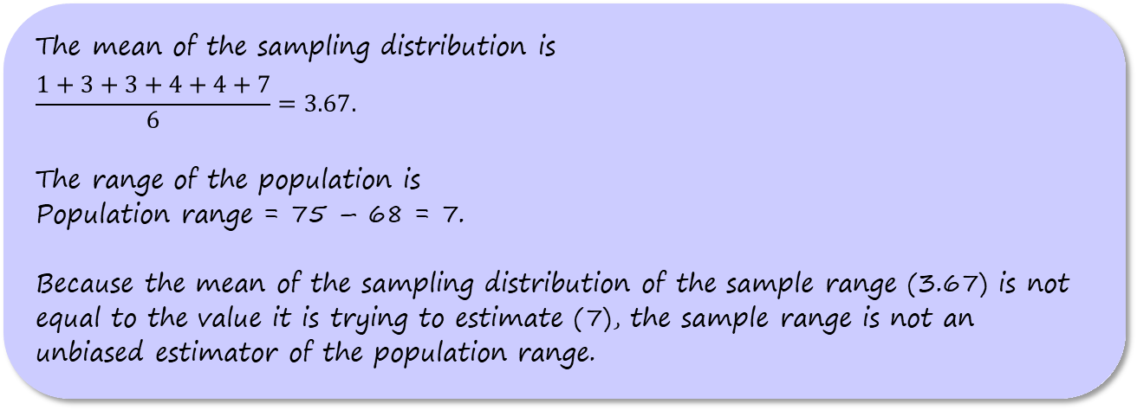
Describing Sampling Distributions
Problem: In the “Sampling heights” example, we created the sampling distribution of the sample range for samples of size n = 2 from the population of John and Carol’s four sons with heights of 71, 75, 72, and 68 inches tall. Is the sample range an unbiased estimator of the population range? Explain your answer.
The mean of the sampling distribution is
$$\frac{1+3+3+4+4+7}{6}=3.67.$$
The range of the population is
Population range = 75 – 68 = 7.
Because the mean of the sampling distribution of the sample range (3.67) is not equal to the value it is trying to estimate (7), the sample range is not an unbiased estimator of the population range.

Slide 44
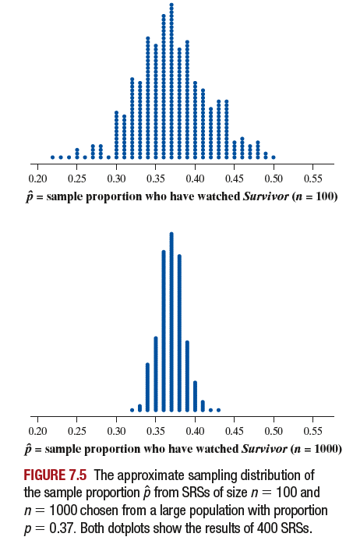
Describing Sampling Distributions
To get a trustworthy estimate of an unknown population parameter, start by using a statistic that’s an unbiased estimator.

Slide 45
Describing Sampling Distributions
To get a trustworthy estimate of an unknown population parameter, start by using a statistic that’s an unbiased estimator.
Unfortunately, using an unbiased estimator doesn’t guarantee that the value of your statistic will be close to the actual parameter value.

Slide 46
Describing Sampling Distributions
To get a trustworthy estimate of an unknown population parameter, start by using a statistic that’s an unbiased estimator.
Unfortunately, using an unbiased estimator doesn’t guarantee that the value of your statistic will be close to the actual parameter value.
We prefer statistics that vary less from the actual parameter value. Larger random samples tend to produce estimates that are closer to the true population value.

Slide 47
Describing Sampling Distributions
In many cases, it is obvious which statistic should be used as an estimator of a population parameter.

Slide 48
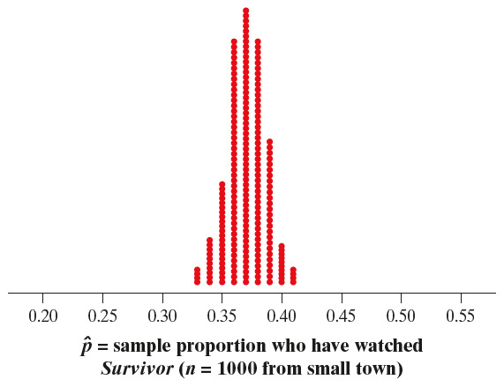
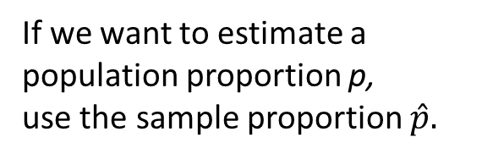
Describing Sampling Distributions
In many cases, it is obvious which statistic should be used as an estimator of a population parameter.
If we want to estimate a population proportion p,
use the sample proportion $\hat{p}.$

Slide 49
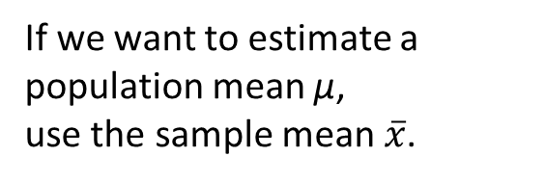
Describing Sampling Distributions
In many cases, it is obvious which statistic should be used as an estimator of a population parameter.
If we want to estimate a population proportion p,
use the sample proportion $\hat{p}.$
If we want to estimate a population mean µ,
use the sample mean $\overline{x}$.

Slide 50
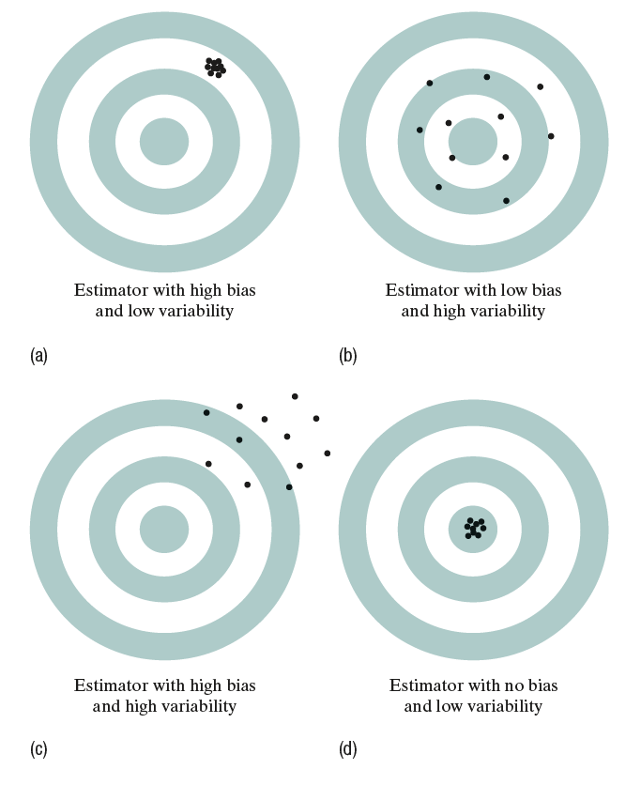
Describing Sampling Distributions
To decide which estimator to use when there are several reasonable choices, consider both bias and variability.

Slide 51
Describing Sampling Distributions
To decide which estimator to use when there are several reasonable choices, consider both bias and variability.
Bias means that our sample statistics do not center on the population parameter. In other words, our estimates are not accurate.

Slide 52
Describing Sampling Distributions
To decide which estimator to use when there are several reasonable choices, consider both bias and variability.
Bias means that our sample statistics do not center on the population parameter. In other words, our estimates are not accurate.
High variability means that repeated samples do not give very similar results. In other words, our estimates are not very precise.

Slide 53
Describing Sampling Distributions
AP® Exam Tip
Make sure to understand the difference between accuracy and precision when writing responses on the AP® Statistics Exam. Many students use “accurate” when they really mean “precise.” For example, a response that says “increasing the sample size will make an estimate more accurate” is incorrect. It should say that increasing the sample size will make an estimate more precise. If you can’t remember which term to use, don’t use either of them. Instead, explain what you mean without using statistical vocabulary.

Slide 54
Section Summary
DISTINGUISH between a parameter and a statistic.
CREATE a sampling distribution using all possible samples from a small population.
USE the sampling distribution of a statistic to EVALUATE a claim about a parameter.
DISTINGUISH among the distribution of a population, the distribution of a sample, and the sampling distribution of a statistic.
DETERMINE if a statistic is an unbiased estimator of a population parameter.
DESCRIBE the relationship between sample size and the variability of a statistic.

