Slide 1


Chapter 7
Sampling Distributions
Section 7.2
Sample Proportions

Slide 2
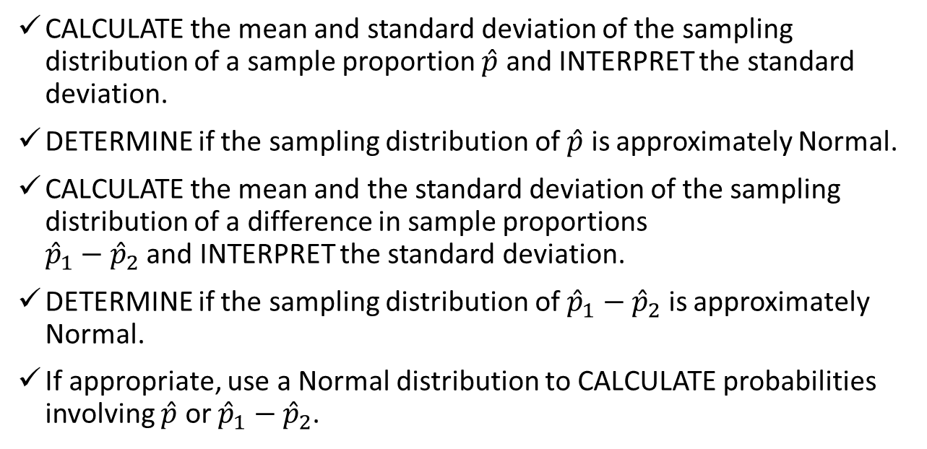
Sample Proportions
CALCULATE the mean and standard deviation of the sampling distribution of a sample proportion $\hat{p}$ and INTERPRET the standard deviation.
DETERMINE if the sampling distribution of $\hat{p}$ is approximately Normal.
CALCULATE the mean and the standard deviation of the sampling distribution of a difference in sample proportions
${\hat{p}}_{1}−{\hat{p}}_{2}$ and INTERPRET the standard deviation.
DETERMINE if the sampling distribution of ${\hat{p}}_{1}−{\hat{p}}_{2}$ is approximately Normal.
If appropriate, use a Normal distribution to CALCULATE probabilities involving $\hat{p}$ or ${\hat{p}}_{1}−{\hat{p}}_{2}$.

Slide 3
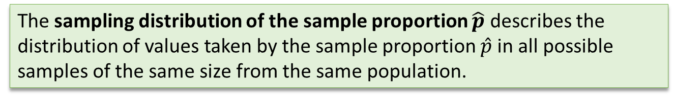
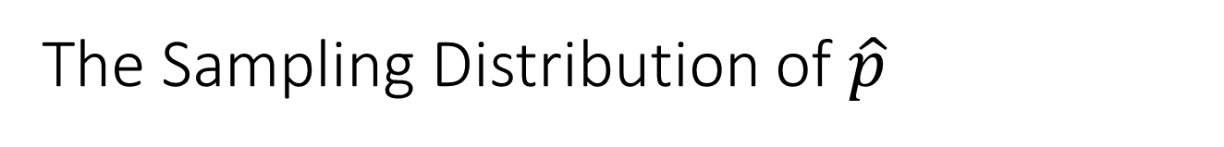
The Sampling Distribution of $\hat{p}$
The sampling distribution of the sample proportion $\hat{p}$ describes the distribution of values taken by the sample proportion $\hat{p}$in all possible samples of the same size from the same population.

Slide 4
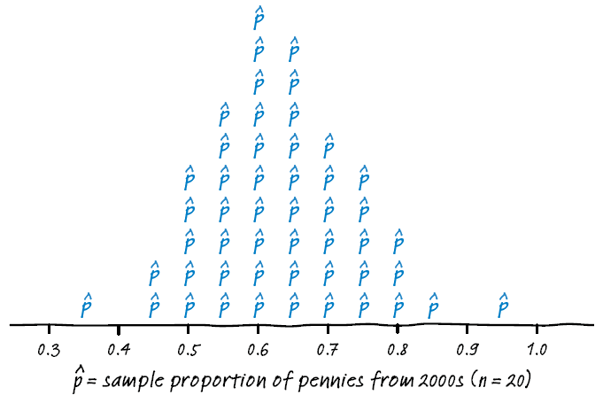
The Sampling Distribution of $\hat{p}$
The sampling distribution of the sample proportion $\hat{p}$ describes the distribution of values taken by the sample proportion $\hat{p}$in all possible samples of the same size from the same population.
Here is the approximate sampling distribution of the sample proportion of pennies from the 2000s in 50 samples of size n = 20 from a population of pennies.

Slide 5
The Sampling Distribution of $\hat{p}$
The sampling distribution of the sample proportion $\hat{p}$ describes the distribution of values taken by the sample proportion $\hat{p}$in all possible samples of the same size from the same population.
Here is the approximate sampling distribution of the sample proportion of pennies from the 2000s in 50 samples of size n = 20 from a population of pennies.
By the end of this section, you should be able to anticipate the shape, center, and variability of distributions like this one.

Slide 6
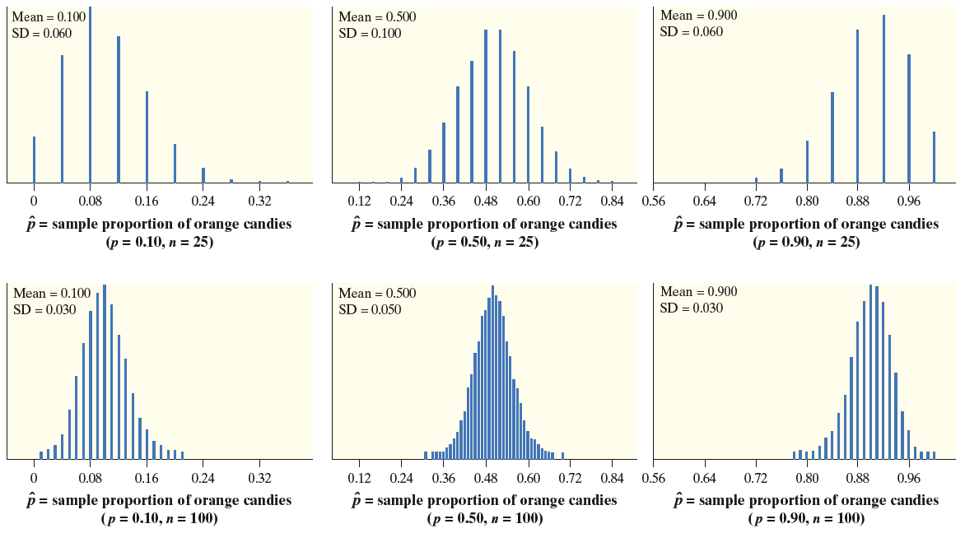
The Sampling Distribution of $\hat{p}$

Slide 7
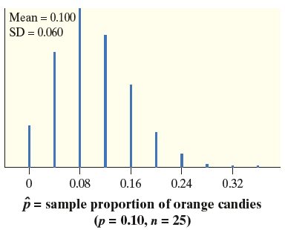
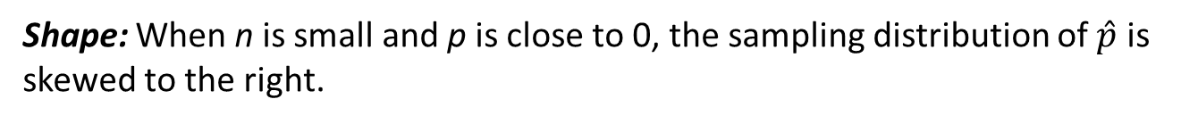
The Sampling Distribution of $\hat{p}$
Shape: When n is small and p is close to 0, the sampling distribution of $\hat{p}$ is skewed to the right.

Slide 8
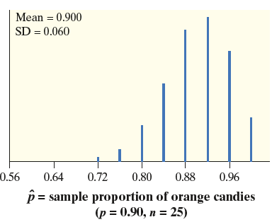
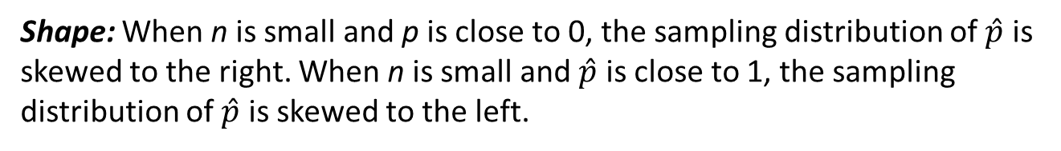
The Sampling Distribution of $\hat{p}$
Shape: When n is small and p is close to 0, the sampling distribution of $\hat{p}$ is skewed to the right. When n is small and $\hat{p}$ is close to 1, the sampling distribution of $\hat{p}$ is skewed to the left.

Slide 9
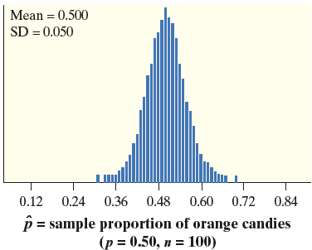
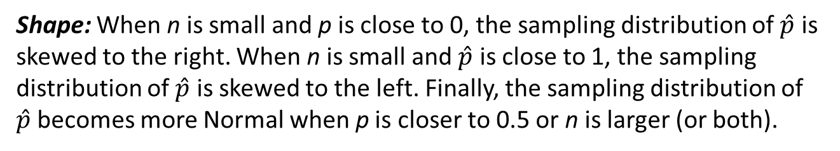
The Sampling Distribution of $\hat{p}$
Shape: When n is small and p is close to 0, the sampling distribution of $\hat{p}$ is skewed to the right. When n is small and $\hat{p}$ is close to 1, the sampling distribution of $\hat{p}$ is skewed to the left. Finally, the sampling distribution of $\hat{p}$becomes more Normal when p is closer to 0.5 or n is larger (or both).

Slide 10
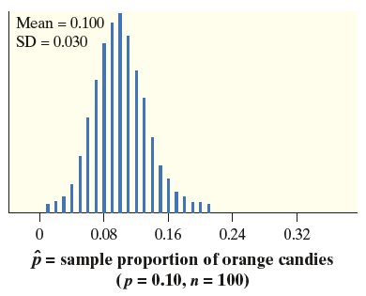
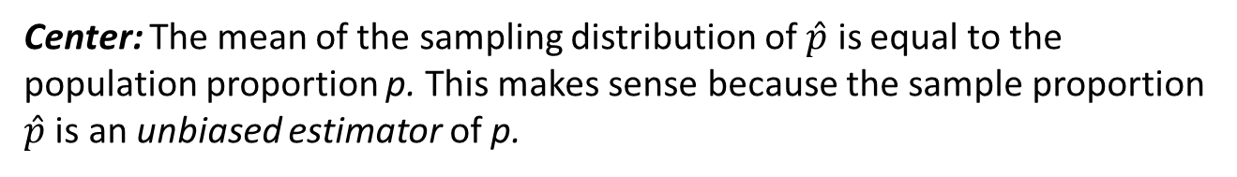
The Sampling Distribution of $\hat{p}$
Center: The mean of the sampling distribution of $\hat{p}$ is equal to the population proportion p. This makes sense because the sample proportion $\hat{p}$ is an unbiased estimator of p.

Slide 11
The Sampling Distribution of $\hat{p}$
Center: The mean of the sampling distribution of $\hat{p}$ is equal to the population proportion p. This makes sense because the sample proportion $\hat{p}$ is an unbiased estimator of p.

Slide 12
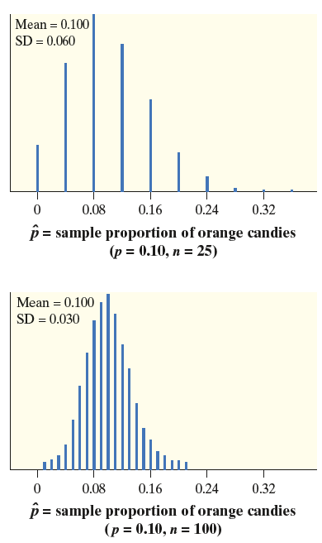
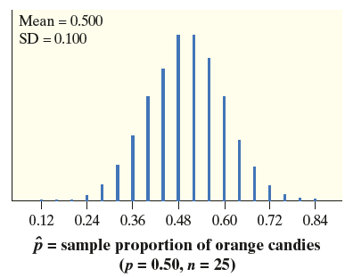
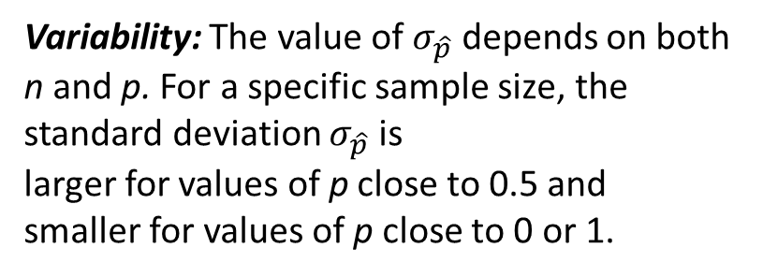
The Sampling Distribution of $\hat{p}$
Variability: The value of $σ_{\hat{p}}$ depends on both n and p. For a specific sample size, the standard deviation $σ_{\hat{p}}$ is
larger for values of p close to 0.5 and
smaller for values of p close to 0 or 1.

Slide 13
The Sampling Distribution of $\hat{p}$
Variability: The value of $σ_{\hat{p}}$ depends on both n and p. For a specific sample size, the standard deviation $σ_{\hat{p}}$ is
larger for values of p close to 0.5 and
smaller for values of p close to 0 or 1.

Slide 14
The Sampling Distribution of $\hat{p}$
Variability: The value of $σ_{\hat{p}}$ depends on both n and p. For a specific sample size, the standard deviation $σ_{\hat{p}}$ is
larger for values of p close to 0.5 and
smaller for values of p close to 0 or 1.

Slide 15
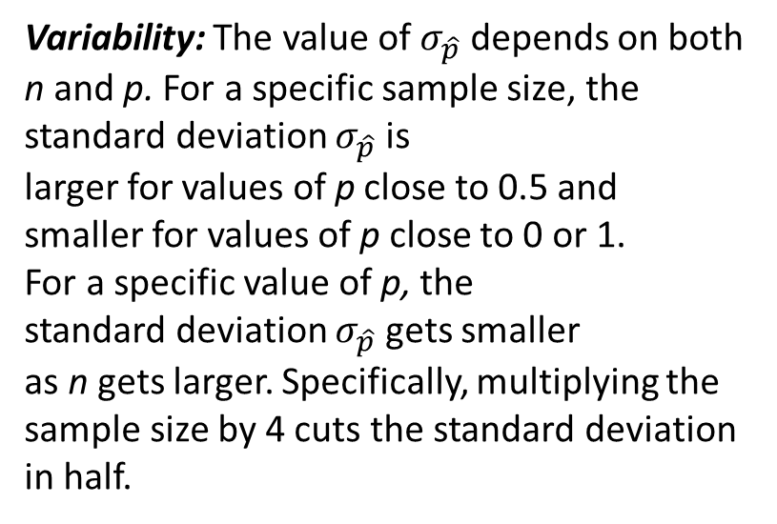
The Sampling Distribution of $\hat{p}$
Variability: The value of $σ_{\hat{p}}$ depends on both n and p. For a specific sample size, the standard deviation $σ_{\hat{p}}$ is
larger for values of p close to 0.5 and
smaller for values of p close to 0 or 1.
For a specific value of p, the
standard deviation $σ_{\hat{p}}$ gets smaller
as n gets larger. Specifically, multiplying the sample size by 4 cuts the standard deviation in half.

Slide 16
The Sampling Distribution of $\hat{p}$
Variability: The value of $σ_{\hat{p}}$ depends on both n and p. For a specific sample size, the standard deviation $σ_{\hat{p}}$ is
larger for values of p close to 0.5 and
smaller for values of p close to 0 or 1.
For a specific value of p, the
standard deviation $σ_{\hat{p}}$ gets smaller
as n gets larger. Specifically, multiplying the sample size by 4 cuts the standard deviation in half.

Slide 17
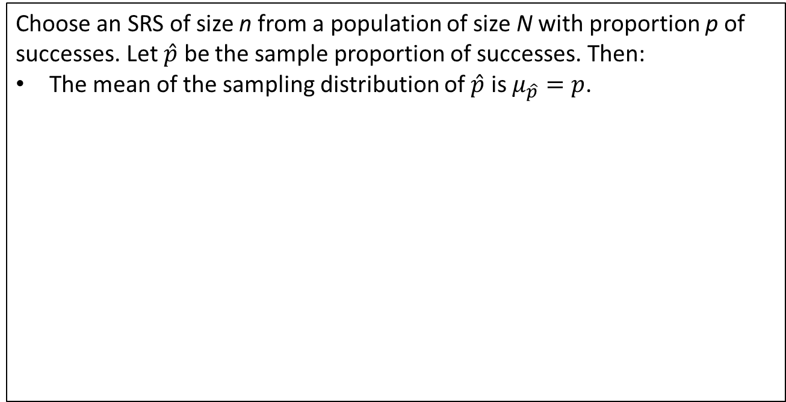
The Sampling Distribution of $\hat{p}$
Sampling Distribution of a Sample Proportion $\hat{p}$
Choose an SRS of size n from a population of size N with proportion p of
successes. Let $\hat{p}$ be the sample proportion of successes. Then:
The mean of the sampling distribution of $\hat{p}$ is $μ_{\hat{p}}=p$.

Slide 18
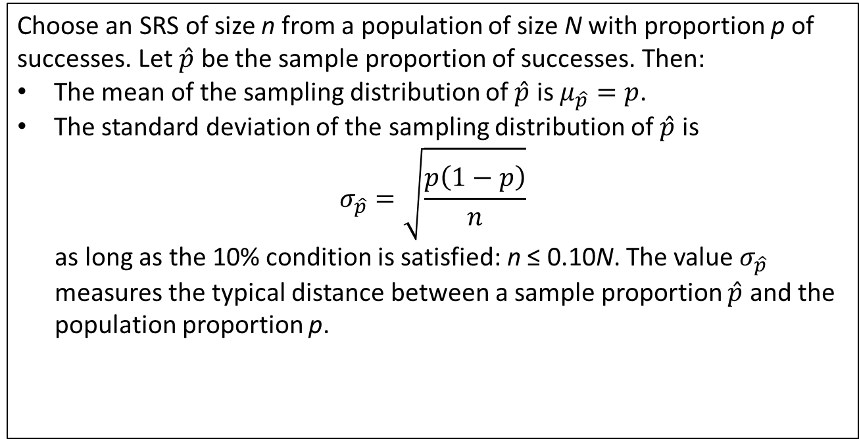
The Sampling Distribution of $\hat{p}$
Sampling Distribution of a Sample Proportion $\hat{p}$
Choose an SRS of size n from a population of size N with proportion p of
successes. Let $\hat{p}$ be the sample proportion of successes. Then:
The mean of the sampling distribution of $\hat{p}$ is $μ_{\hat{p}}=p$.
The standard deviation of the sampling distribution of $\hat{p}$ is
$$σ_{\hat{p}}=\sqrt{\frac{p\left(1−p\right)}{n}}$$
as long as the 10% condition is satisfied: n ≤ 0.10N. The value $σ_{\hat{p}}$ measures the typical distance between a sample proportion $\hat{p}$ and the population proportion p.

Slide 19
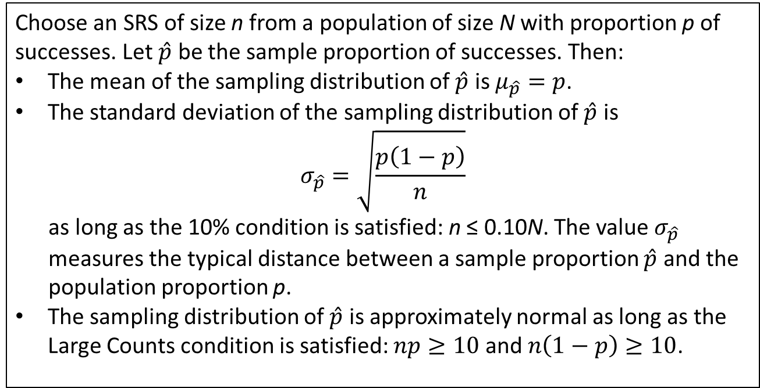
The Sampling Distribution of $\hat{p}$
Sampling Distribution of a Sample Proportion $\hat{p}$
Choose an SRS of size n from a population of size N with proportion p of
successes. Let $\hat{p}$ be the sample proportion of successes. Then:
The mean of the sampling distribution of $\hat{p}$ is $μ_{\hat{p}}=p$.
The standard deviation of the sampling distribution of $\hat{p}$ is
$$σ_{\hat{p}}=\sqrt{\frac{p\left(1−p\right)}{n}}$$
as long as the 10% condition is satisfied: n ≤ 0.10N. The value $σ_{\hat{p}}$ measures the typical distance between a sample proportion $\hat{p}$ and the population proportion p.
The sampling distribution of $\hat{p}$ is approximately normal as long as the Large Counts condition is satisfied: $np≥10$ and $n\left(1−p\right)≥10$.

Slide 20
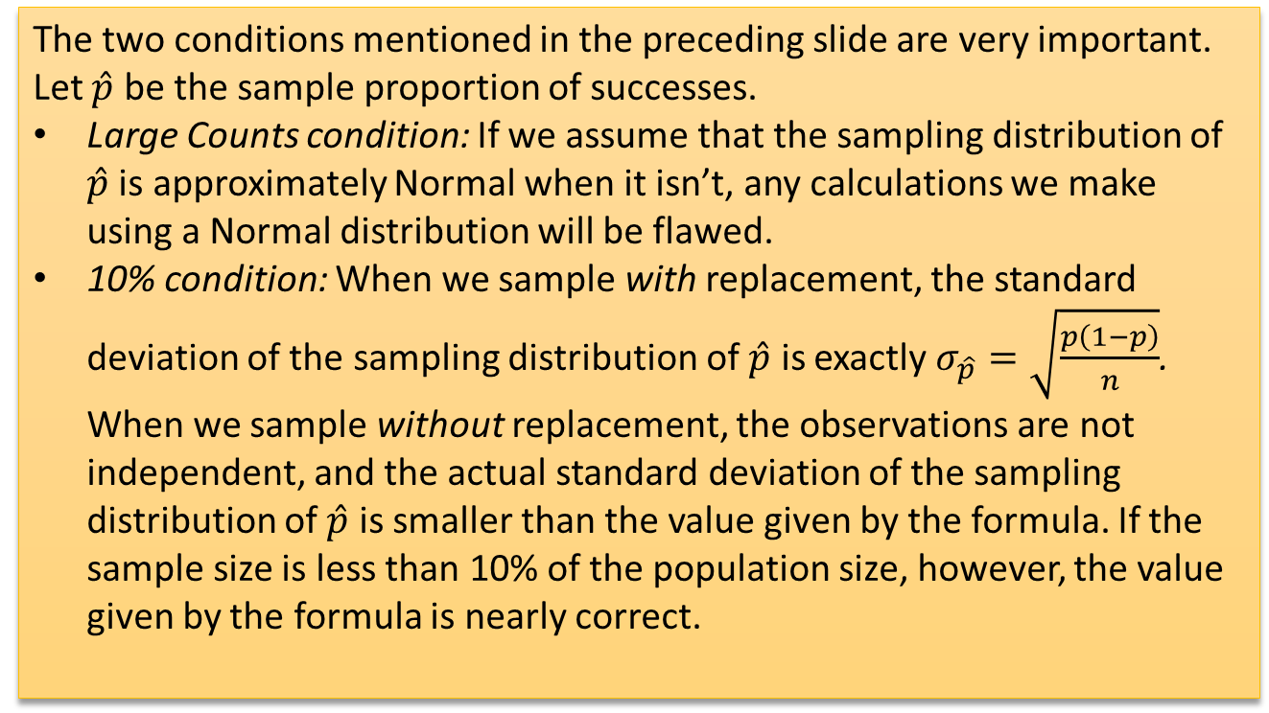
The Sampling Distribution of $\hat{p}$
The two conditions mentioned in the preceding slide are very important. Let $\hat{p}$ be the sample proportion of successes.
Large Counts condition: If we assume that the sampling distribution of $\hat{p}$ is approximately Normal when it isn’t, any calculations we make using a Normal distribution will be flawed.
10% condition: When we sample with replacement, the standard deviation of the sampling distribution of $\hat{p}$ is exactly $σ_{\hat{p}}=\sqrt{\frac{p\left(1−p\right)}{n}}$. When we sample without replacement, the observations are not independent, and the actual standard deviation of the sampling distribution of $\hat{p}$ is smaller than the value given by the formula. If the sample size is less than 10% of the population size, however, the value given by the formula is nearly correct.

Slide 21
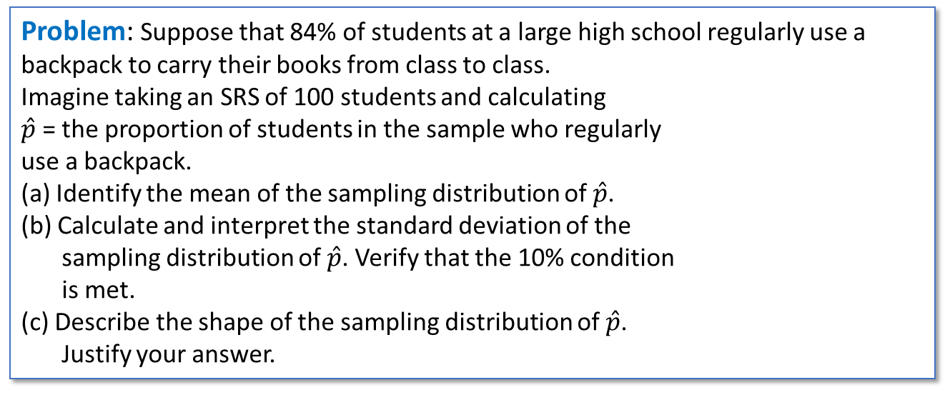
The Sampling Distribution of $\hat{p}$
Problem: Suppose that 84% of students at a large high school regularly use a backpack to carry their books from class to class.
Imagine taking an SRS of 100 students and calculating
$\hat{p}$ = the proportion of students in the sample who regularly
use a backpack.
(a) Identify the mean of the sampling distribution of $\hat{p}$.
(b) Calculate and interpret the standard deviation of the
sampling distribution of $\hat{p}$. Verify that the 10% condition
is met.
(c) Describe the shape of the sampling distribution of $\hat{p}$.
Justify your answer.
bo1982/Getty Images

Slide 22
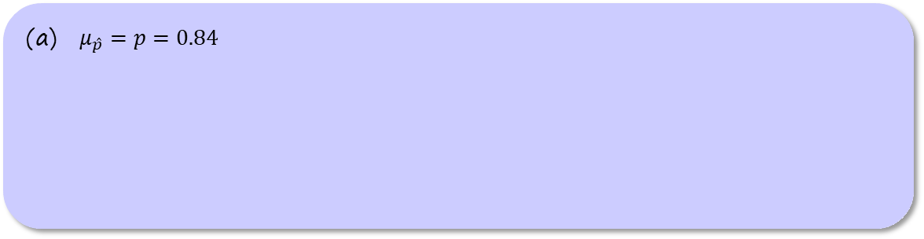
The Sampling Distribution of $\hat{p}$
Problem: Suppose that 84% of students at a large high school regularly use a backpack to carry their books from class to class.
Imagine taking an SRS of 100 students and calculating
$\hat{p}$ = the proportion of students in the sample who regularly
use a backpack.
(a) Identify the mean of the sampling distribution of $\hat{p}$.
(b) Calculate and interpret the standard deviation of the
sampling distribution of $\hat{p}$. Verify that the 10% condition
is met.
(c) Describe the shape of the sampling distribution of $\hat{p}$.
Justify your answer.
bo1982/Getty Images
$μ_{\hat{p}}=p=0.84$

Slide 23
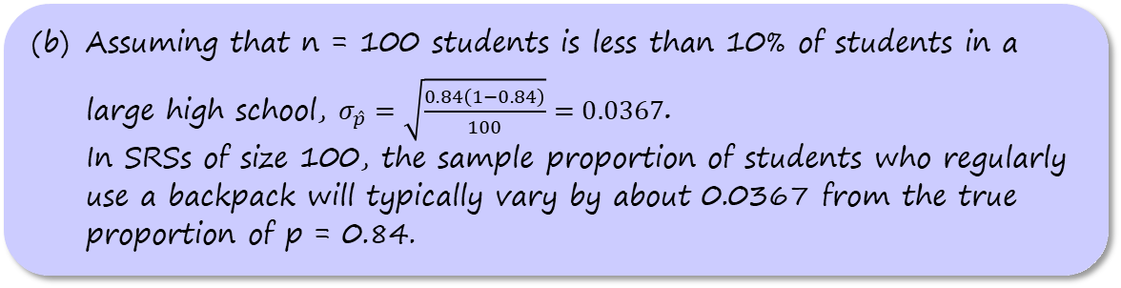
The Sampling Distribution of $\hat{p}$
Problem: Suppose that 84% of students at a large high school regularly use a backpack to carry their books from class to class.
Imagine taking an SRS of 100 students and calculating
$\hat{p}$ = the proportion of students in the sample who regularly
use a backpack.
(a) Identify the mean of the sampling distribution of $\hat{p}$.
(b) Calculate and interpret the standard deviation of the
sampling distribution of $\hat{p}$. Verify that the 10% condition
is met.
(c) Describe the shape of the sampling distribution of $\hat{p}$.
Justify your answer.
bo1982/Getty Images
(b) Assuming that n = 100 students is less than 10% of students in a large high school, $σ_{\hat{p}}=\sqrt{\frac{0.84\left(1−0.84\right)}{100}}=0.0367$.
In SRSs of size 100, the sample proportion of students who regularly use a backpack will typically vary by about 0.0367 from the true proportion of p = 0.84.

Slide 24
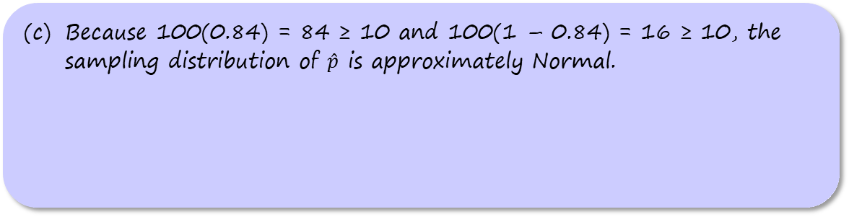
The Sampling Distribution of $\hat{p}$
Problem: Suppose that 84% of students at a large high school regularly use a backpack to carry their books from class to class.
Imagine taking an SRS of 100 students and calculating
$\hat{p}$ = the proportion of students in the sample who regularly
use a backpack.
(a) Identify the mean of the sampling distribution of $\hat{p}$.
(b) Calculate and interpret the standard deviation of the
sampling distribution of $\hat{p}$. Verify that the 10% condition
is met.
(c) Describe the shape of the sampling distribution of $\hat{p}$.
Justify your answer.
bo1982/Getty Images
(c) Because 100(0.84) = 84 ≥ 10 and 100(1 – 0.84) = 16 ≥ 10, the sampling distribution of $\hat{p}$ is approximately Normal.

Slide 25
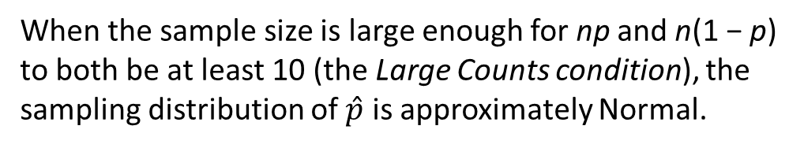
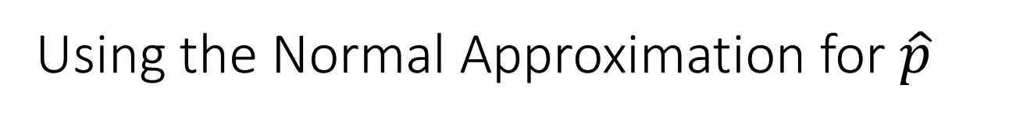
Using the Normal Approximation for $\hat{p}$
When the sample size is large enough for np and n(1 − p) to both be at least 10 (the Large Counts condition), the sampling distribution of $\hat{p}$ is approximately Normal.

Slide 26
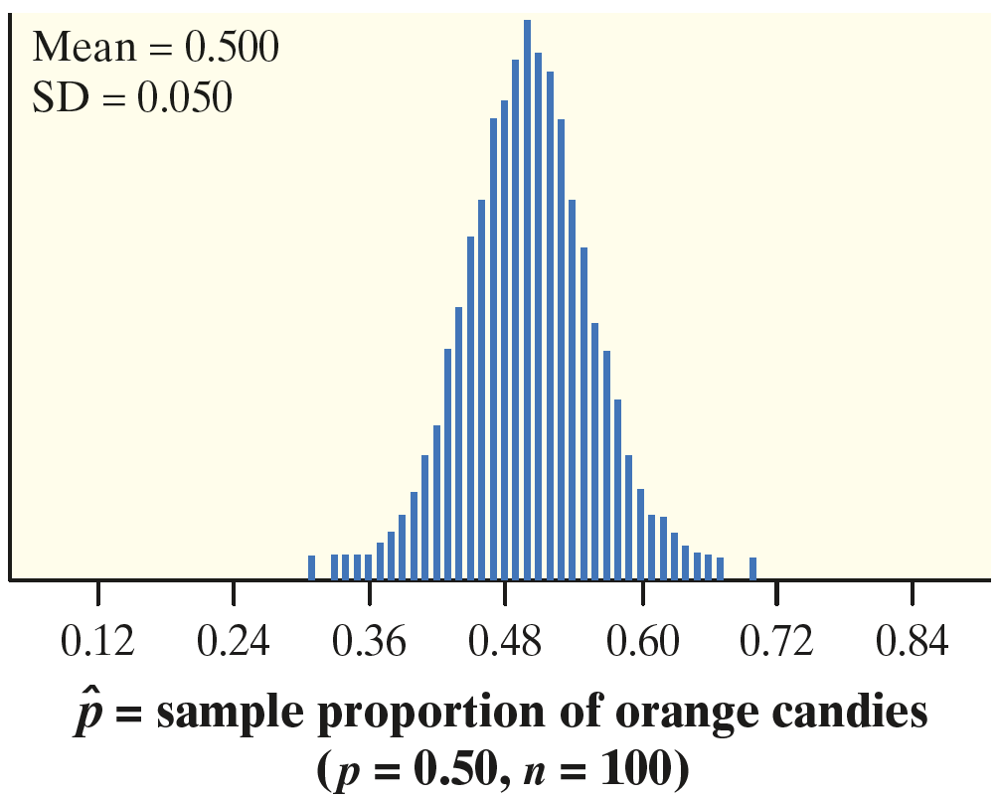
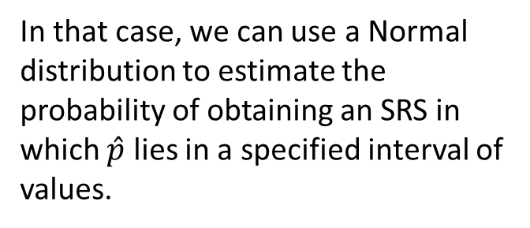
Using the Normal Approximation for $\hat{p}$
When the sample size is large enough for np and n(1 − p) to both be at least 10 (the Large Counts condition), the sampling distribution of $\hat{p}$ is approximately Normal.
In that case, we can use a Normal distribution to estimate the probability of obtaining an SRS in which $\hat{p}$ lies in a specified interval of values.

Slide 27

The Sampling Distribution of $\hat{p}$
Problem: A polling organization asks an SRS of 1500 first-year
college students how far away their home is. Suppose that
35% of all first-year students attend college within 50 miles
of home. Find the probability that the random sample of 1500
students will give a result within 2 percentage points of the
true value.
Ivan Vukovic/Shutterstock

Slide 28
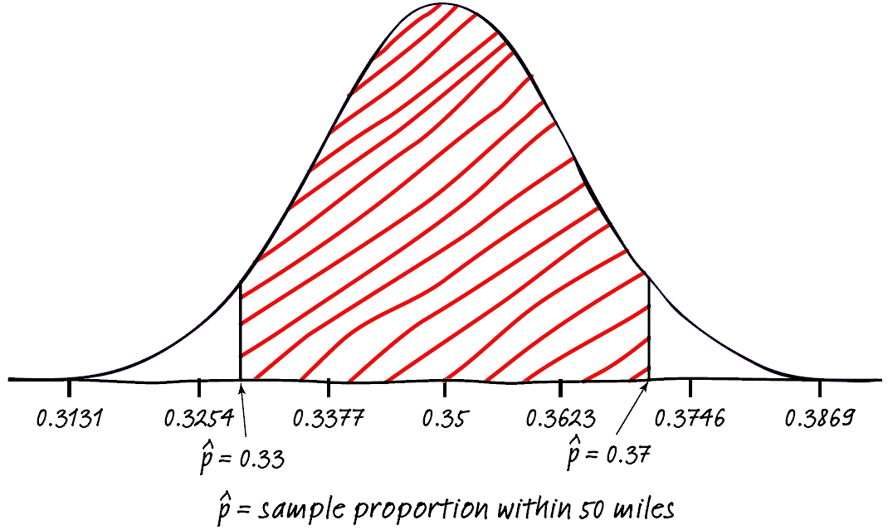
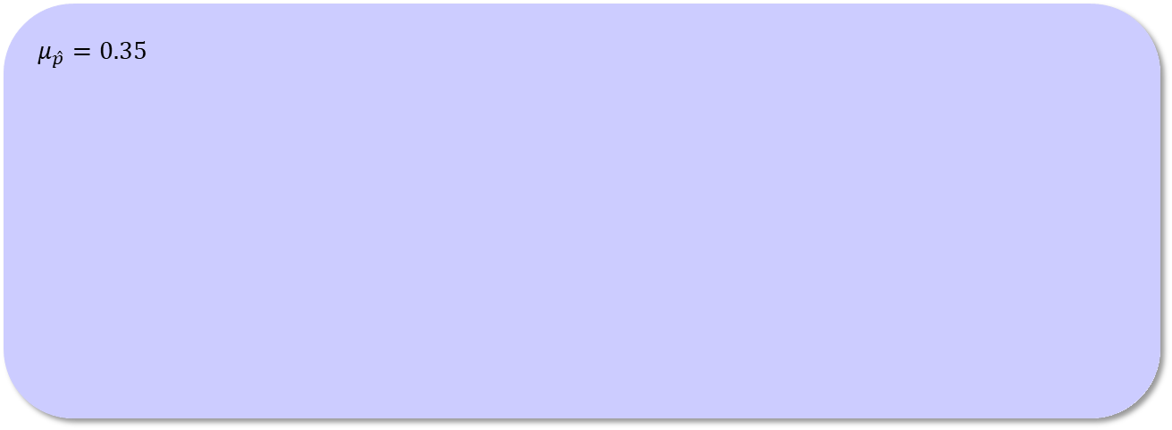
The Sampling Distribution of $\hat{p}$
Problem: A polling organization asks an SRS of 1500 first-year
college students how far away their home is. Suppose that
35% of all first-year students attend college within 50 miles
of home. Find the probability that the random sample of 1500
students will give a result within 2 percentage points of the
true value.
Ivan Vukovic/Shutterstock
$$μ_{\hat{p}}=0.35$$

Slide 29
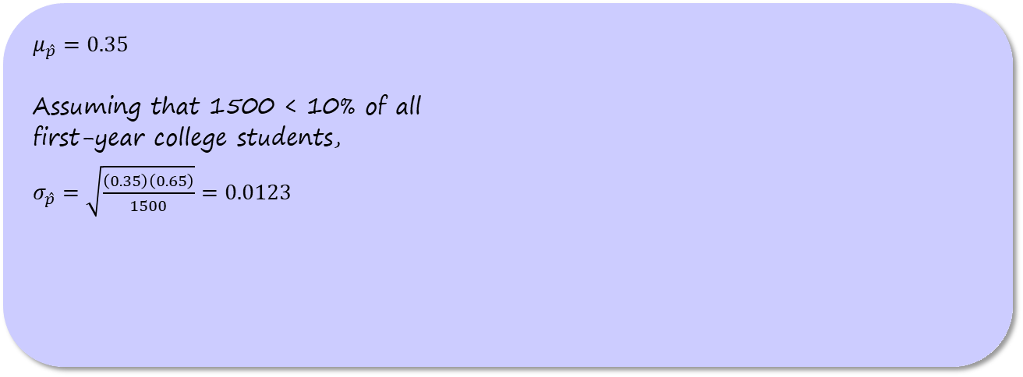
The Sampling Distribution of $\hat{p}$
Problem: A polling organization asks an SRS of 1500 first-year
college students how far away their home is. Suppose that
35% of all first-year students attend college within 50 miles
of home. Find the probability that the random sample of 1500
students will give a result within 2 percentage points of the
true value.
Ivan Vukovic/Shutterstock
$$μ_{\hat{p}}=0.35$$
Assuming that 1500 < 10% of all
first-year college students,
$σ_{\hat{p}}=\sqrt{\frac{\left(0.35\right)\left(0.65\right)}{1500}}=0.0123$

Slide 30
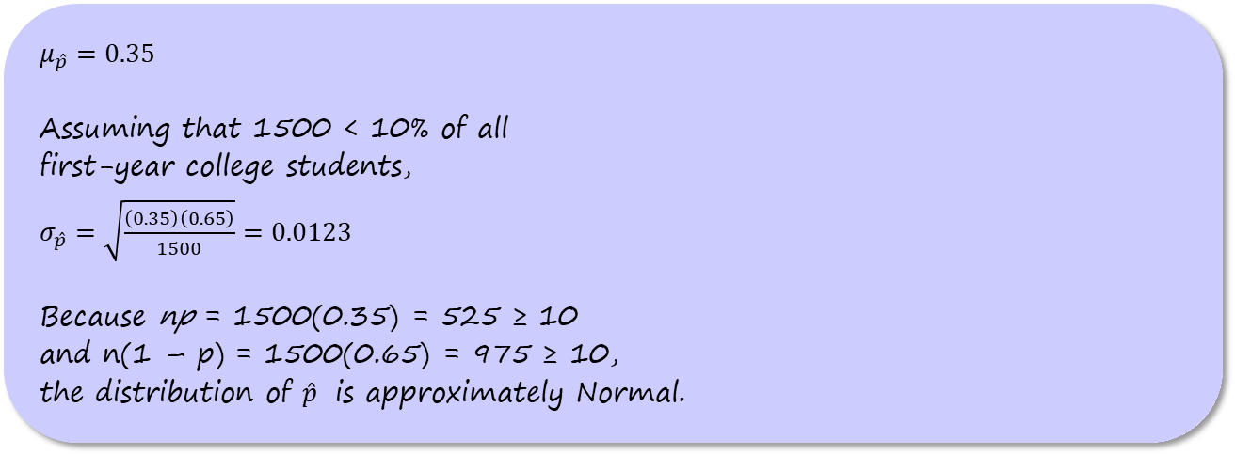
The Sampling Distribution of $\hat{p}$
Problem: A polling organization asks an SRS of 1500 first-year
college students how far away their home is. Suppose that
35% of all first-year students attend college within 50 miles
of home. Find the probability that the random sample of 1500
students will give a result within 2 percentage points of the
true value.
Ivan Vukovic/Shutterstock
$$μ_{\hat{p}}=0.35$$
Assuming that 1500 < 10% of all
first-year college students,
$σ_{\hat{p}}=\sqrt{\frac{\left(0.35\right)\left(0.65\right)}{1500}}=0.0123$
Because np = 1500(0.35) = 525 ≥ 10
and n(1 – p) = 1500(0.65) = 975 ≥ 10,
the distribution of $\hat{p}$ is approximately Normal.

Slide 31
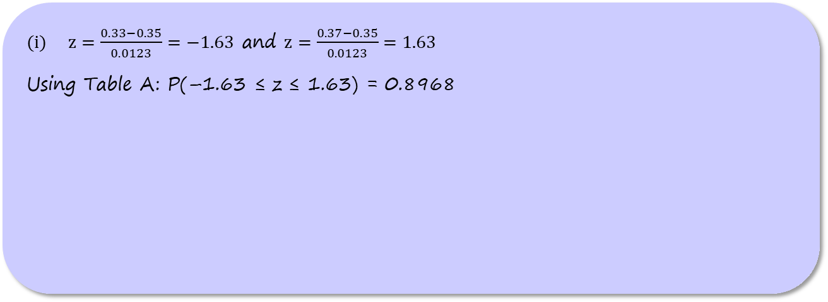
The Sampling Distribution of $\hat{p}$
Problem: A polling organization asks an SRS of 1500 first-year
college students how far away their home is. Suppose that
35% of all first-year students attend college within 50 miles
of home. Find the probability that the random sample of 1500
students will give a result within 2 percentage points of the
true value.
Ivan Vukovic/Shutterstock
$z=\frac{0.33−0.35}{0.0123}=−1.63$ and $z=\frac{0.37−0.35}{0.0123}=1.63$
Using Table A: P(–1.63 ≤ z ≤ 1.63) = 0.8968

Slide 32
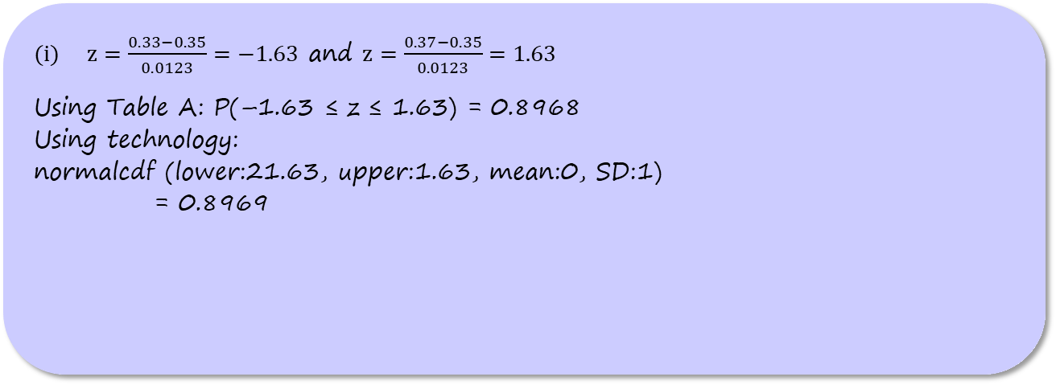
The Sampling Distribution of $\hat{p}$
Problem: A polling organization asks an SRS of 1500 first-year
college students how far away their home is. Suppose that
35% of all first-year students attend college within 50 miles
of home. Find the probability that the random sample of 1500
students will give a result within 2 percentage points of the
true value.
Ivan Vukovic/Shutterstock
$z=\frac{0.33−0.35}{0.0123}=−1.63$ and $z=\frac{0.37−0.35}{0.0123}=1.63$
Using Table A: P(–1.63 ≤ z ≤ 1.63) = 0.8968
Using technology:
normalcdf (lower:21.63, upper:1.63, mean:0, SD:1)
= 0.8969

Slide 33
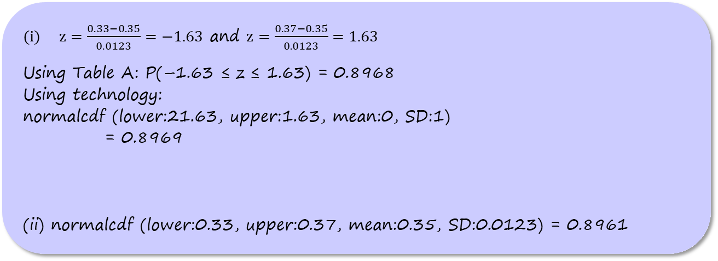
The Sampling Distribution of $\hat{p}$
Problem: A polling organization asks an SRS of 1500 first-year
college students how far away their home is. Suppose that
35% of all first-year students attend college within 50 miles
of home. Find the probability that the random sample of 1500
students will give a result within 2 percentage points of the
true value.
Ivan Vukovic/Shutterstock
$z=\frac{0.33−0.35}{0.0123}=−1.63$ and $z=\frac{0.37−0.35}{0.0123}=1.63$
Using Table A: P(–1.63 ≤ z ≤ 1.63) = 0.8968
Using technology:
normalcdf (lower:21.63, upper:1.63, mean:0, SD:1)
= 0.8969
(ii) normalcdf (lower:0.33, upper:0.37, mean:0.35, SD:0.0123) = 0.8961

Slide 34
The Sampling Distribution of a Difference
Between Two Proportions
At School 1, 70% of students did their homework last night (p₁ = 0.70).

Slide 35
The Sampling Distribution of a Difference
Between Two Proportions
At School 1, 70% of students did their homework last night (p₁ = 0.70).
At School 2, only 50% of the students did their homework last night (p₂ = 0.50).

Slide 36
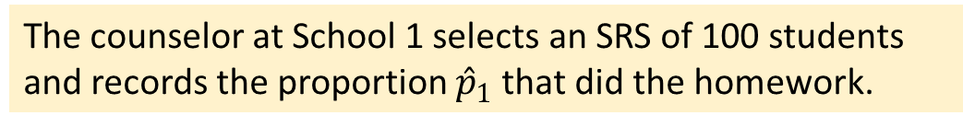
The Sampling Distribution of a Difference
Between Two Proportions
At School 1, 70% of students did their homework last night (p₁ = 0.70).
At School 2, only 50% of the students did their homework last night (p₂ = 0.50).
The counselor at School 1 selects an SRS of 100 students and records the proportion ${\hat{p}}_{1}$that did the homework.

Slide 37
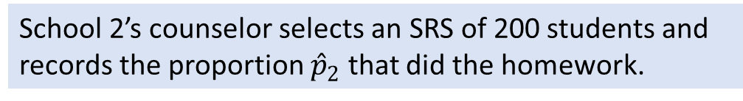
The Sampling Distribution of a Difference
Between Two Proportions
At School 1, 70% of students did their homework last night (p₁ = 0.70).
At School 2, only 50% of the students did their homework last night (p₂ = 0.50).
The counselor at School 1 selects an SRS of 100 students and records the proportion ${\hat{p}}_{1}$that did the homework.
School 2’s counselor selects an SRS of 200 students and records the proportion ${\hat{p}}_{2}$ that did the homework.

Slide 38
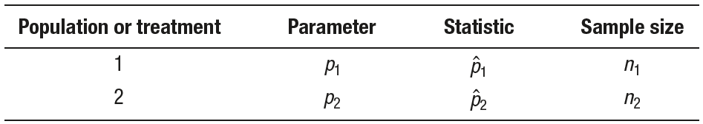
The Sampling Distribution of a Difference
Between Two Proportions
At School 1, 70% of students did their homework last night (p₁ = 0.70).
At School 2, only 50% of the students did their homework last night (p₂ = 0.50).
The counselor at School 1 selects an SRS of 100 students and records the proportion ${\hat{p}}_{1}$that did the homework.
School 2’s counselor selects an SRS of 200 students and records the proportion ${\hat{p}}_{2}$ that did the homework.

Slide 39
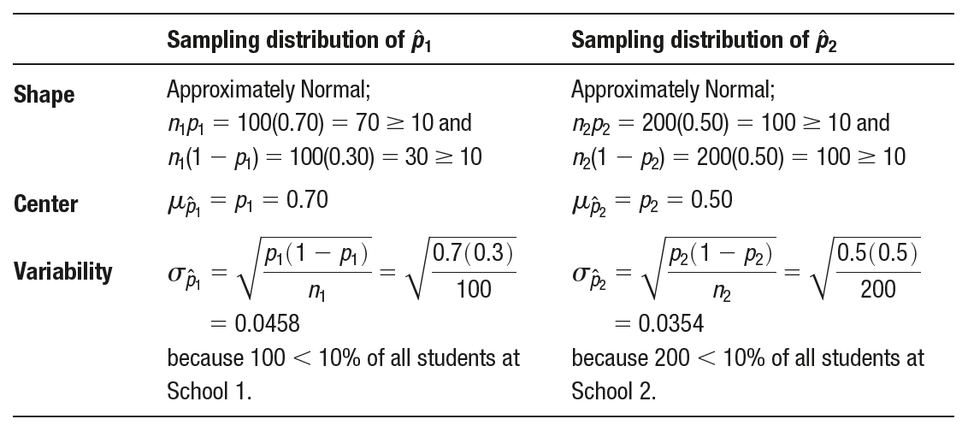
The Sampling Distribution of a Difference
Between Two Proportions

Slide 40
The Sampling Distribution of a Difference
Between Two Proportions
What can we say about the difference ${\hat{p}}_{1}−{\hat{p}}_{2}$ in the sample proportions?

Slide 41
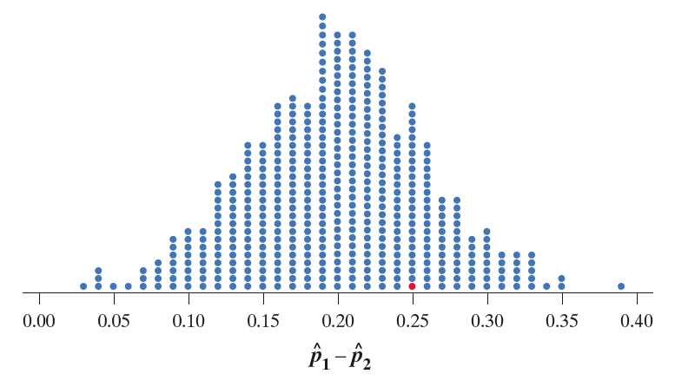
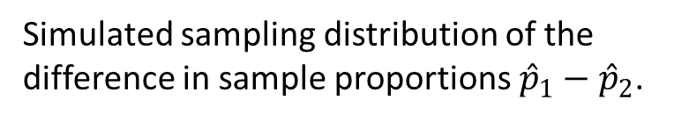
The Sampling Distribution of a Difference
Between Two Proportions
What can we say about the difference ${\hat{p}}_{1}−{\hat{p}}_{2}$ in the sample proportions?
Simulated sampling distribution of the difference in sample proportions ${\hat{p}}_{1}−{\hat{p}}_{2}$.

Slide 42
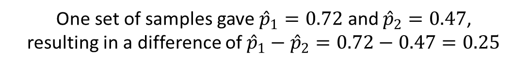
The Sampling Distribution of a Difference
Between Two Proportions
What can we say about the difference ${\hat{p}}_{1}−{\hat{p}}_{2}$ in the sample proportions?
Simulated sampling distribution of the difference in sample proportions ${\hat{p}}_{1}−{\hat{p}}_{2}$.
One set of samples gave ${\hat{p}}_{1}=0.72$ and ${\hat{p}}_{2}=0.47$,
resulting in a difference of ${\hat{p}}_{1}−{\hat{p}}_{2}=0.72−0.47=0.25$

Slide 43
The Sampling Distribution of a Difference
Between Two Proportions
What can we say about the difference ${\hat{p}}_{1}−{\hat{p}}_{2}$ in the sample proportions?

Slide 44
The Sampling Distribution of a Difference
Between Two Proportions
What can we say about the difference ${\hat{p}}_{1}−{\hat{p}}_{2}$ in the sample proportions?
mean = p₁ – p₂ = 0.20

Slide 45
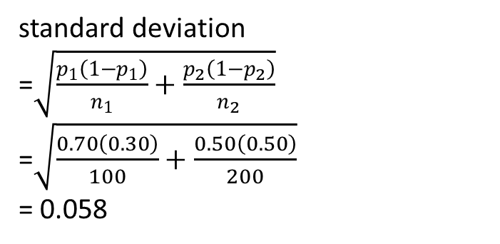
The Sampling Distribution of a Difference
Between Two Proportions
What can we say about the difference ${\hat{p}}_{1}−{\hat{p}}_{2}$ in the sample proportions?
standard deviation
=$\sqrt{\frac{p_{1}\left(1−p_{1}\right)}{n_{1}}+\frac{p_{2}\left(1−p_{2}\right)}{n_{2}}}$
=$\sqrt{\frac{0.70\left(0.30\right)}{100}+\frac{0.50\left(0.50\right)}{200}}$
= 0.058
mean = p₁ – p₂ = 0.20

Slide 46
The Sampling Distribution of a Difference
Between Two Proportions
The Sampling Distribution of ${\hat{p}}_{1}−{\hat{p}}_{2}$
Choose an SRS of size n₁ from Population 1 with proportion of successes
p₁ and an independent SRS of size n₂ from Population 2 with proportion of
successes p₂. Then:

Slide 47
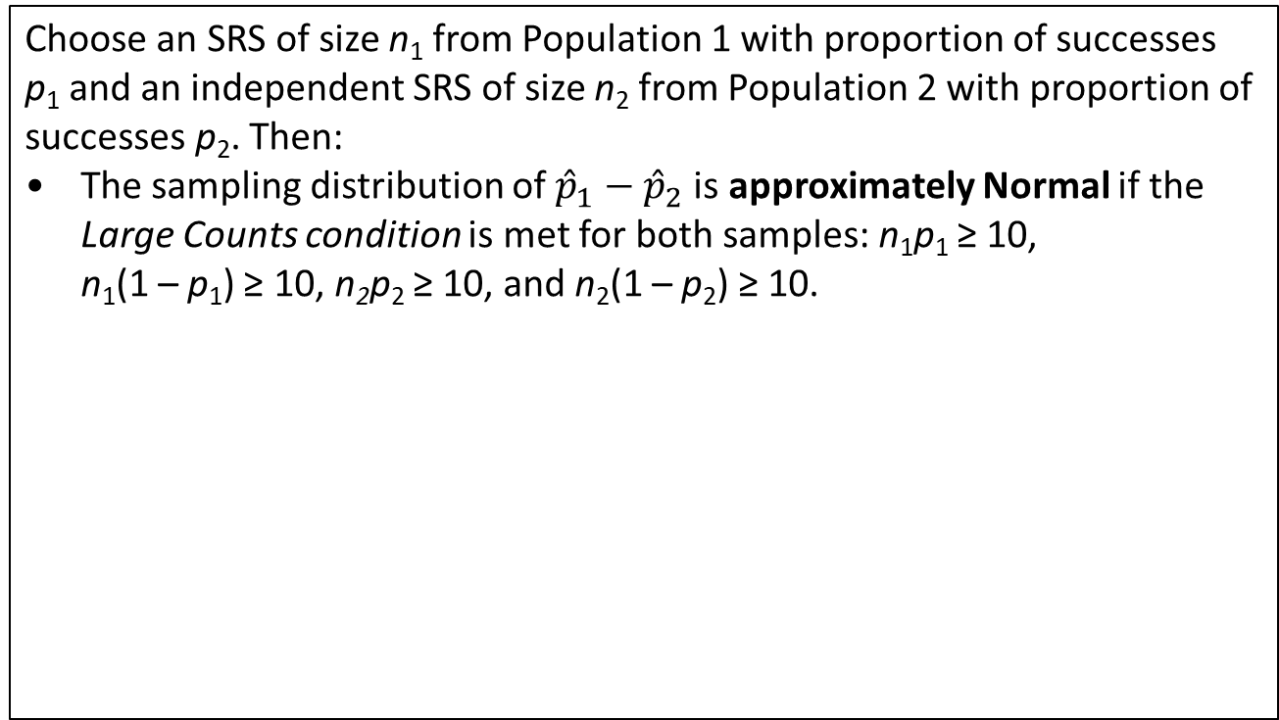
The Sampling Distribution of a Difference
Between Two Proportions
The Sampling Distribution of ${\hat{p}}_{1}−{\hat{p}}_{2}$
Choose an SRS of size n₁ from Population 1 with proportion of successes
p₁ and an independent SRS of size n₂ from Population 2 with proportion of
successes p₂. Then:
• The sampling distribution of ${\hat{p}}_{1}−{\hat{p}}_{2}$is approximately Normal if the Large Counts condition is met for both samples: n₁p₁ ≥ 10,
n₁(1 – p₁) ≥ 10, n₂p₂ ≥ 10, and n₂(1 – p₂) ≥ 10.

Slide 48
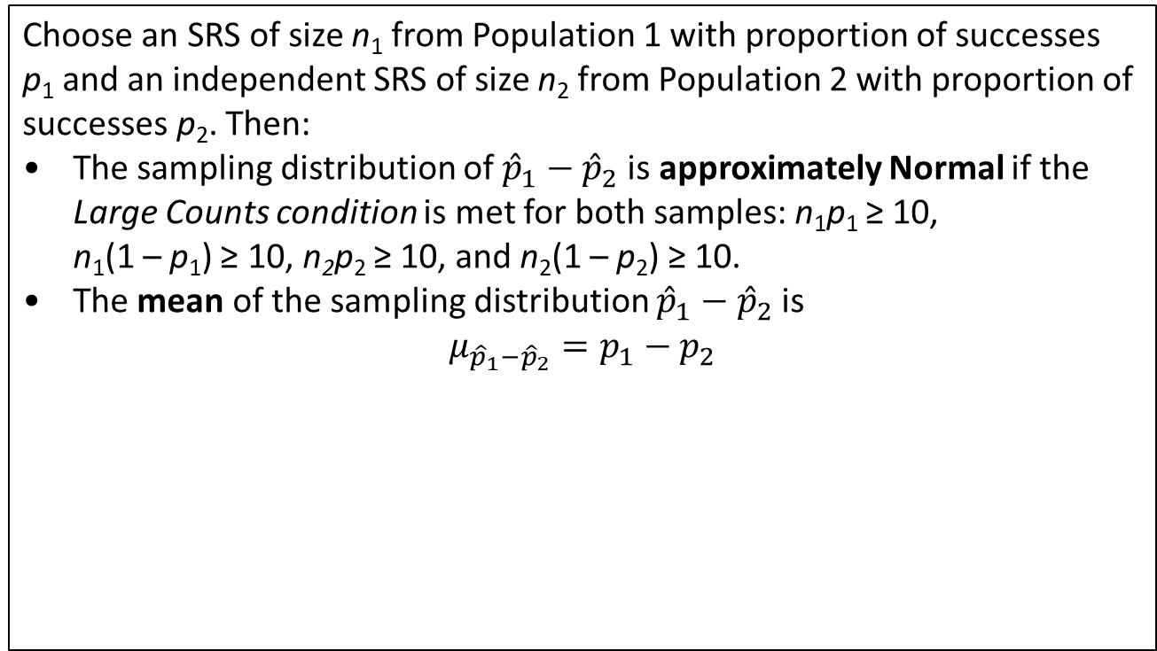
The Sampling Distribution of a Difference
Between Two Proportions
The Sampling Distribution of ${\hat{p}}_{1}−{\hat{p}}_{2}$
Choose an SRS of size n₁ from Population 1 with proportion of successes
p₁ and an independent SRS of size n₂ from Population 2 with proportion of
successes p₂. Then:
• The sampling distribution of ${\hat{p}}_{1}−{\hat{p}}_{2}$is approximately Normal if the Large Counts condition is met for both samples: n₁p₁ ≥ 10,
n₁(1 – p₁) ≥ 10, n₂p₂ ≥ 10, and n₂(1 – p₂) ≥ 10.
• The mean of the sampling distribution ${\hat{p}}_{1}−{\hat{p}}_{2}$is
$$μ_{{\hat{p}}_{1}−{\hat{p}}_{2}}=p_{1}−p_{2}$$

Slide 49
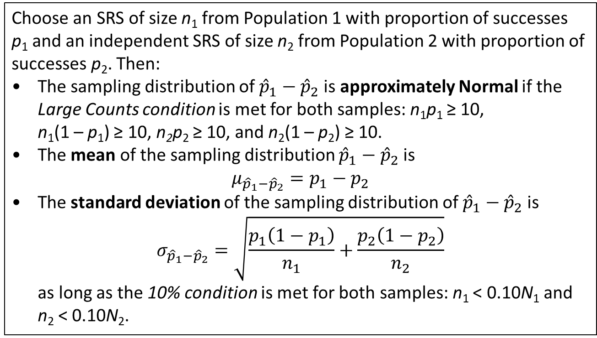
The Sampling Distribution of a Difference
Between Two Proportions
The Sampling Distribution of ${\hat{p}}_{1}−{\hat{p}}_{2}$
Choose an SRS of size n₁ from Population 1 with proportion of successes
p₁ and an independent SRS of size n₂ from Population 2 with proportion of
successes p₂. Then:
• The sampling distribution of ${\hat{p}}_{1}−{\hat{p}}_{2}$is approximately Normal if the Large Counts condition is met for both samples: n₁p₁ ≥ 10,
n₁(1 – p₁) ≥ 10, n₂p₂ ≥ 10, and n₂(1 – p₂) ≥ 10.
• The mean of the sampling distribution ${\hat{p}}_{1}−{\hat{p}}_{2}$is
$$μ_{{\hat{p}}_{1}−{\hat{p}}_{2}}=p_{1}−p_{2}$$
• The standard deviation of the sampling distribution of ${\hat{p}}_{1}−{\hat{p}}_{2}$is
$$σ_{{\hat{p}}_{1}−{\hat{p}}_{2}}=\sqrt{\frac{p_{1}\left(1−p_{1}\right)}{n_{1}}+\frac{p_{2}\left(1−p_{2}\right)}{n_{2}}}$$
as long as the 10% condition is met for both samples: n₁ < 0.10N₁ and
n₂ < 0.10N₂.

Slide 50
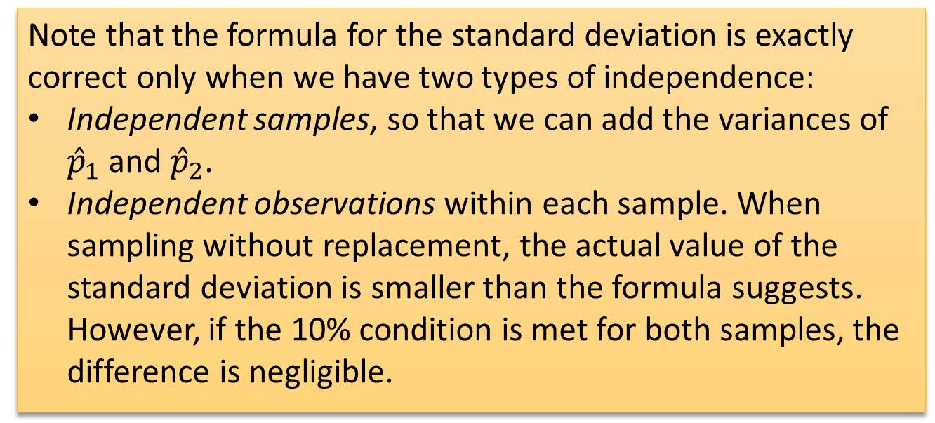
The Sampling Distribution of a Difference
Between Two Proportions
Note that the formula for the standard deviation is exactly correct only when we have two types of independence:
Independent samples, so that we can add the variances of ${\hat{p}}_{1}$ and ${\hat{p}}_{2}$.
Independent observations within each sample. When sampling without replacement, the actual value of the standard deviation is smaller than the formula suggests. However, if the 10% condition is met for both samples, the difference is negligible.

Slide 51
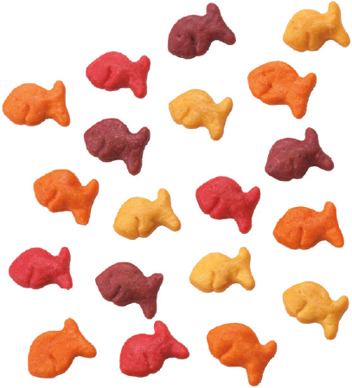
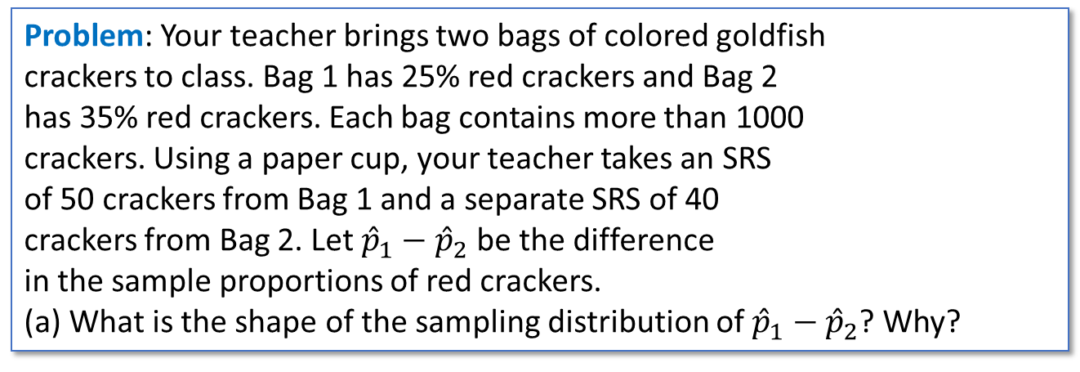
The Sampling Distribution of a Difference
Between Two Proportions
Problem: Your teacher brings two bags of colored goldfish
crackers to class. Bag 1 has 25% red crackers and Bag 2
has 35% red crackers. Each bag contains more than 1000
crackers. Using a paper cup, your teacher takes an SRS
of 50 crackers from Bag 1 and a separate SRS of 40
crackers from Bag 2. Let ${\hat{p}}_{1}−{\hat{p}}_{2}$be the difference
in the sample proportions of red crackers.
(a) What is the shape of the sampling distribution of ${\hat{p}}_{1}−{\hat{p}}_{2}$? Why?
Envision/Getty Images

Slide 52
The Sampling Distribution of a Difference
Between Two Proportions
Problem: Your teacher brings two bags of colored goldfish
crackers to class. Bag 1 has 25% red crackers and Bag 2
has 35% red crackers. Each bag contains more than 1000
crackers. Using a paper cup, your teacher takes an SRS
of 50 crackers from Bag 1 and a separate SRS of 40
crackers from Bag 2. Let ${\hat{p}}_{1}−{\hat{p}}_{2}$be the difference
in the sample proportions of red crackers.
(a) What is the shape of the sampling distribution of ${\hat{p}}_{1}−{\hat{p}}_{2}$? Why?
Envision/Getty Images
(a) Approximately Normal, because
n₁p₁ = 50(0.25) = 12.5
n₁(1 – p₁) = 50(0.75) = 37.5
n₂p₂ = 40(0.35) = 14
n₂(1 – p₂) = 40(0.65) = 26
are all ≥ 10.

Slide 53

The Sampling Distribution of a Difference
Between Two Proportions
Problem: Your teacher brings two bags of colored goldfish
crackers to class. Bag 1 has 25% red crackers and Bag 2
has 35% red crackers. Each bag contains more than 1000
crackers. Using a paper cup, your teacher takes an SRS
of 50 crackers from Bag 1 and a separate SRS of 40
crackers from Bag 2. Let ${\hat{p}}_{1}−{\hat{p}}_{2}$be the difference
in the sample proportions of red crackers.
(b) Find the mean of the sampling distribution.
Envision/Getty Images

Slide 54

The Sampling Distribution of a Difference
Between Two Proportions
Problem: Your teacher brings two bags of colored goldfish
crackers to class. Bag 1 has 25% red crackers and Bag 2
has 35% red crackers. Each bag contains more than 1000
crackers. Using a paper cup, your teacher takes an SRS
of 50 crackers from Bag 1 and a separate SRS of 40
crackers from Bag 2. Let ${\hat{p}}_{1}−{\hat{p}}_{2}$be the difference
in the sample proportions of red crackers.
(b) Find the mean of the sampling distribution.
Envision/Getty Images
(b) $μ_{{\hat{p}}_{1}−{\hat{p}}_{2}}$= 0.25 – 0.35 = –0.10

Slide 55

The Sampling Distribution of a Difference
Between Two Proportions
Problem: Your teacher brings two bags of colored goldfish
crackers to class. Bag 1 has 25% red crackers and Bag 2
has 35% red crackers. Each bag contains more than 1000
crackers. Using a paper cup, your teacher takes an SRS
of 50 crackers from Bag 1 and a separate SRS of 40
crackers from Bag 2. Let ${\hat{p}}_{1}−{\hat{p}}_{2}$be the difference
in the sample proportions of red crackers.
(c) Calculate and interpret the standard deviation of the sampling distribution.
Envision/Getty Images

Slide 56

The Sampling Distribution of a Difference
Between Two Proportions
Problem: Your teacher brings two bags of colored goldfish
crackers to class. Bag 1 has 25% red crackers and Bag 2
has 35% red crackers. Each bag contains more than 1000
crackers. Using a paper cup, your teacher takes an SRS
of 50 crackers from Bag 1 and a separate SRS of 40
crackers from Bag 2. Let ${\hat{p}}_{1}−{\hat{p}}_{2}$be the difference
in the sample proportions of red crackers.
(c) Calculate and interpret the standard deviation of the sampling distribution.
Envision/Getty Images
(c) Because 50 < 10% of all crackers in Bag 1 and 40 < 10% of all crackers in Bag 2, $σ_{{\hat{p}}_{1}−{\hat{p}}_{2}}=\sqrt{\frac{0.25\left(0.75\right)}{50}+\frac{0.35\left(0.65\right)}{40}}=0.0971$
The difference (Bag 1 – Bag 2) in the sample proportions of red goldfish crackers typically varies by about 0.097 from the true difference in proportions of –0.10.

Slide 57

The Sampling Distribution of a Difference
Between Two Proportions
Problem: Your teacher brings two bags of colored goldfish
crackers to class. Bag 1 has 25% red crackers and Bag 2
has 35% red crackers. Each bag contains more than 1000
crackers. Using a paper cup, your teacher takes an SRS
of 50 crackers from Bag 1 and a separate SRS of 40
crackers from Bag 2. Let ${\hat{p}}_{1}−{\hat{p}}_{2}$be the difference
in the sample proportions of red crackers.
(d) Estimate the probability that the proportion of red crackers in the sample from Bag 1 is greater than the proportion of red crackers in the sample from Bag 2.
Envision/Getty Images

Slide 58

The Sampling Distribution of a Difference
Between Two Proportions
Problem: Your teacher brings two bags of colored goldfish
crackers to class. Bag 1 has 25% red crackers and Bag 2
has 35% red crackers. Each bag contains more than 1000
crackers. Using a paper cup, your teacher takes an SRS
of 50 crackers from Bag 1 and a separate SRS of 40
crackers from Bag 2. Let ${\hat{p}}_{1}−{\hat{p}}_{2}$be the difference
in the sample proportions of red crackers.
(d) Estimate the probability that the proportion of red crackers in the sample from Bag 1 is greater than the proportion of red crackers in the sample from Bag 2.
Envision/Getty Images
(d) P(${\hat{p}}_{1}>{\hat{p}}_{2}$) = P(${\hat{p}}_{1}−{\hat{p}}_{2}>0$)
= P$\left(z>\frac{0−(−0.10)}{0.0971}\right)$
= P(z > 1.03)
= normalcdf(lower:0,upper:1000,mean:−0.10,SD:0.0971)
= 0.1515

Slide 59

Section Summary
CALCULATE the mean and standard deviation of the sampling distribution of a sample proportion $\hat{p}$ and INTERPRET the standard deviation.
DETERMINE if the sampling distribution of $\hat{p}$ is approximately Normal.
CALCULATE the mean and the standard deviation of the sampling distribution of a difference in sample proportions
${\hat{p}}_{1}−{\hat{p}}_{2}$ and INTERPRET the standard deviation.
DETERMINE if the sampling distribution of ${\hat{p}}_{1}−{\hat{p}}_{2}$ is approximately Normal.
If appropriate, use a Normal distribution to CALCULATE probabilities involving $\hat{p}$ or ${\hat{p}}_{1}−{\hat{p}}_{2}$.

