Slide 1


Chapter 7
Sampling Distributions
Section 7.3
Sample Means

Slide 2
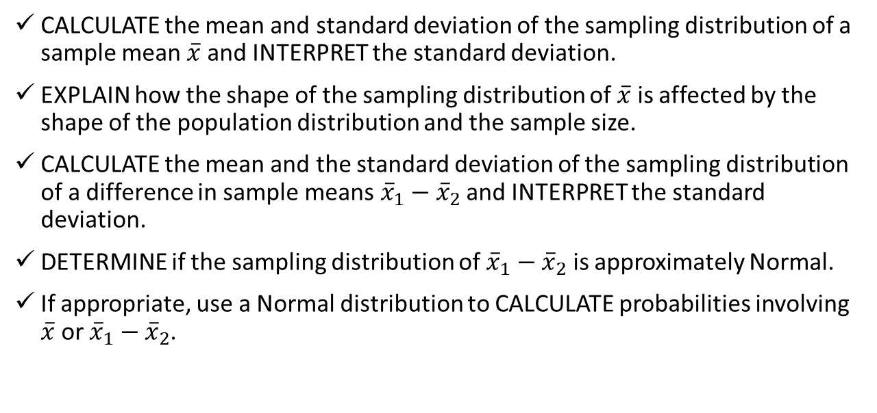
Sample Means
CALCULATE the mean and standard deviation of the sampling distribution of a sample mean $\overline{x}$ and INTERPRET the standard deviation.
EXPLAIN how the shape of the sampling distribution of $\overline{x}$ is affected by the shape of the population distribution and the sample size.
CALCULATE the mean and the standard deviation of the sampling distribution of a difference in sample means${\overline{x}}_{1}−{\overline{x}}_{2}$ and INTERPRET the standard deviation.
DETERMINE if the sampling distribution of ${\overline{x}}_{1}−{\overline{x}}_{2}$ is approximately Normal.
If appropriate, use a Normal distribution to CALCULATE probabilities involving $\overline{x}$or ${\overline{x}}_{1}−{\overline{x}}_{2}$.

Slide 3
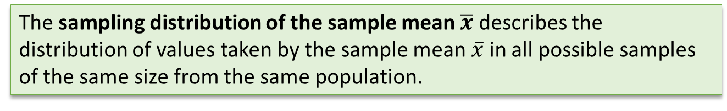

The Sampling Distribution of $\overline{x}$
The sampling distribution of the sample mean $\overline{x}$ describes the distribution of values taken by the sample mean $\overline{x}$ in all possible samples of the same size from the same population.

Slide 4
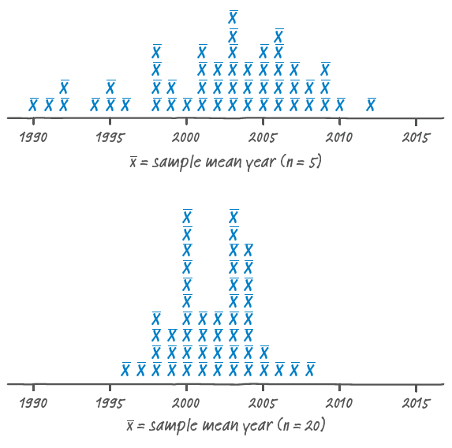
The Sampling Distribution of $\overline{x}$
The sampling distribution of the sample mean $\overline{x}$ describes the distribution of values taken by the sample mean $\overline{x}$ in all possible samples of the same size from the same population.
Here is the approximate sampling distribution of the sample mean year of pennies in 50 samples of size n = 5 and 50 samples of size n = 20 from a
population of pennies.

Slide 5
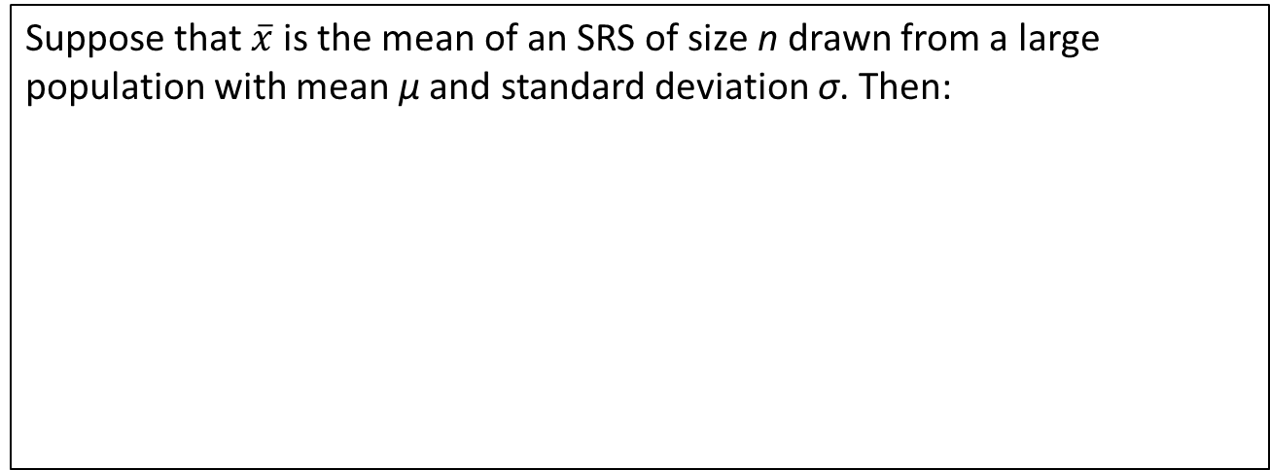
The Sampling Distribution of $\overline{x}$
Sampling Distribution of $\overline{x}$: Mean and Standard Deviation
Suppose that $\overline{x}$ is the mean of an SRS of size n drawn from a large population with mean µ and standard deviation σ. Then:

Slide 6
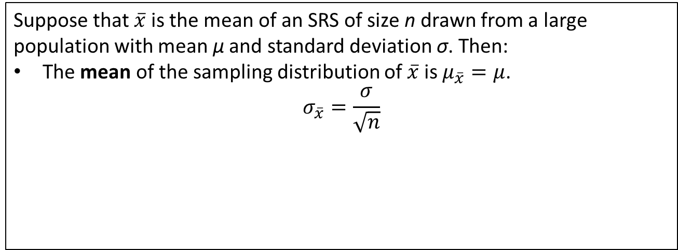
The Sampling Distribution of $\overline{x}$
Sampling Distribution of $\overline{x}$: Mean and Standard Deviation
Suppose that $\overline{x}$ is the mean of an SRS of size n drawn from a large population with mean µ and standard deviation σ. Then:
The mean of the sampling distribution of $\overline{x}$ is $μ_{\overline{x}}=μ$.
$$σ_{\overline{x}}=\frac{σ}{\sqrt{n}}$$

Slide 7
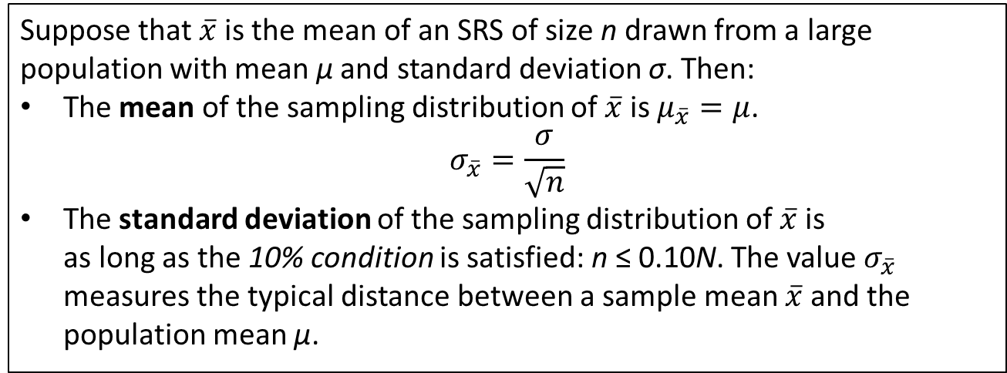
The Sampling Distribution of $\overline{x}$
Sampling Distribution of $\overline{x}$: Mean and Standard Deviation
Suppose that $\overline{x}$ is the mean of an SRS of size n drawn from a large population with mean µ and standard deviation σ. Then:
The mean of the sampling distribution of $\overline{x}$ is $μ_{\overline{x}}=μ$.
$$σ_{\overline{x}}=\frac{σ}{\sqrt{n}}$$
The standard deviation of the sampling distribution of $\overline{x}$ is
as long as the 10% condition is satisfied: n ≤ 0.10N. The value $σ_{\overline{x}}$ measures the typical distance between a sample mean $\overline{x}$ and the population mean µ.

Slide 8
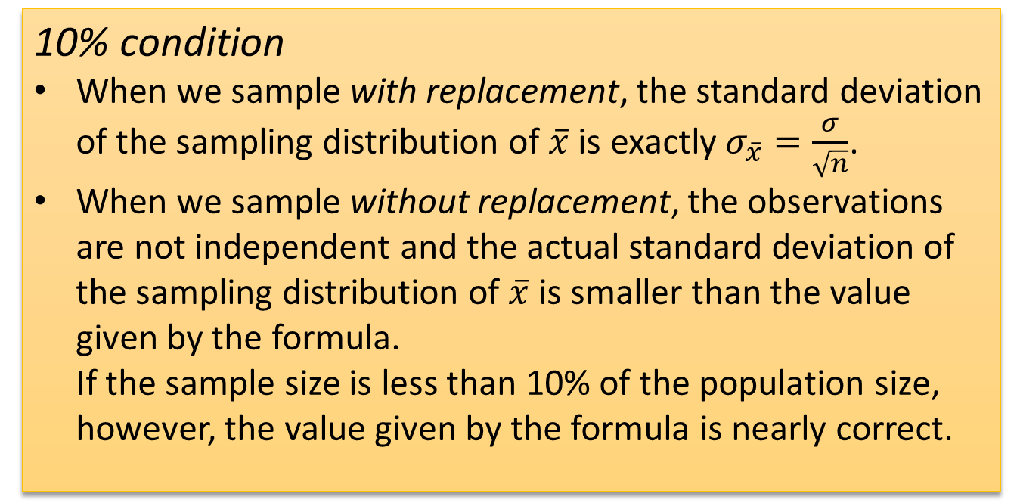
The Sampling Distribution of $\overline{x}$
10% condition
When we sample with replacement, the standard deviation of the sampling distribution of $\overline{x}$ is exactly $σ_{\overline{x}}=\frac{σ}{\sqrt{n}}$.
When we sample without replacement, the observations are not independent and the actual standard deviation of the sampling distribution of $\overline{x}$ is smaller than the value given by the formula.
If the sample size is less than 10% of the population size, however, the value given by the formula is nearly correct.

Slide 9
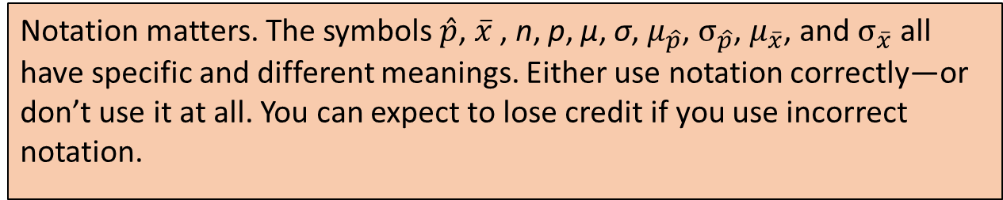
The Sampling Distribution of $\overline{x}$
AP® Exam Tip
Notation matters. The symbols $\hat{p}$, $\overline{x}$ , n, p, µ, σ, $μ_{\hat{p}}$, $σ_{\hat{p}}$, $μ_{\overline{x}}$, and $σ_{\overline{x}}$ all have specific and different meanings. Either use notation correctly—or don’t use it at all. You can expect to lose credit if you use incorrect notation.

Slide 10
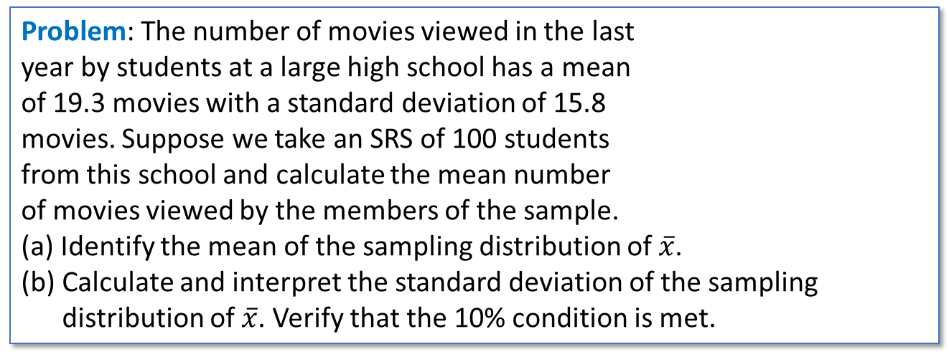
The Sampling Distribution of $\overline{x}$
Problem: The number of movies viewed in the last
year by students at a large high school has a mean
of 19.3 movies with a standard deviation of 15.8
movies. Suppose we take an SRS of 100 students
from this school and calculate the mean number
of movies viewed by the members of the sample.
(a) Identify the mean of the sampling distribution of $\overline{x}$.
(b) Calculate and interpret the standard deviation of the sampling distribution of $\overline{x}$. Verify that the 10% condition is met.
PatriciaPix/Getty Images

Slide 11

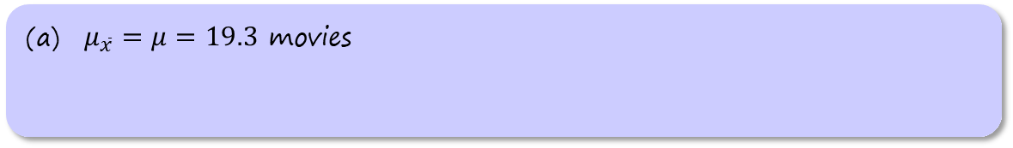
The Sampling Distribution of $\overline{x}$
Problem: The number of movies viewed in the last
year by students at a large high school has a mean
of 19.3 movies with a standard deviation of 15.8
movies. Suppose we take an SRS of 100 students
from this school and calculate the mean number
of movies viewed by the members of the sample.
(a) Identify the mean of the sampling distribution of $\overline{x}$.
(b) Calculate and interpret the standard deviation of the sampling distribution of $\overline{x}$. Verify that the 10% condition is met.
PatriciaPix/Getty Images
$μ_{\overline{x}}=μ=19.3$ movies

Slide 12
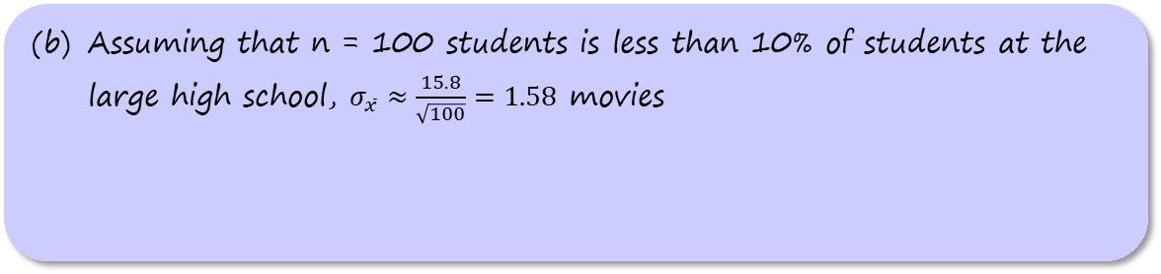
The Sampling Distribution of $\overline{x}$
Problem: The number of movies viewed in the last
year by students at a large high school has a mean
of 19.3 movies with a standard deviation of 15.8
movies. Suppose we take an SRS of 100 students
from this school and calculate the mean number
of movies viewed by the members of the sample.
(a) Identify the mean of the sampling distribution of $\overline{x}$.
(b) Calculate and interpret the standard deviation of the sampling distribution of $\overline{x}$. Verify that the 10% condition is met.
PatriciaPix/Getty Images
(b) Assuming that n = 100 students is less than 10% of students at the large high school, $σ_{\overline{x}}≈\frac{15.8}{\sqrt{100}}=1.58$ movies

Slide 13
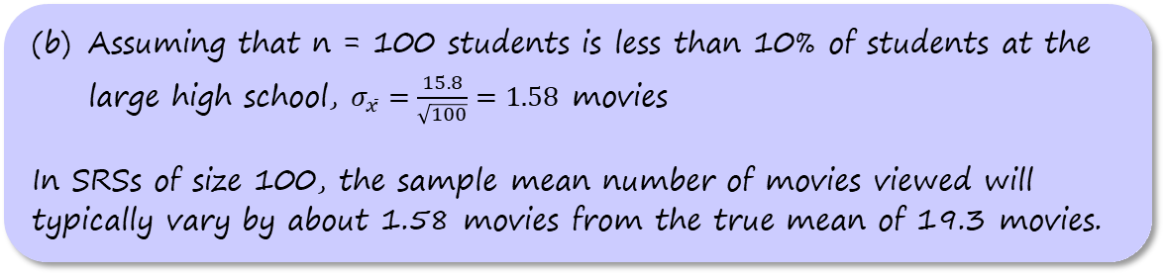
The Sampling Distribution of $\overline{x}$
Problem: The number of movies viewed in the last
year by students at a large high school has a mean
of 19.3 movies with a standard deviation of 15.8
movies. Suppose we take an SRS of 100 students
from this school and calculate the mean number
of movies viewed by the members of the sample.
(a) Identify the mean of the sampling distribution of $\overline{x}$.
(b) Calculate and interpret the standard deviation of the sampling distribution of $\overline{x}$. Verify that the 10% condition is met.
PatriciaPix/Getty Images
(b) Assuming that n = 100 students is less than 10% of students at the large high school, $σ_{\overline{x}}=\frac{15.8}{\sqrt{100}}=1.58$ movies
In SRSs of size 100, the sample mean number of movies viewed will typically vary by about 1.58 movies from the true mean of 19.3 movies.

Slide 14
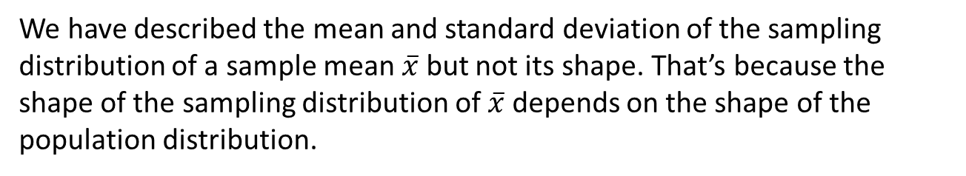
Sampling from a Normal Population
We have described the mean and standard deviation of the sampling distribution of a sample mean $\overline{x}$ but not its shape. That’s because the shape of the sampling distribution of $\overline{x}$ depends on the shape of the population distribution.

Slide 15
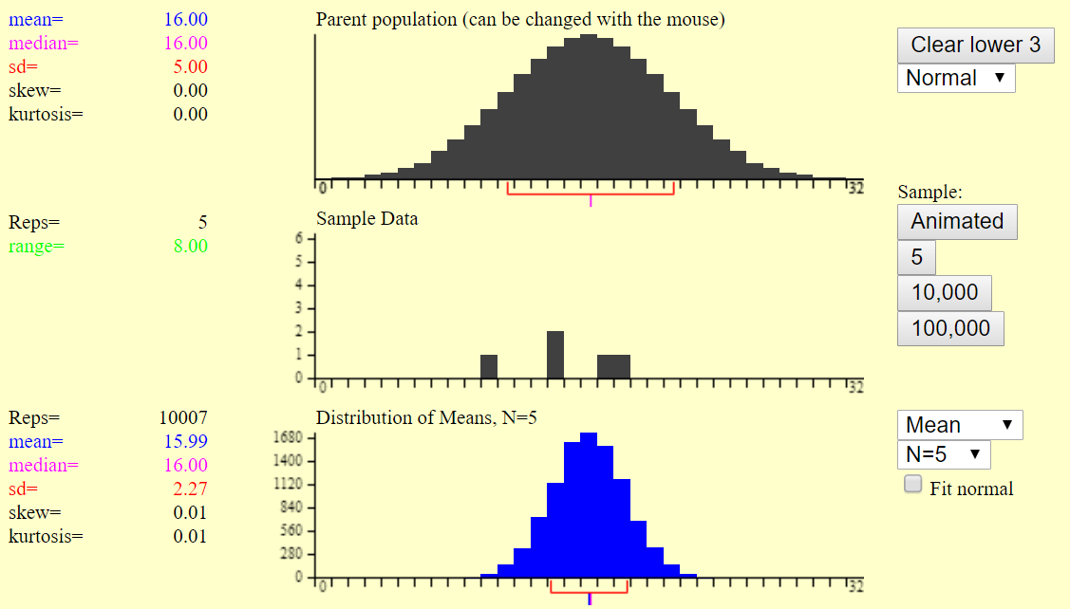
Sampling from a Normal Population
We have described the mean and standard deviation of the sampling distribution of a sample mean $\overline{x}$ but not its shape. That’s because the shape of the sampling distribution of $\overline{x}$ depends on the shape of the population distribution.

Slide 16
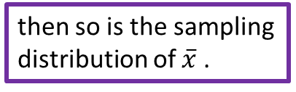
Sampling from a Normal Population
We have described the mean and standard deviation of the sampling distribution of a sample mean $\overline{x}$ but not its shape. That’s because the shape of the sampling distribution of $\overline{x}$ depends on the shape of the population distribution.
If the population distribution is Normal,
then so is the sampling distribution of $\overline{x}$ .

Slide 17
Sampling from a Normal Population
We have described the mean and standard deviation of the sampling distribution of a sample mean $\overline{x}$ but not its shape. That’s because the shape of the sampling distribution of $\overline{x}$ depends on the shape of the population distribution.
If the population distribution is Normal,
then so is the sampling distribution of $\overline{x}$ .
This is true no matter what the
sample size is.

Slide 18
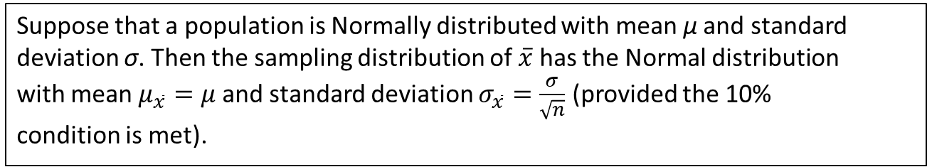

Sampling from a Normal Population
Sampling Distribution of the Sample Mean $\overline{x}$
When Sampling from a Normal Population
Suppose that a population is Normally distributed with mean µ and standard
deviation σ. Then the sampling distribution of $\overline{x}$ has the Normal distribution
with mean $μ_{\overline{x}}=μ$and standard deviation $σ_{\overline{x}}=\frac{σ}{\sqrt{n}}$ (provided the 10%
condition is met).

Slide 19

Sampling from a Normal Population
Problem: The heights of young women follow a Normal
distribution with mean µ = 64.5 inches and standard
deviation σ = 2.5 inches.
(a) Find the probability that a randomly selected young
woman is taller than 66.5 inches.
(b) Find the probability that the mean height of an SRS
of 10 young women exceeds 66.5 inches.
Alamy Images

Slide 20
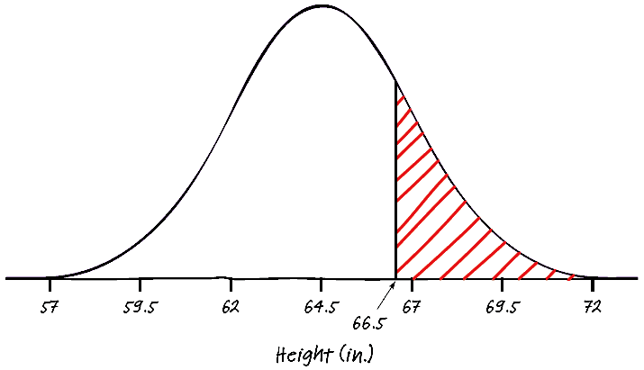
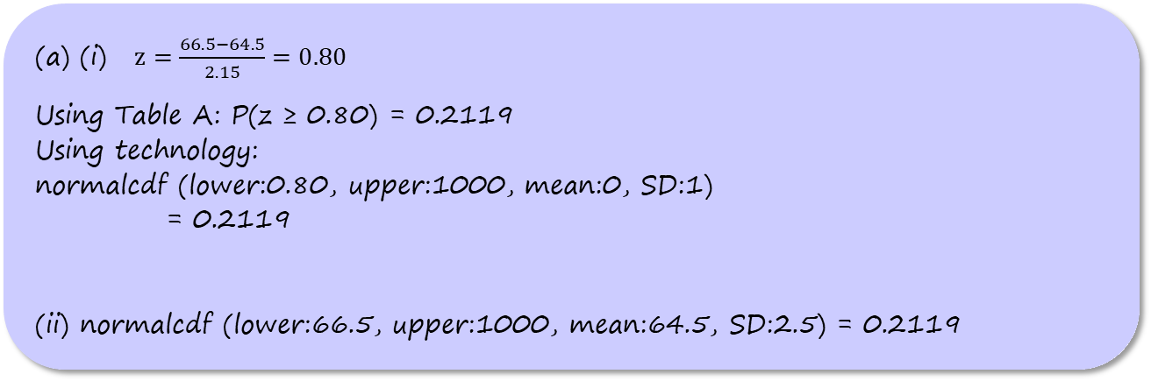
Sampling from a Normal Population
Problem: The heights of young women follow a Normal
distribution with mean µ = 64.5 inches and standard
deviation σ = 2.5 inches.
(a) Find the probability that a randomly selected young
woman is taller than 66.5 inches.
(b) Find the probability that the mean height of an SRS
of 10 young women exceeds 66.5 inches.
Alamy Images
(a) (i) $z=\frac{66.5−64.5}{2.15}=0.80$
Using Table A: P(z ≥ 0.80) = 0.2119
Using technology:
normalcdf (lower:0.80, upper:1000, mean:0, SD:1)
= 0.2119
(ii) normalcdf (lower:66.5, upper:1000, mean:64.5, SD:2.5) = 0.2119

Slide 21
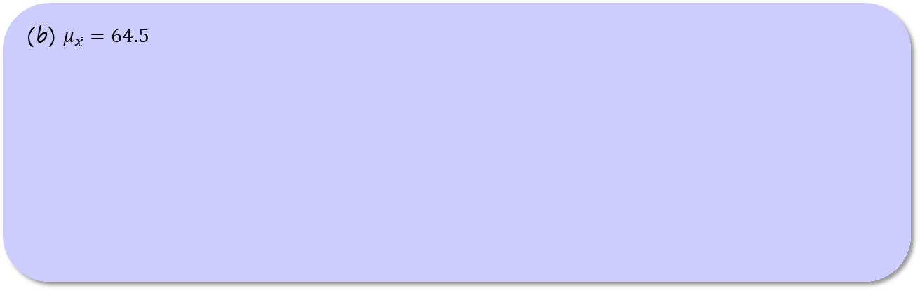
Sampling from a Normal Population
Problem: The heights of young women follow a Normal
distribution with mean µ = 64.5 inches and standard
deviation σ = 2.5 inches.
(a) Find the probability that a randomly selected young
woman is taller than 66.5 inches.
(b) Find the probability that the mean height of an SRS
of 10 young women exceeds 66.5 inches.
Alamy Images
(b) $μ_{\overline{x}}=64.5$

Slide 22
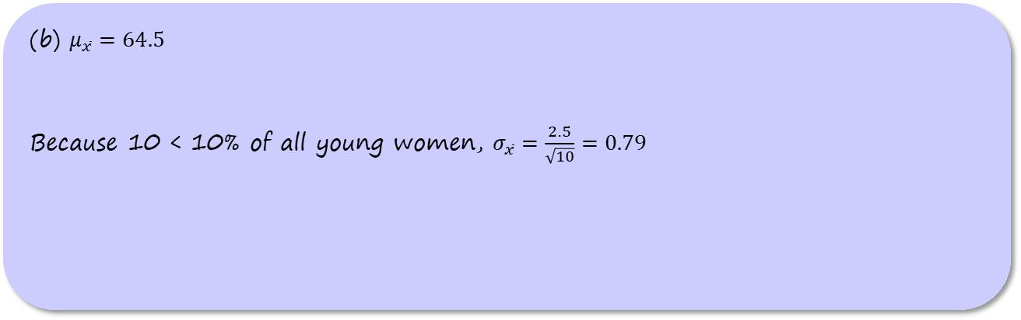
Sampling from a Normal Population
Problem: The heights of young women follow a Normal
distribution with mean µ = 64.5 inches and standard
deviation σ = 2.5 inches.
(a) Find the probability that a randomly selected young
woman is taller than 66.5 inches.
(b) Find the probability that the mean height of an SRS
of 10 young women exceeds 66.5 inches.
Alamy Images
(b) $μ_{\overline{x}}=64.5$
Because 10 < 10% of all young women, $σ_{\overline{x}}=\frac{2.5}{\sqrt{10}}=0.79$

Slide 23
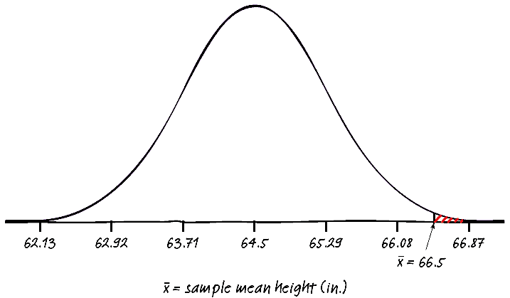
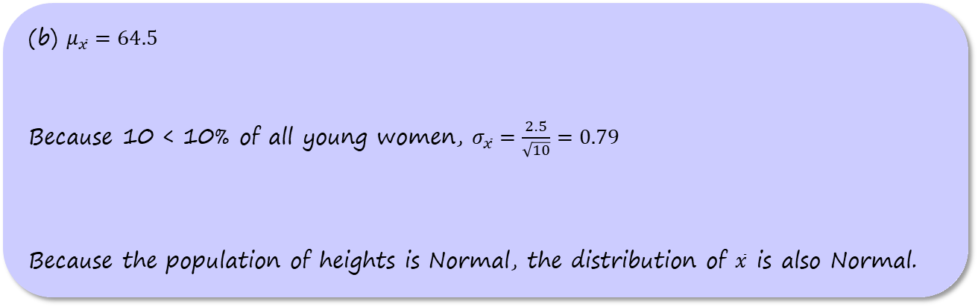
Sampling from a Normal Population
Problem: The heights of young women follow a Normal
distribution with mean µ = 64.5 inches and standard
deviation σ = 2.5 inches.
(a) Find the probability that a randomly selected young
woman is taller than 66.5 inches.
(b) Find the probability that the mean height of an SRS
of 10 young women exceeds 66.5 inches.
Alamy Images
(b) $μ_{\overline{x}}=64.5$
Because 10 < 10% of all young women, $σ_{\overline{x}}=\frac{2.5}{\sqrt{10}}=0.79$
Because the population of heights is Normal, the distribution of $\overline{x}$ is also Normal.

Slide 24
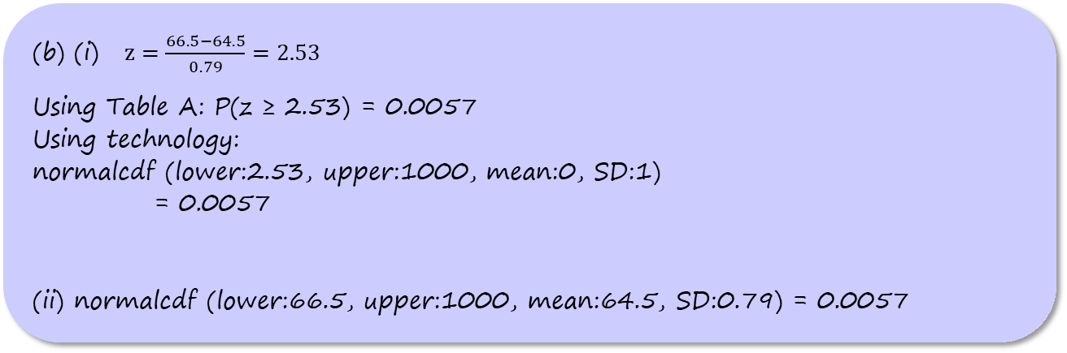
Sampling from a Normal Population
Problem: The heights of young women follow a Normal
distribution with mean µ = 64.5 inches and standard
deviation σ = 2.5 inches.
(a) Find the probability that a randomly selected young
woman is taller than 66.5 inches.
(b) Find the probability that the mean height of an SRS
of 10 young women exceeds 66.5 inches.
Alamy Images
(b) (i) $z=\frac{66.5−64.5}{0.79}=2.53$
Using Table A: P(z ≥ 2.53) = 0.0057
Using technology:
normalcdf (lower:2.53, upper:1000, mean:0, SD:1)
= 0.0057
(ii) normalcdf (lower:66.5, upper:1000, mean:64.5, SD:0.79) = 0.0057

Slide 25
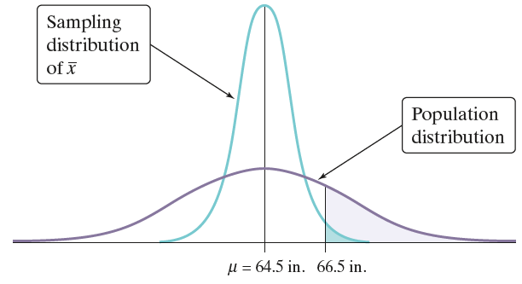
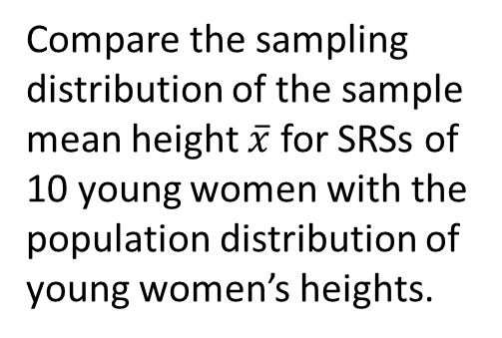
Sampling from a Normal Population
Compare the sampling
distribution of the sample mean height $\overline{x}$ for SRSs of 10 young women with the population distribution of young women’s heights.

Slide 26
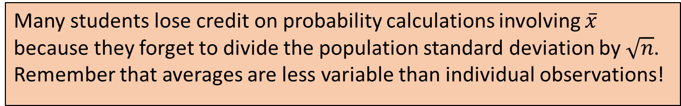
Sampling from a Normal Population
Compare the sampling
distribution of the sample mean height $\overline{x}$ for SRSs of 10 young women with the population distribution of young women’s heights.
AP® Exam Tip
Many students lose credit on probability calculations involving $\overline{x}$ because they forget to divide the population standard deviation by $\sqrt{n}$. Remember that averages are less variable than individual observations!

Slide 27
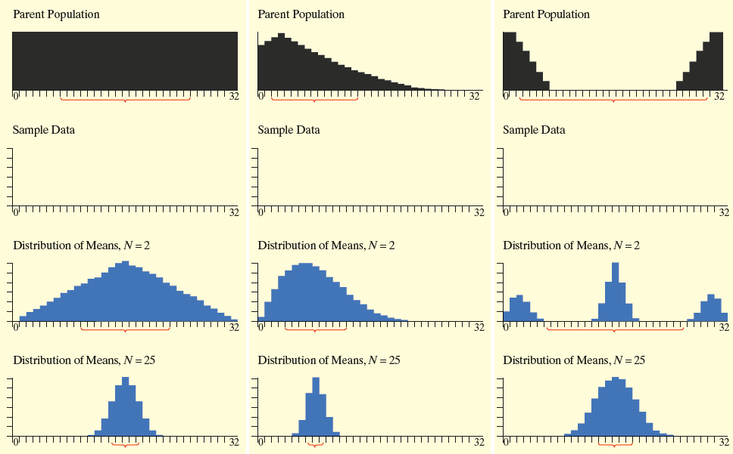
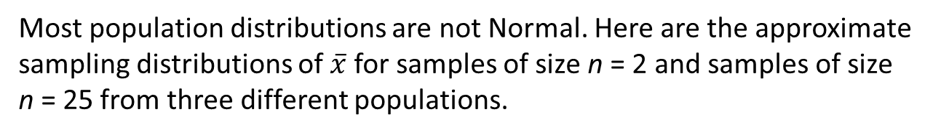
The Central Limit Theorem
Most population distributions are not Normal. Here are the approximate sampling distributions of $\overline{x}$ for samples of size n = 2 and samples of size
n = 25 from three different populations.

Slide 28
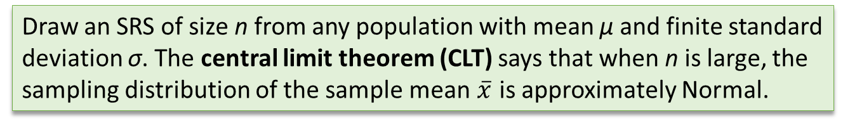
The Central Limit Theorem
Draw an SRS of size n from any population with mean µ and finite standard deviation σ. The central limit theorem (CLT) says that when n is large, the
sampling distribution of the sample mean $\overline{x}$ is approximately Normal.

Slide 29
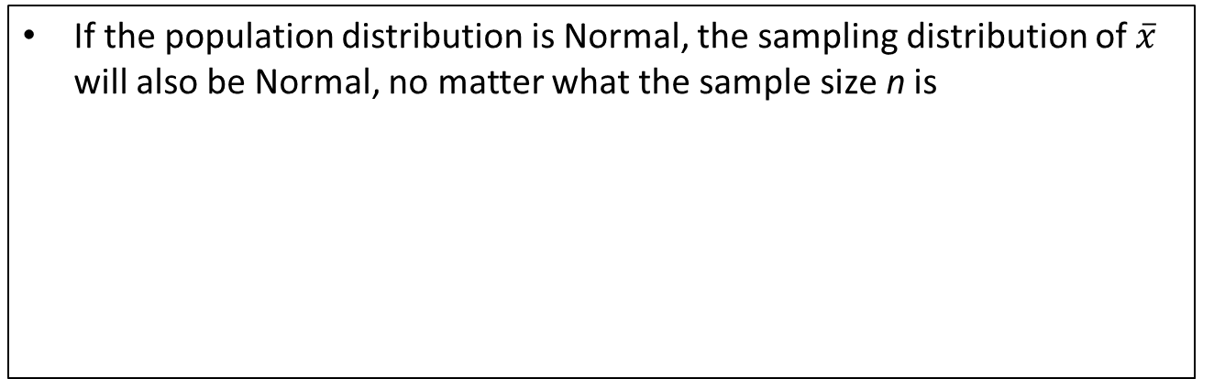
The Central Limit Theorem
Draw an SRS of size n from any population with mean µ and finite standard deviation σ. The central limit theorem (CLT) says that when n is large, the
sampling distribution of the sample mean $\overline{x}$ is approximately Normal.
Shape of the Sampling Distribution of the Sample Mean $\overline{x}$
If the population distribution is Normal, the sampling distribution of $\overline{x}$ will also be Normal, no matter what the sample size n is

Slide 30
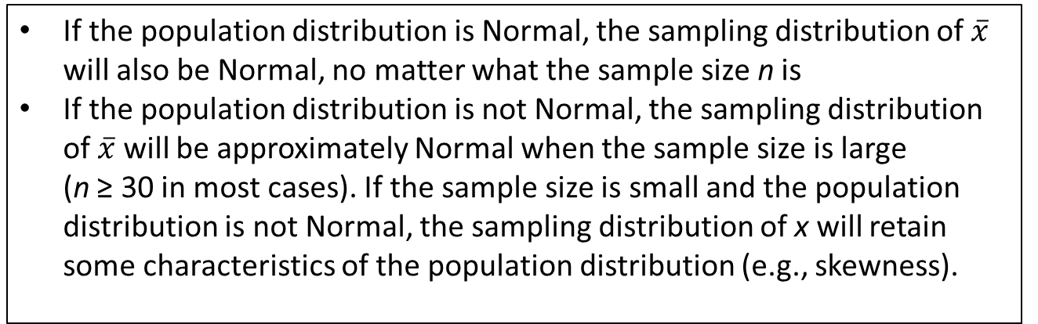
The Central Limit Theorem
Draw an SRS of size n from any population with mean µ and finite standard deviation σ. The central limit theorem (CLT) says that when n is large, the
sampling distribution of the sample mean $\overline{x}$ is approximately Normal.
Shape of the Sampling Distribution of the Sample Mean $\overline{x}$
If the population distribution is Normal, the sampling distribution of $\overline{x}$ will also be Normal, no matter what the sample size n is
If the population distribution is not Normal, the sampling distribution of $\overline{x}$ will be approximately Normal when the sample size is large
(n ≥ 30 in most cases). If the sample size is small and the population distribution is not Normal, the sampling distribution of x will retain some characteristics of the population distribution (e.g., skewness).

Slide 31
The Central Limit Theorem
Problem: Keith is the manager of an auto-care center. Based
on service records from the past year, the time (in hours) that
a technician requires to complete a standard oil change and
inspection follows a right-skewed distribution with µ = 30
minutes and σ = 20 minutes. For a promotion, Keith randomly
selects 40 current customers and offers them a free oil change and inspection if they redeem the offer during the next month. Keith budgets an average of 35 minutes per customer for a technician to complete the work. Will this
be enough?
Joe Belanger/Alamy

Slide 32
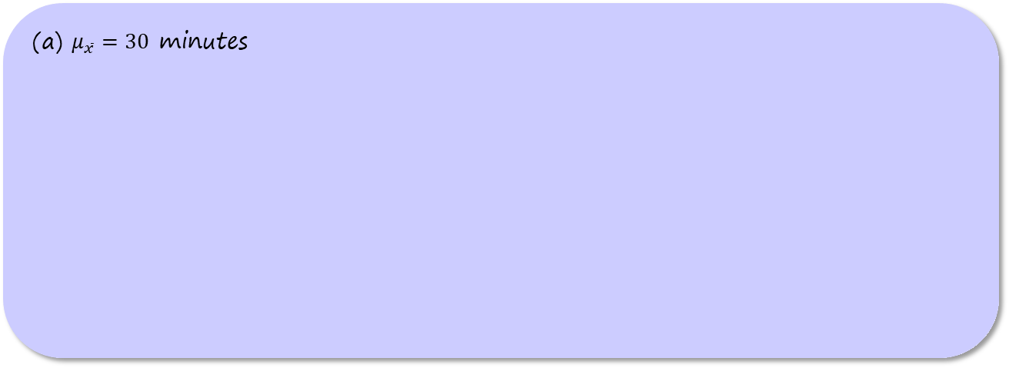
The Central Limit Theorem
Problem:
(a) Calculate the probability that the average time it takes to
complete the work exceeds 35 minutes.
(b) How much average time per customer should Keith
budget if he wants to be 99% certain that he doesn’t go
“over budget”?
Joe Belanger/Alamy
(a) $μ_{\overline{x}}=30$ minutes

Slide 33
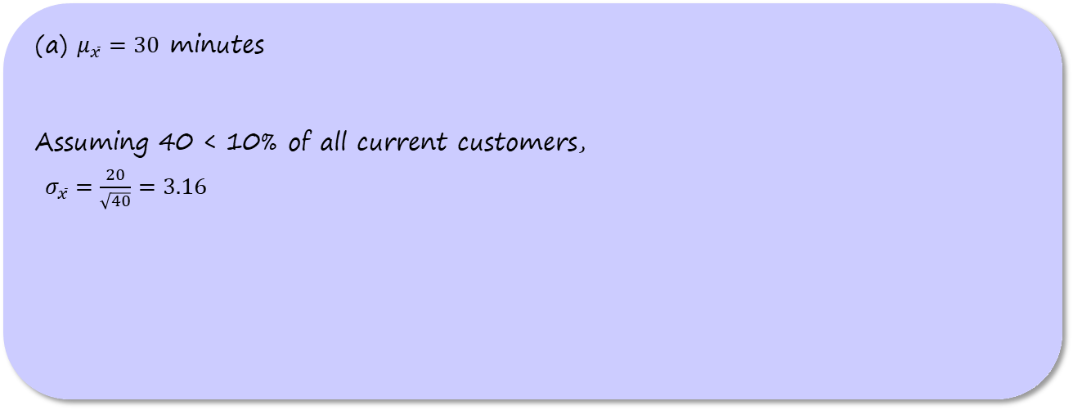
The Central Limit Theorem
Problem:
(a) Calculate the probability that the average time it takes to
complete the work exceeds 35 minutes.
(b) How much average time per customer should Keith
budget if he wants to be 99% certain that he doesn’t go
“over budget”?
Joe Belanger/Alamy
(a) $μ_{\overline{x}}=30$ minutes
Assuming 40 < 10% of all current customers,
$σ_{\overline{x}}=\frac{20}{\sqrt{40}}=3.16$

Slide 34
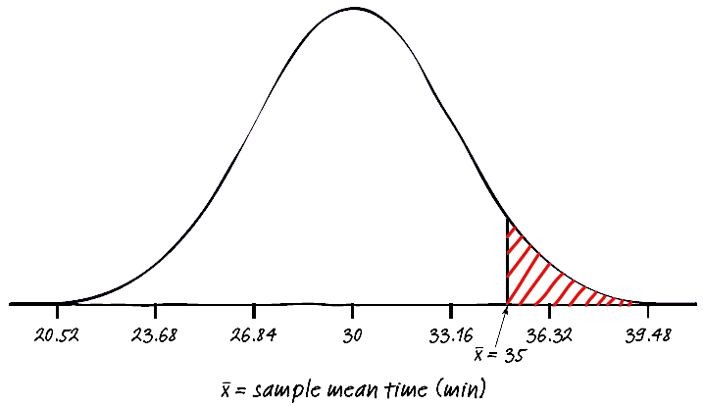
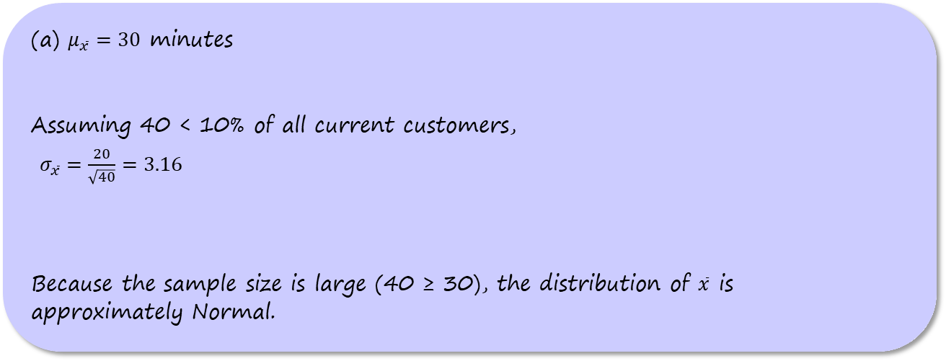
The Central Limit Theorem
Problem:
(a) Calculate the probability that the average time it takes to
complete the work exceeds 35 minutes.
(b) How much average time per customer should Keith
budget if he wants to be 99% certain that he doesn’t go
“over budget”?
Joe Belanger/Alamy
(a) $μ_{\overline{x}}=30$ minutes
Assuming 40 < 10% of all current customers,
$σ_{\overline{x}}=\frac{20}{\sqrt{40}}=3.16$
Because the sample size is large (40 ≥ 30), the distribution of $\overline{x}$ is
approximately Normal.

Slide 35
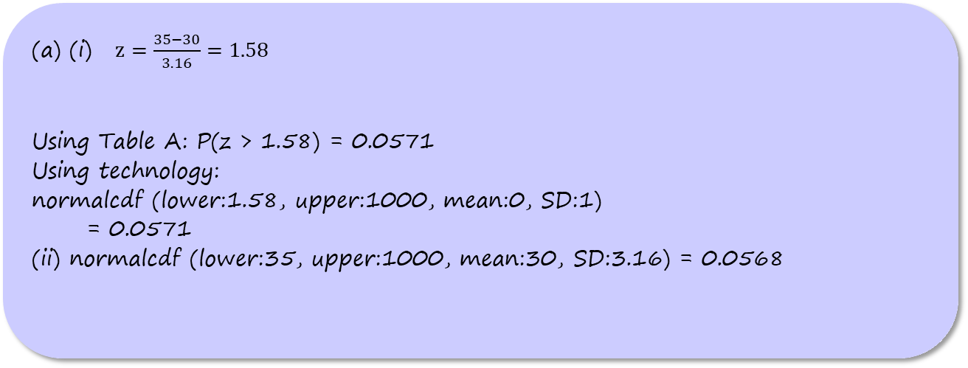
The Central Limit Theorem
Problem:
(a) Calculate the probability that the average time it takes to
complete the work exceeds 35 minutes.
(b) How much average time per customer should Keith
budget if he wants to be 99% certain that he doesn’t go
“over budget”?
Joe Belanger/Alamy
(a) (i) $z=\frac{35−30}{3.16}=1.58$
Using Table A: P(z > 1.58) = 0.0571
Using technology:
normalcdf (lower:1.58, upper:1000, mean:0, SD:1)
= 0.0571
(ii) normalcdf (lower:35, upper:1000, mean:30, SD:3.16) = 0.0568

Slide 36
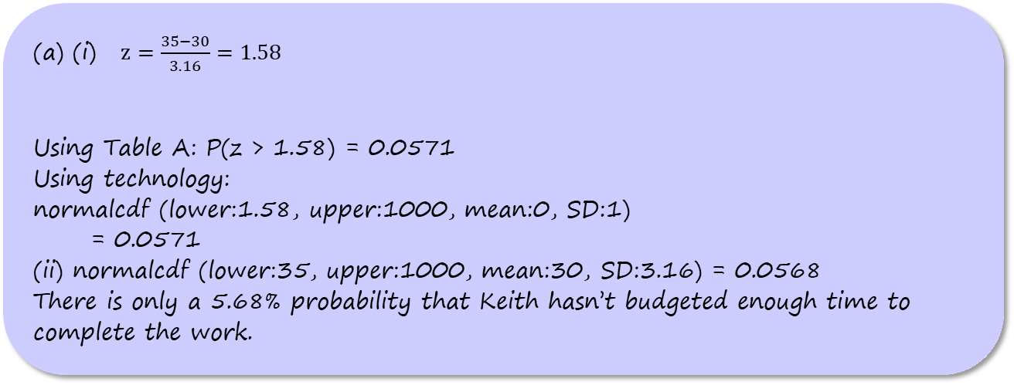
The Central Limit Theorem
Problem:
(a) Calculate the probability that the average time it takes to
complete the work exceeds 35 minutes.
(b) How much average time per customer should Keith
budget if he wants to be 99% certain that he doesn’t go
“over budget”?
Joe Belanger/Alamy
(a) (i) $z=\frac{35−30}{3.16}=1.58$
Using Table A: P(z > 1.58) = 0.0571
Using technology:
normalcdf (lower:1.58, upper:1000, mean:0, SD:1)
= 0.0571
(ii) normalcdf (lower:35, upper:1000, mean:30, SD:3.16) = 0.0568
There is only a 5.68% probability that Keith hasn’t budgeted enough time to complete the work.

Slide 37
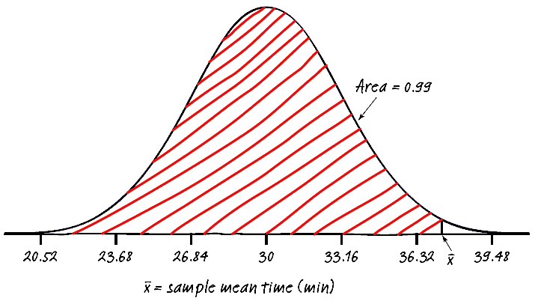
The Central Limit Theorem
Problem:
(a) Calculate the probability that the average time it takes to
complete the work exceeds 35 minutes.
(b) How much average time per customer should Keith
budget if he wants to be 99% certain that he doesn’t go
“over budget”?
Joe Belanger/Alamy
(b)

Slide 38
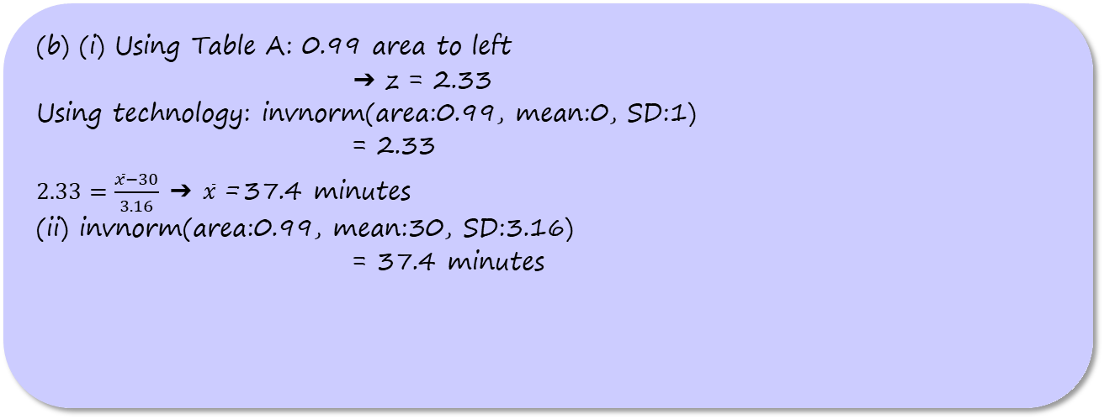
The Central Limit Theorem
Problem:
(a) Calculate the probability that the average time it takes to
complete the work exceeds 35 minutes.
(b) How much average time per customer should Keith
budget if he wants to be 99% certain that he doesn’t go
“over budget”?
Joe Belanger/Alamy
(b) (i) Using Table A: 0.99 area to left
➔ z = 2.33
Using technology: invnorm(area:0.99, mean:0, SD:1)
= 2.33
$2.33=\frac{\overline{x}−30}{3.16}$ ➔ $\overline{x}$ = 37.4 minutes
(ii) invnorm(area:0.99, mean:30, SD:3.16)
= 37.4 minutes

Slide 39
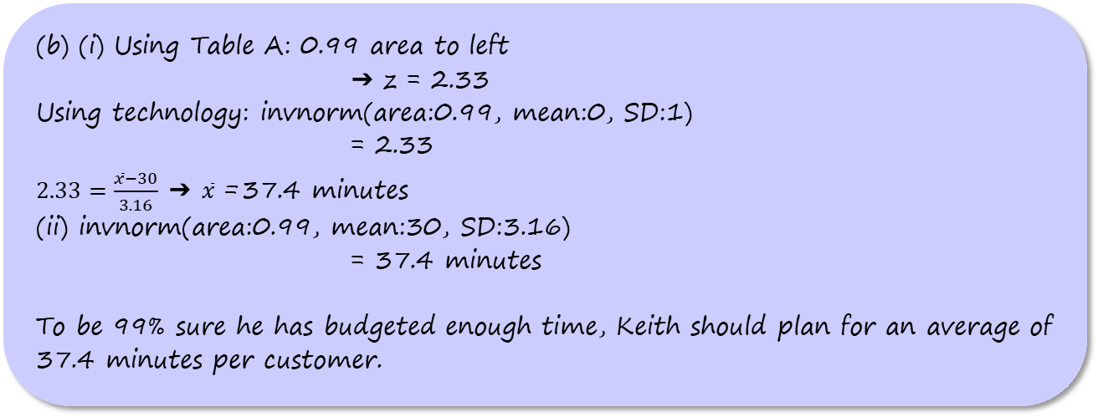
The Central Limit Theorem
Problem:
(a) Calculate the probability that the average time it takes to
complete the work exceeds 35 minutes.
(b) How much average time per customer should Keith
budget if he wants to be 99% certain that he doesn’t go
“over budget”?
Joe Belanger/Alamy
(b) (i) Using Table A: 0.99 area to left
➔ z = 2.33
Using technology: invnorm(area:0.99, mean:0, SD:1)
= 2.33
$2.33=\frac{\overline{x}−30}{3.16}$ ➔ $\overline{x}$ = 37.4 minutes
(ii) invnorm(area:0.99, mean:30, SD:3.16)
= 37.4 minutes
To be 99% sure he has budgeted enough time, Keith should plan for an average of 37.4 minutes per customer.

Slide 40
The Sampling Distribution of a Difference
Between Two Means
The heights of 10-year-old girls can be modeled by a Normal distribution with mean µ_{G} = 56.4 inches and standard deviation σ_{G} = 2.7 inches.

Slide 41
The Sampling Distribution of a Difference
Between Two Means
The heights of 10-year-old girls can be modeled by a Normal distribution with mean µ_{G} = 56.4 inches and standard deviation σ_{G} = 2.7 inches.
The heights of 10-year-old boys can be modeled by a Normal distribution with mean µ_{B} = 55.7 inches and standard deviation σ_{B} = 3.8 inches.

Slide 42
The Sampling Distribution of a Difference
Between Two Means
The heights of 10-year-old girls can be modeled by a Normal distribution with mean µ_{G} = 56.4 inches and standard deviation σ_{G} = 2.7 inches.
The heights of 10-year-old boys can be modeled by a Normal distribution with mean µ_{B} = 55.7 inches and standard deviation σ_{B} = 3.8 inches.
Suppose we take independent SRSs of 12 girls and 8 boys of this age and measure their heights.

Slide 43
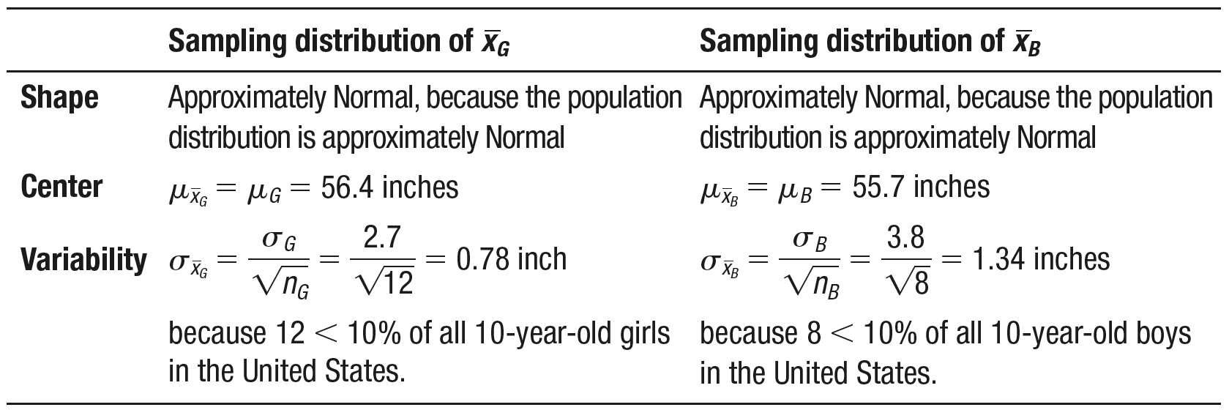
The Sampling Distribution of a Difference
Between Two Means

Slide 44
The Sampling Distribution of a Difference
Between Two Means
What can we say about the difference ${\overline{x}}_{G}−{\overline{x}}_{B}$ in the sample means?

Slide 45
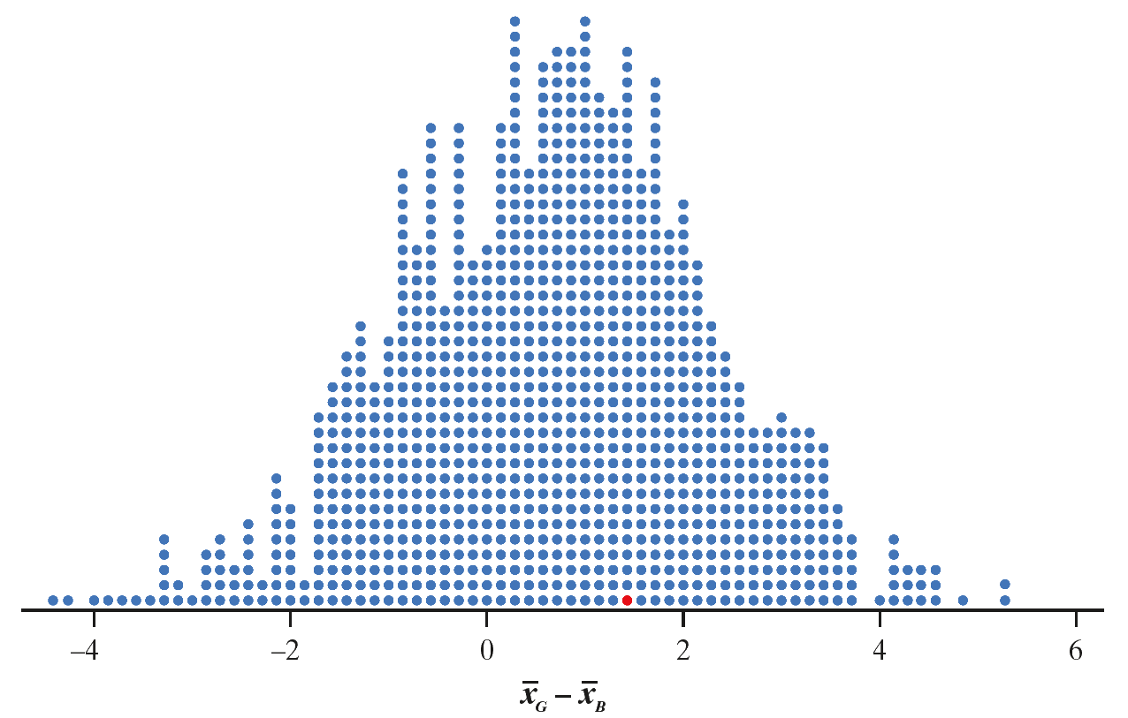
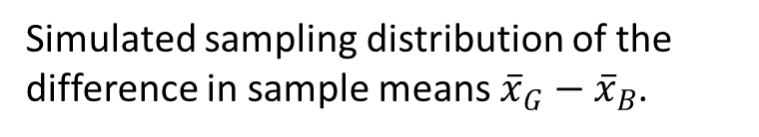
The Sampling Distribution of a Difference
Between Two Means
What can we say about the difference ${\overline{x}}_{G}−{\overline{x}}_{B}$ in the sample means?
Simulated sampling distribution of the difference in sample means ${\overline{x}}_{G}−{\overline{x}}_{B}$.

Slide 46
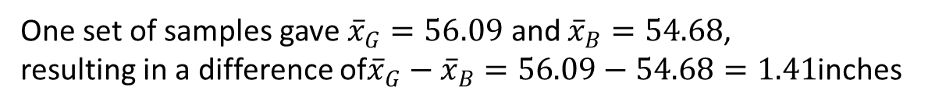
The Sampling Distribution of a Difference
Between Two Means
What can we say about the difference ${\overline{x}}_{G}−{\overline{x}}_{B}$ in the sample means?
Simulated sampling distribution of the difference in sample means ${\overline{x}}_{G}−{\overline{x}}_{B}$.
One set of samples gave ${\overline{x}}_{G}=56.09$ and ${\overline{x}}_{B}=54.68$,
resulting in a difference of${\overline{x}}_{G}−{\overline{x}}_{B}=56.09−54.68=1.41$inches

Slide 47
The Sampling Distribution of a Difference
Between Two Means
What can we say about the difference ${\overline{x}}_{G}−{\overline{x}}_{B}$ in the sample means?
Simulated sampling distribution of the difference in sample means ${\overline{x}}_{G}−{\overline{x}}_{B}$.
One set of samples gave ${\overline{x}}_{G}=56.09$ and ${\overline{x}}_{B}=54.68$,
resulting in a difference of${\overline{x}}_{G}−{\overline{x}}_{B}=56.09−54.68=1.41$inches

Slide 48

The Sampling Distribution of a Difference
Between Two Means
What can we say about the difference ${\overline{x}}_{G}−{\overline{x}}_{B}$ in the sample means?
mean = $μ_{G}−μ_{B}=0.7$ inches

Slide 49
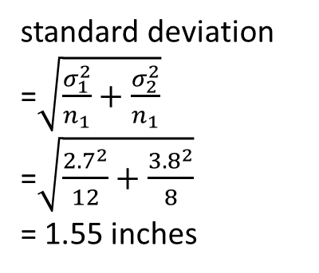
The Sampling Distribution of a Difference
Between Two Means
What can we say about the difference ${\overline{x}}_{G}−{\overline{x}}_{B}$ in the sample means?
standard deviation
=$\sqrt{\frac{σ_{1}^{2}}{n_{1}}+\frac{σ_{2}^{2}}{n_{1}}}$
=$\sqrt{\frac{{2.7}^{2}}{12}+\frac{{3.8}^{2}}{8}}$
= 1.55 inches
mean = $μ_{G}−μ_{B}=0.7$ inches

Slide 50
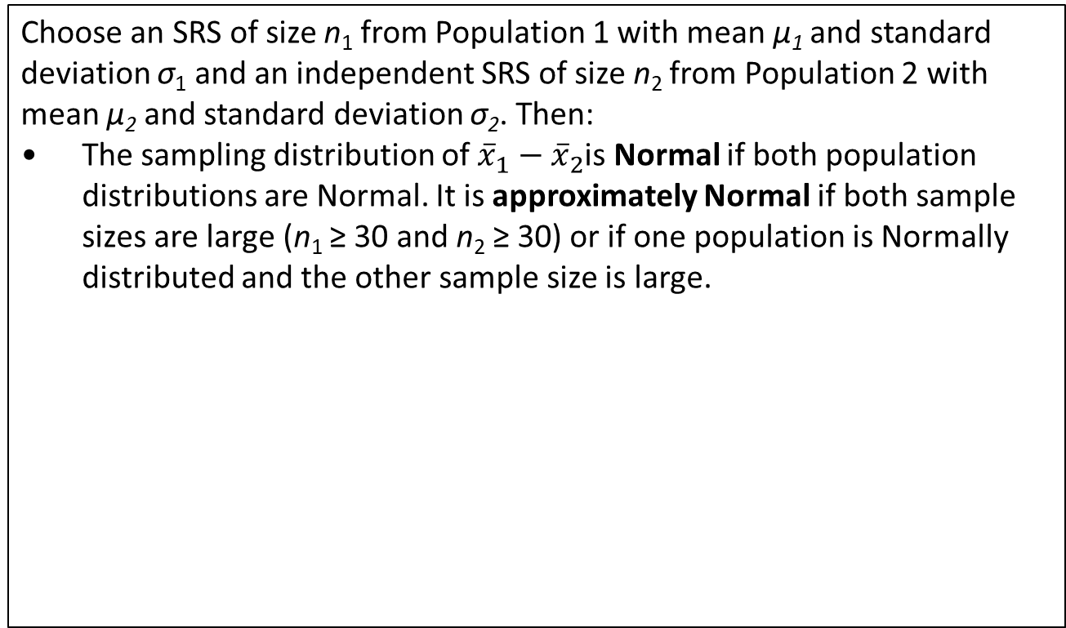
The Sampling Distribution of a Difference
Between Two Means
The Sampling Distribution of ${\overline{x}}_{1}−{\overline{x}}_{2}$
Choose an SRS of size n₁ from Population 1 with mean µ₁ and standard deviation σ₁ and an independent SRS of size n₂ from Population 2 with mean µ₂ and standard deviation σ₂. Then:
• The sampling distribution of ${\overline{x}}_{1}−{\overline{x}}_{2}$is Normal if both population distributions are Normal. It is approximately Normal if both sample sizes are large (n₁ ≥ 30 and n₂ ≥ 30) or if one population is Normally distributed and the other sample size is large.

Slide 51
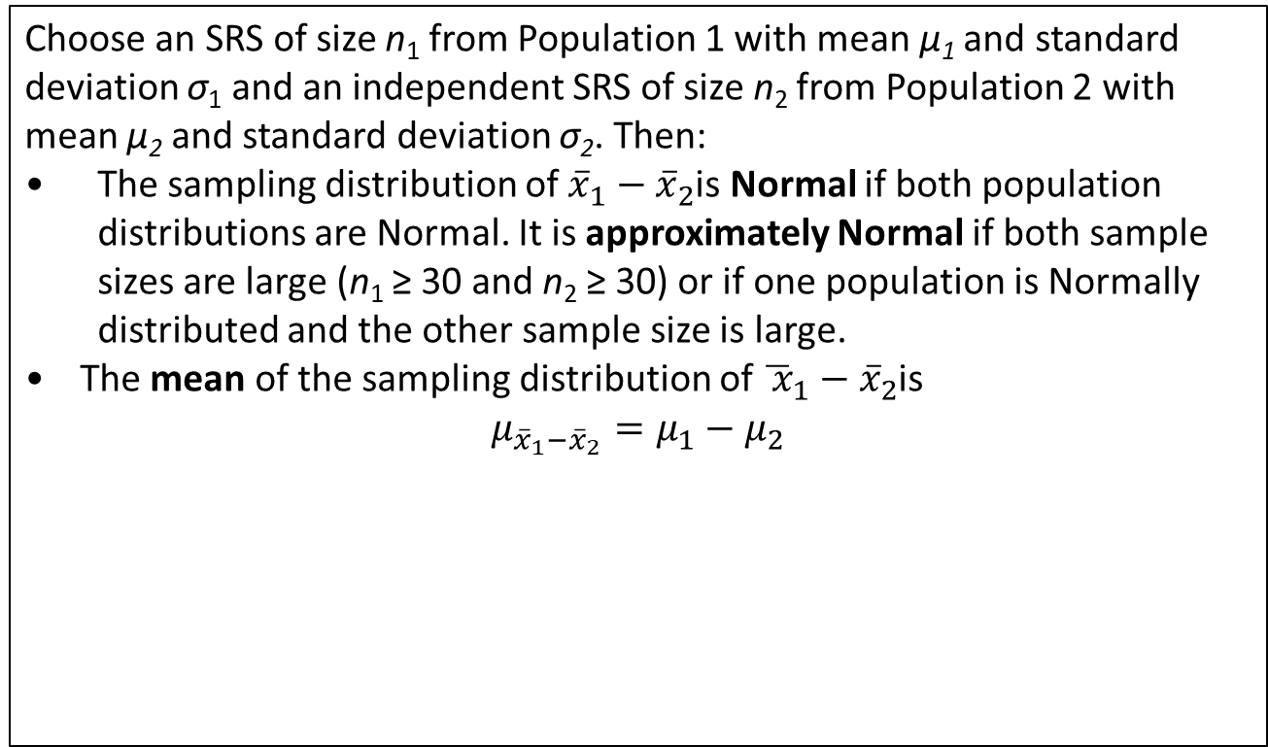
The Sampling Distribution of a Difference
Between Two Means
The Sampling Distribution of ${\overline{x}}_{1}−{\overline{x}}_{2}$
Choose an SRS of size n₁ from Population 1 with mean µ₁ and standard deviation σ₁ and an independent SRS of size n₂ from Population 2 with mean µ₂ and standard deviation σ₂. Then:
• The sampling distribution of ${\overline{x}}_{1}−{\overline{x}}_{2}$is Normal if both population distributions are Normal. It is approximately Normal if both sample sizes are large (n₁ ≥ 30 and n₂ ≥ 30) or if one population is Normally distributed and the other sample size is large.
• The mean of the sampling distribution of ${\overline{ x}}_{1}−{\overline{x}}_{2}$is
$$μ_{{\overline{x}}_{1}−{\overline{x}}_{2}}=μ_{1}−μ_{2}$$

Slide 52
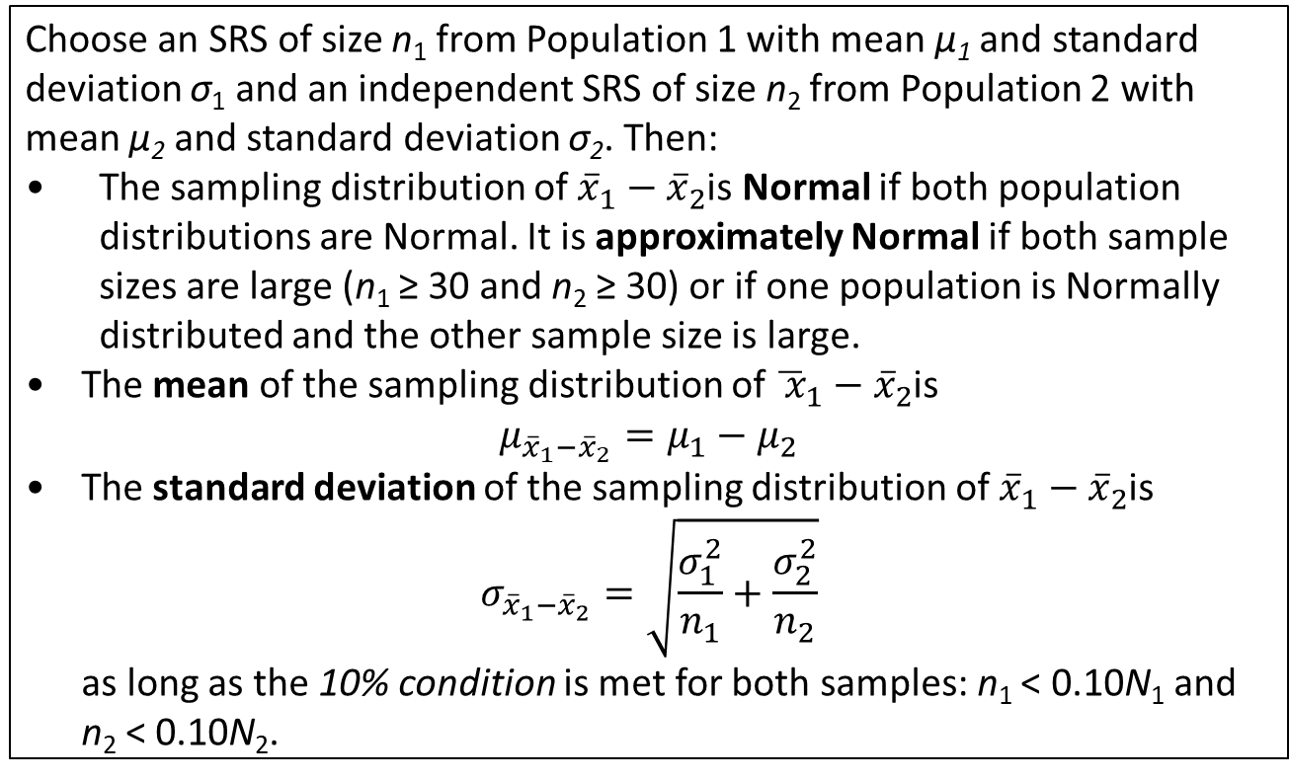
The Sampling Distribution of a Difference
Between Two Means
The Sampling Distribution of ${\overline{x}}_{1}−{\overline{x}}_{2}$
Choose an SRS of size n₁ from Population 1 with mean µ₁ and standard deviation σ₁ and an independent SRS of size n₂ from Population 2 with mean µ₂ and standard deviation σ₂. Then:
• The sampling distribution of ${\overline{x}}_{1}−{\overline{x}}_{2}$is Normal if both population distributions are Normal. It is approximately Normal if both sample sizes are large (n₁ ≥ 30 and n₂ ≥ 30) or if one population is Normally distributed and the other sample size is large.
• The mean of the sampling distribution of ${\overline{ x}}_{1}−{\overline{x}}_{2}$is
$$μ_{{\overline{x}}_{1}−{\overline{x}}_{2}}=μ_{1}−μ_{2}$$
• The standard deviation of the sampling distribution of ${\overline{x}}_{1}−{\overline{x}}_{2}$is
$$σ_{{\overline{x}}_{1}−{\overline{x}}_{2}}=\sqrt{\frac{σ_{1}^{2}}{n_{1}}+\frac{σ_{2}^{2}}{n_{2}}}$$
as long as the 10% condition is met for both samples: n₁ < 0.10N₁ and
n₂ < 0.10N₂.

Slide 53
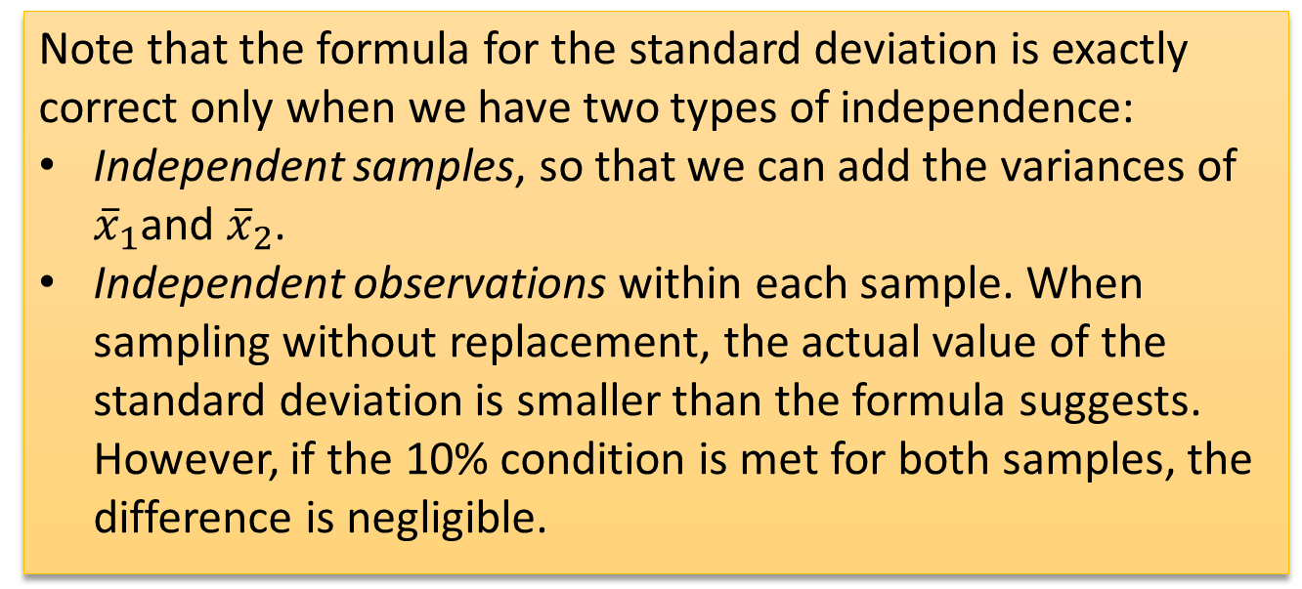
The Sampling Distribution of a Difference
Between Two Means
Note that the formula for the standard deviation is exactly correct only when we have two types of independence:
Independent samples, so that we can add the variances of ${\overline{x}}_{1}$and ${\overline{x}}_{2}$.
Independent observations within each sample. When sampling without replacement, the actual value of the standard deviation is smaller than the formula suggests. However, if the 10% condition is met for both samples, the difference is negligible.

Slide 54
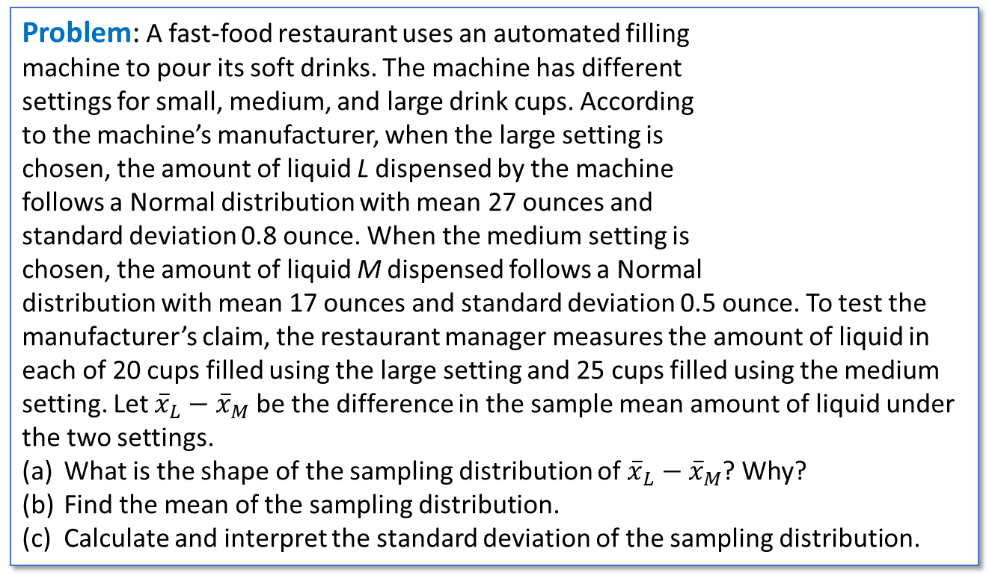
The Sampling Distribution of a Difference
Between Two Means
Problem: A fast-food restaurant uses an automated filling
machine to pour its soft drinks. The machine has different
settings for small, medium, and large drink cups. According
to the machine’s manufacturer, when the large setting is
chosen, the amount of liquid L dispensed by the machine
follows a Normal distribution with mean 27 ounces and
standard deviation 0.8 ounce. When the medium setting is
chosen, the amount of liquid M dispensed follows a Normal
distribution with mean 17 ounces and standard deviation 0.5 ounce. To test the manufacturer’s claim, the restaurant manager measures the amount of liquid in each of 20 cups filled using the large setting and 25 cups filled using the medium setting. Let ${\overline{x}}_{L}−{\overline{x}}_{M}$be the difference in the sample mean amount of liquid under the two settings.
What is the shape of the sampling distribution of ${\overline{x}}_{L}−{\overline{x}}_{M}$? Why?
Find the mean of the sampling distribution.
Calculate and interpret the standard deviation of the sampling distribution.
RichLegg/Getty Images

Slide 55

The Sampling Distribution of a Difference
Between Two Means
Problem: … the amount of liquid L dispensed by the machine
follows a Normal distribution with mean 27 ounces and
standard deviation 0.8 ounce. When the medium setting is
chosen, the amount of liquid M dispensed follows a Normal
distribution with mean 17 ounces and standard deviation 0.5
ounce. …the restaurant manager measures the amount of
liquid in each of 20 cups filled using the large setting and 25
cups filled using the medium setting. Let ${\overline{x}}_{L}−{\overline{x}}_{M}$be the
difference in the sample mean amount of liquid under the two settings.
What is the shape of the sampling distribution of ${\overline{x}}_{L}−{\overline{x}}_{M}$? Why?
RichLegg/Getty Images

Slide 56
The Sampling Distribution of a Difference
Between Two Means
Problem: … the amount of liquid L dispensed by the machine
follows a Normal distribution with mean 27 ounces and
standard deviation 0.8 ounce. When the medium setting is
chosen, the amount of liquid M dispensed follows a Normal
distribution with mean 17 ounces and standard deviation 0.5
ounce. …the restaurant manager measures the amount of
liquid in each of 20 cups filled using the large setting and 25
cups filled using the medium setting. Let ${\overline{x}}_{L}−{\overline{x}}_{M}$be the
difference in the sample mean amount of liquid under the two settings.
What is the shape of the sampling distribution of ${\overline{x}}_{L}−{\overline{x}}_{M}$? Why?
RichLegg/Getty Images
(a) Normal, because both population distributions are Normal.

Slide 57

The Sampling Distribution of a Difference
Between Two Means
Problem: … the amount of liquid L dispensed by the machine
follows a Normal distribution with mean 27 ounces and
standard deviation 0.8 ounce. When the medium setting is
chosen, the amount of liquid M dispensed follows a Normal
distribution with mean 17 ounces and standard deviation 0.5
ounce. …the restaurant manager measures the amount of
liquid in each of 20 cups filled using the large setting and 25
cups filled using the medium setting. Let ${\overline{x}}_{L}−{\overline{x}}_{M}$be the
difference in the sample mean amount of liquid under the two settings.
(b) Find the mean of the sampling distribution.
RichLegg/Getty Images

Slide 58

The Sampling Distribution of a Difference
Between Two Means
Problem: … the amount of liquid L dispensed by the machine
follows a Normal distribution with mean 27 ounces and
standard deviation 0.8 ounce. When the medium setting is
chosen, the amount of liquid M dispensed follows a Normal
distribution with mean 17 ounces and standard deviation 0.5
ounce. …the restaurant manager measures the amount of
liquid in each of 20 cups filled using the large setting and 25
cups filled using the medium setting. Let ${\overline{x}}_{L}−{\overline{x}}_{M}$be the
difference in the sample mean amount of liquid under the two settings.
(b) Find the mean of the sampling distribution.
RichLegg/Getty Images
(b) $μ_{{\overline{x}}_{L}−{\overline{x}}_{M}}=$ 27 – 17 = 10 ounces.

Slide 59

The Sampling Distribution of a Difference
Between Two Means
Problem: … the amount of liquid L dispensed by the machine
follows a Normal distribution with mean 27 ounces and
standard deviation 0.8 ounce. When the medium setting is
chosen, the amount of liquid M dispensed follows a Normal
distribution with mean 17 ounces and standard deviation 0.5
ounce. …the restaurant manager measures the amount of
liquid in each of 20 cups filled using the large setting and 25
cups filled using the medium setting. Let ${\overline{x}}_{L}−{\overline{x}}_{M}$be the
difference in the sample mean amount of liquid under the two settings.
(c) Calculate and interpret the standard deviation of the sampling distribution.
RichLegg/Getty Images

Slide 60

The Sampling Distribution of a Difference
Between Two Means
Problem: … the amount of liquid L dispensed by the machine
follows a Normal distribution with mean 27 ounces and
standard deviation 0.8 ounce. When the medium setting is
chosen, the amount of liquid M dispensed follows a Normal
distribution with mean 17 ounces and standard deviation 0.5
ounce. …the restaurant manager measures the amount of
liquid in each of 20 cups filled using the large setting and 25
cups filled using the medium setting. Let ${\overline{x}}_{L}−{\overline{x}}_{M}$be the
difference in the sample mean amount of liquid under the two settings.
(c) Calculate and interpret the standard deviation of the sampling distribution.
RichLegg/Getty Images
(c) $σ_{{\overline{x}}_{L}−{\overline{x}}_{M}}=$ $\sqrt{\frac{{0.8}^{2}}{20}+\frac{{0.5}^{2}}{25}}=$ 0.205 ounce.
Note: We do not have to check the 10% condition because we are not sampling without replacement from a finite population.

Slide 61
The Sampling Distribution of a Difference
Between Two Means
Problem: … the amount of liquid L dispensed by the machine
follows a Normal distribution with mean 27 ounces and
standard deviation 0.8 ounce. When the medium setting is
chosen, the amount of liquid M dispensed follows a Normal
distribution with mean 17 ounces and standard deviation 0.5
ounce. …the restaurant manager measures the amount of
liquid in each of 20 cups filled using the large setting and 25
cups filled using the medium setting. Let ${\overline{x}}_{L}−{\overline{x}}_{M}$be the
difference in the sample mean amount of liquid under the two settings.
(c) Calculate and interpret the standard deviation of the sampling distribution.
RichLegg/Getty Images
(c) The difference (Large cup – Medium cup) in the sample mean amounts of liquid typically varies by about 0.2 ounce from the true difference in means of 10 ounces..

Slide 62

The Sampling Distribution of a Difference
Between Two Means
Problem: … the amount of liquid L dispensed by the machine
follows a Normal distribution with mean 27 ounces and
standard deviation 0.8 ounce. When the medium setting is
chosen, the amount of liquid M dispensed follows a Normal
distribution with mean 17 ounces and standard deviation 0.5
ounce. …the restaurant manager measures the amount of
liquid in each of 20 cups filled using the large setting and 25
cups filled using the medium setting. Let ${\overline{x}}_{L}−{\overline{x}}_{M}$be the
difference in the sample mean amount of liquid under the two settings.
(d) Estimate the probability that the difference in sample means is within 0.25 ounce of the true difference in means.
RichLegg/Getty Images

Slide 63

The Sampling Distribution of a Difference
Between Two Means
Problem: … the amount of liquid L dispensed by the machine
follows a Normal distribution with mean 27 ounces and
standard deviation 0.8 ounce. When the medium setting is
chosen, the amount of liquid M dispensed follows a Normal
distribution with mean 17 ounces and standard deviation 0.5
ounce. …the restaurant manager measures the amount of
liquid in each of 20 cups filled using the large setting and 25
cups filled using the medium setting. Let ${\overline{x}}_{L}−{\overline{x}}_{M}$be the
difference in the sample mean amount of liquid under the two settings.
(d) Estimate the probability that the difference in sample means is within 0.25 ounce of the true difference in means.
RichLegg/Getty Images
(d) P($9.75≤{\overline{x}}_{L}−{\overline{x}}_{M}≤10.25$)
= normalcdf(lower:9.75,upper:10.25,mean:10,SD:0.205)
= 0.7774

Slide 64
Section Summary
CALCULATE the mean and standard deviation of the sampling distribution of a sample mean $\overline{x}$ and INTERPRET the standard deviation.
EXPLAIN how the shape of the sampling distribution of $\overline{x}$ is affected by the shape of the population distribution and the sample size.
CALCULATE the mean and the standard deviation of the sampling distribution of a difference in sample means${\overline{x}}_{1}−{\overline{x}}_{2}$ and INTERPRET the standard deviation.
DETERMINE if the sampling distribution of ${\overline{x}}_{1}−{\overline{x}}_{2}$ is approximately Normal.
If appropriate, use a Normal distribution to CALCULATE probabilities involving $\overline{x}$or ${\overline{x}}_{1}−{\overline{x}}_{2}$.

