Slide 1
Warm Up
Find the area of each figure. Round to the nearest tenth.
1. A triangle with base length 20 cm and height 17.32 cm.
3. a circle with radius 6.8 in.
4. a circle with diameter 14 ft
173.2 cm²
145.3 in²
153.9 ft²

Slide 2
10-6
Volume of Prisms and Cylinders
Warm Up
Lesson Presentation
Lesson Quiz
Holt McDougal Geometry
Holt Geometry

Slide 3
Objectives
Learn and apply the formula for the volume of a prism.
Learn and apply the formula for the volume of a cylinder.
Volume in the Game of Golf

Slide 4
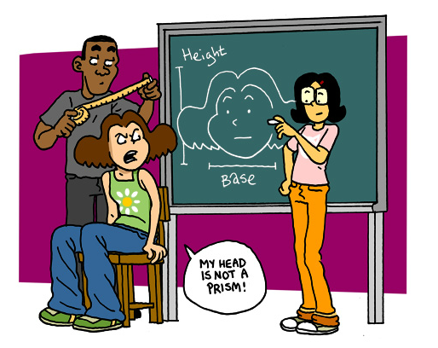
Brain Pop: Volume of Prisms

Slide 5
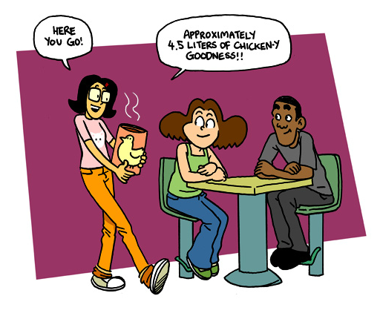
Brain Pop: Volume of Cylinders

Slide 6
The volume of a three-dimensional figure is the number of nonoverlapping unit cubes of a given size that will exactly fill the interior.
Cavalieri’s principle says that if two three-dimensional figures have the same height and have the same cross-sectional area at every level, they have the same volume.
A right prism and an oblique prism with the same base and height have the same volume.

Slide 7
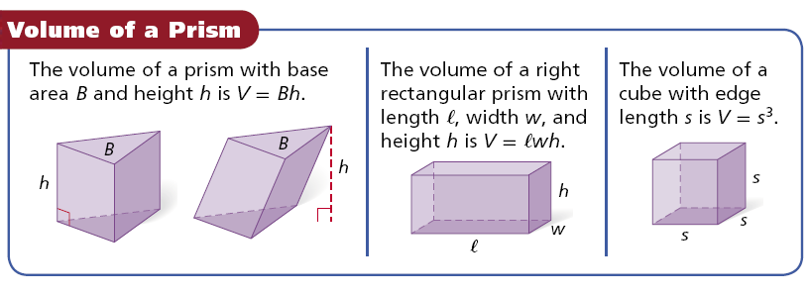

Slide 8
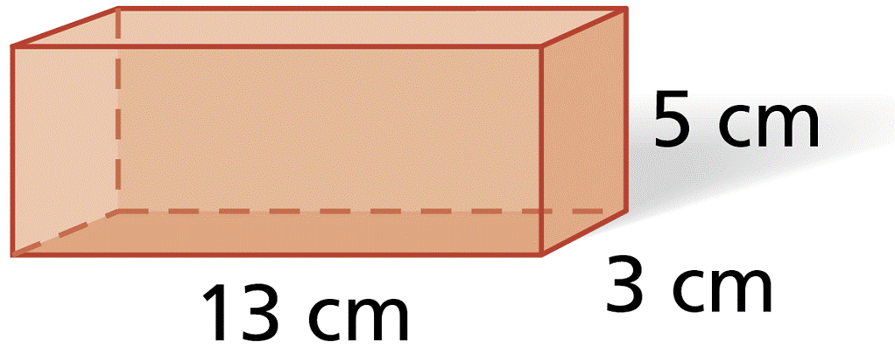
Example 1A: Finding Volumes of Prisms
Find the volume of the prism. Round to the nearest tenth, if necessary.
V = Bh
Volume of a right rectangular prism
= (13)(3)(5)
= 195 cm³
Substitute 13 for ℓ, 3 for w, and 5 for h.

Slide 9
Example 1B: Finding Volumes of Prisms
Find the volume of a cube with edge length 15 in. Round to the nearest tenth, if necessary.
V = s³
Volume of a cube
= (15)³
= 3375 in³
Substitute 15 for s.

Slide 10
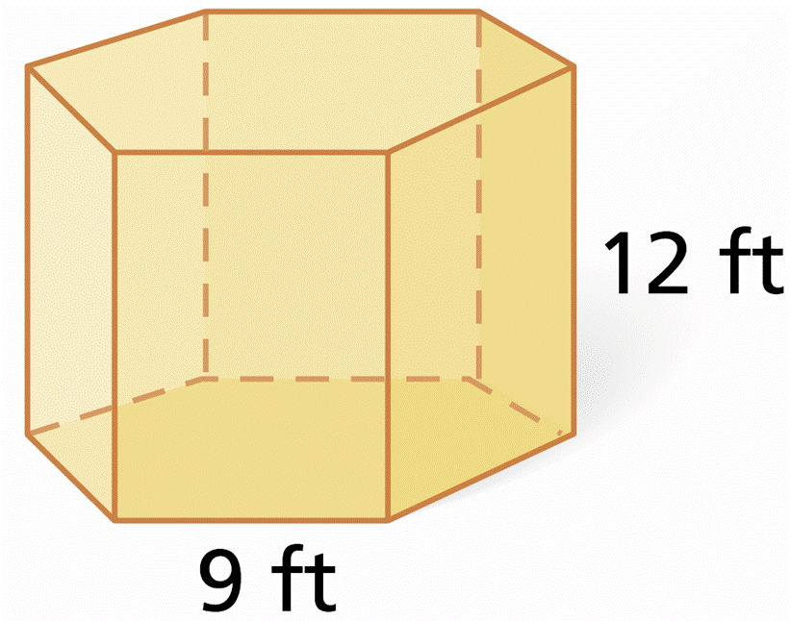
Example 1C: Finding Volumes of Prisms
Find the volume of the right regular hexagonal prism. Round to the nearest tenth, if necessary.
Step 1 Find the apothem a of the base. First draw a right triangle on one base. The measure of the angle with its vertex at the center is .

Slide 11
Example 1C Continued
Find the volume of the right regular hexagonal prism. Round to the nearest tenth, if necessary.
So the sides are in ratio .
The leg of the triangle is half the side length, or 4.5 ft.
Solve for a.
Step 2 Use the value of a to find the base area.
P = 6(9) = 54 ft

Slide 12
Example 1C Continued
Find the volume of the right regular hexagonal prism. Round to the nearest tenth, if necessary.
Step 3 Use the base area to find the volume.

Slide 13
Check It Out! Example 1
Find the volume of a triangular prism with a height of 9 yd whose base is a right triangle with legs 7 yd and 5 yd long.
Volume of a triangular prism

Slide 14
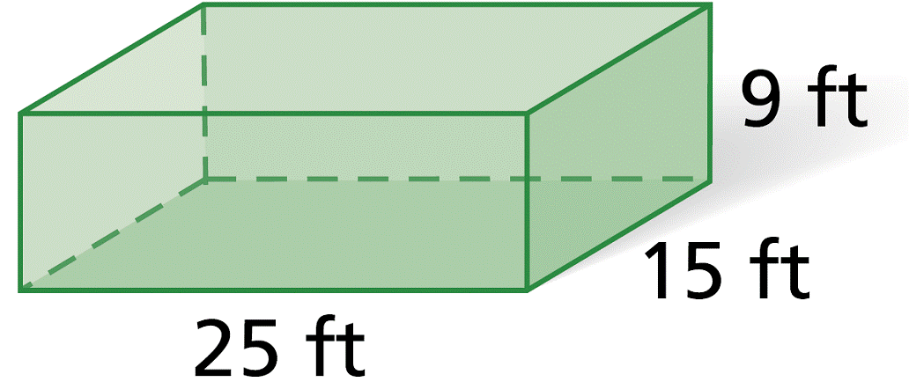
Example 2: Recreation Application
A swimming pool is a rectangular prism. Estimate the volume of water in the pool in gallons when it is completely full (Hint: 1 gallon ≈ 0.134 ft³). The density of water is about 8.33 pounds per gallon. Estimate the weight of the water in pounds.

Slide 15
Example 2 Continued
Step 1 Find the volume of the swimming pool in cubic feet.
V = Bh = (25)(15)(19) = 3375 ft³
Step 2 Use the conversion factor to estimate the volume in gallons.

Slide 16
Example 2 Continued
Step 3 Use the conversion factor to estimate the weight of the water.
≈ 209,804 pounds
The swimming pool holds about 25,187 gallons. The water in the swimming pool weighs about 209,804 pounds.

Slide 17
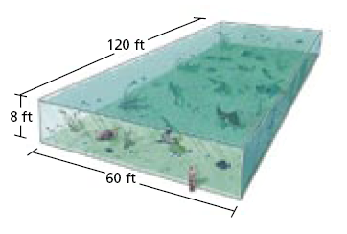
Check It Out! Example 2
What if…? Estimate the volume in gallons and the weight of the water in the aquarium if the height were doubled.
Step 1 Find the volume of the aquarium in cubic feet.
V = Bh = (120)(60)(16) = 115,200 ft³

Slide 18
Check It Out! Example 2 Continued
What if…? Estimate the volume in gallons and the weight of the water in the aquarium if the height were doubled.
Step 2 Use the conversion factor to estimate the volume in gallons.

Slide 19
Check It Out! Example 2 Continued
What if…? Estimate the volume in gallons and the weight of the water in the aquarium if the height were doubled.
Step 3 Use the conversion factor to estimate the weight of the water.

Slide 20
Check It Out! Example 2 Continued
What if…? Estimate the volume in gallons and the weight of the water in the aquarium if the height were doubled.
The swimming pool holds about 859,701 gallons. The water in the swimming pool weighs about 7,161,313 pounds.

Slide 21
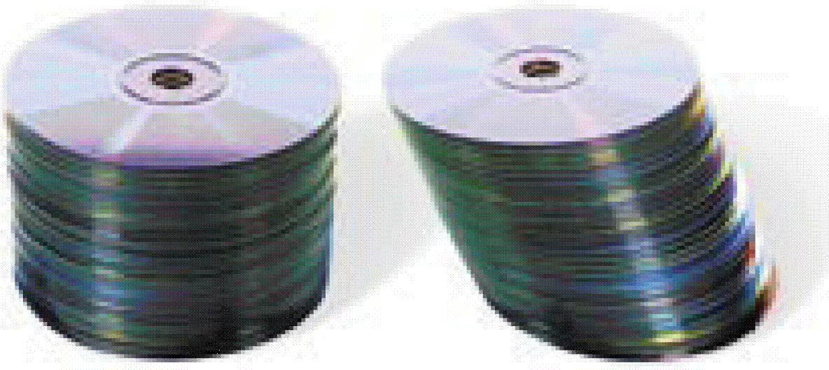
Cavalieri’s principle
also relates to cylinders.
The two stacks have
the same number of
CDs, so they have
the same volume.

Slide 22
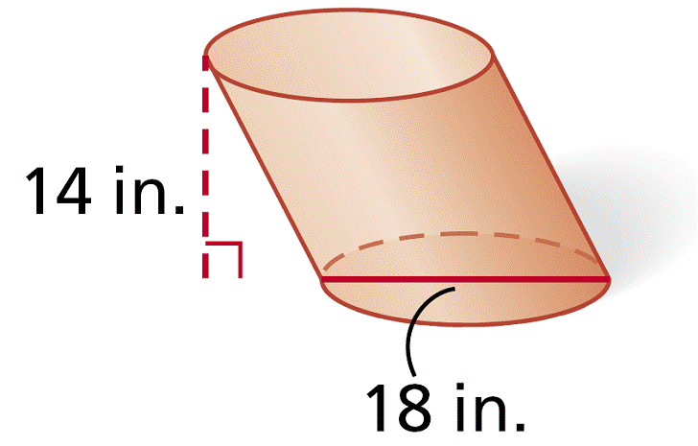
Example 3A: Finding Volumes of Cylinders
Find the volume of the cylinder. Give your answers in terms of π and rounded to the nearest tenth.
V = πr²h
Volume of a cylinder
= π(9)²(14)
= 1134π in³ ≈ 3562.6 in³

Slide 23
Example 3B: Finding Volumes of Cylinders
Find the volume of a cylinder with base area 121π cm² and a height equal to twice the radius. Give your answer in terms of π and rounded to the nearest tenth.
Step 1 Use the base area to find the radius.
πr² = 121π
Substitute 121π for the base area.
r = 11
Solve for r.
Step 2 Use the radius to find the height. The height is equal to twice the radius.
h = 2(r)
= 2(11) = 22 cm

Slide 24
Example 3B Continued
Find the volume of a cylinder with base area π and a height equal to twice the radius. Give your answers in terms of π and rounded to the nearest tenth.
Step 3 Use the radius and height to find the volume.
V = πr²h
Volume of a cylinder
= π(11)²(22)
= 2662π cm³ ≈ 8362.9 cm³

Slide 25
Check It Out! Example 3
Find the volume of a cylinder with a diameter of 16 in. and a height of 17 in. Give your answer both in terms of π and rounded to the nearest tenth.
V = πr²h
Volume of a cylinder
= π(8)²(17)
Substitute 8 for r and 17 for h.
= 1088π in³ ≈ 3418.1 in³

Slide 26
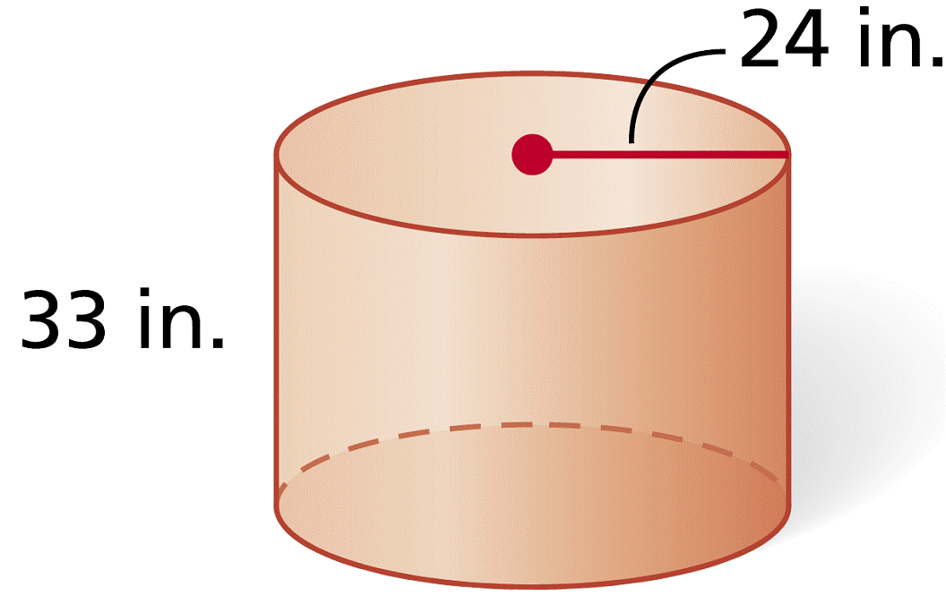
Example 4: Exploring Effects of Changing Dimensions
The radius and height of the cylinder are multiplied by . Describe the effect on the volume.
radius and height multiplied by :
original dimensions:

Slide 27
Example 4 Continued
The radius and height of the cylinder are multiplied by . Describe the effect on the volume.
Notice that . If the radius and height are multiplied by , the volume is multiplied by , or .

Slide 28
Check It Out! Example 4
The length, width, and height of the prism are doubled. Describe the effect on the volume.
original dimensions:
dimensions multiplied by 2:
V = Bh
V = Bh
= (1.5)(4)(3)
= (3)(8)(6)
= 18
= 144
Doubling the dimensions increases the volume by 8 times.

Slide 29
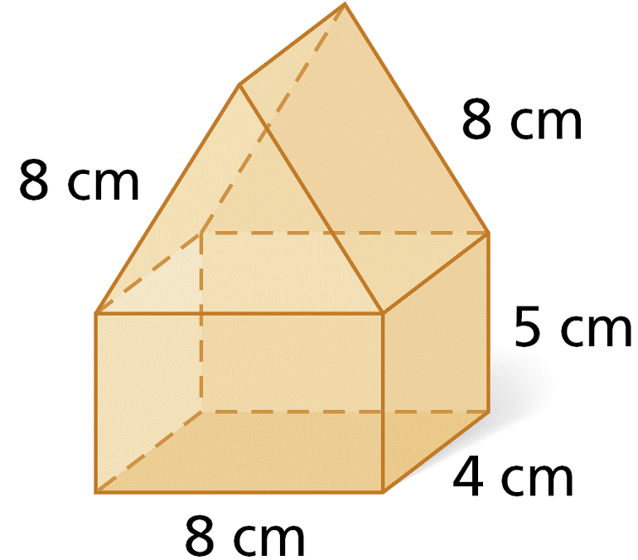
Example 5: Finding Volumes of Composite Three-Dimensional Figures
Find the volume of the composite figure. Round to the nearest tenth.
The volume of the rectangular prism is:
V = Bh = (8)(4)(5) = 160 cm³
The base area of the regular triangular prism is:
The volume of the regular triangular prism is:
The total volume of the figure is the sum of the volumes.

Slide 30
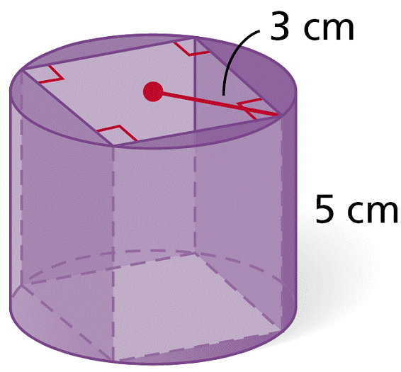
Check It Out! Example 5
Find the volume of the composite figure. Round to the nearest tenth.
Find the side length s of the base:
The volume of the square prism is:
The volume of the cylinder is:
The volume of the composite is the cylinder minus the rectangular prism.
V_{cylinder} — V_{square prism} = 45π — 90 ≈ 51.4 cm³

Slide 31
Lesson Quiz: Part I
Find the volume of each figure. Round to the nearest tenth, if necessary.
1. a right rectangular prism with length 14 cm, width 11 cm, and height 18 cm
2. a cube with edge length 22 ft
3. a regular hexagonal prism with edge length 10 ft and height 10 ft
4. a cylinder with diameter 16 in. and height 7 in.
V = 2772 cm³
V = 10,648 ft³
V ≈ 2598.1 ft³
V ≈ 1407.4 in³

Slide 32
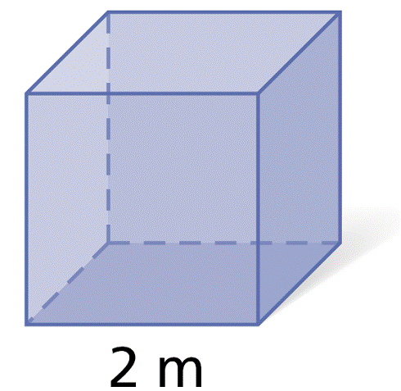
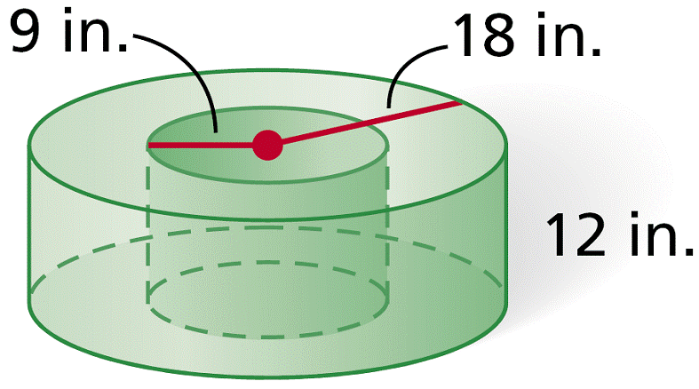
Lesson Quiz: Part II
5. a cylinder with base area 196π cm² and a height equal to the diameter
6. The edge length of the cube is tripled.
Describe the effect on the volume.
7. Find the volume of the composite
figure. Round to the nearest tenth.
V ≈ 17,241.1 cm³
The volume is multiplied by 27.
9160.9 in³

